Slide 1
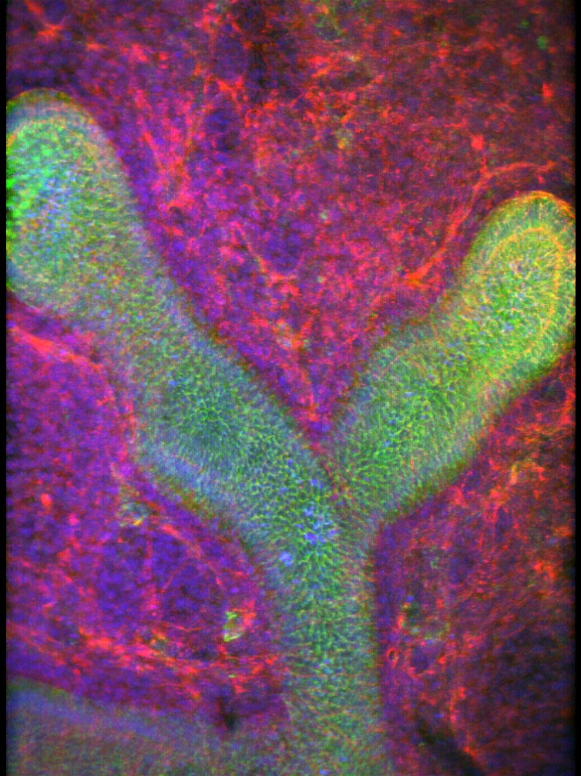
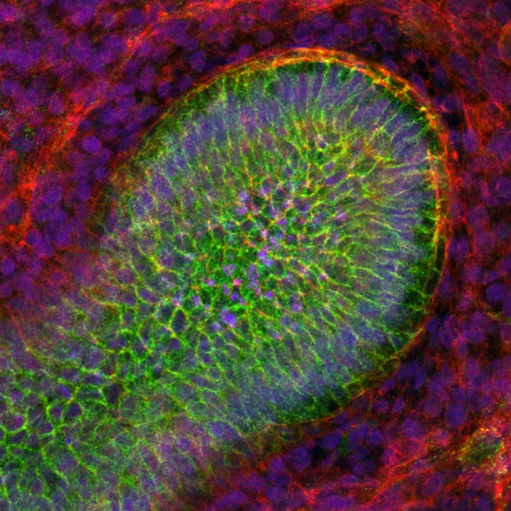
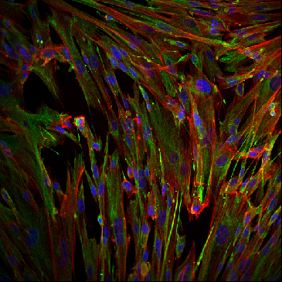
Fig. S1
Epithelial cells
A
B
E-Cadherin
Mesenchymal cells
C
Vimentin

