Slide 1
Supplemental Figure 1
p < 3 x 10⁻⁷
p < 0.001
p < 0.005

Slide 2
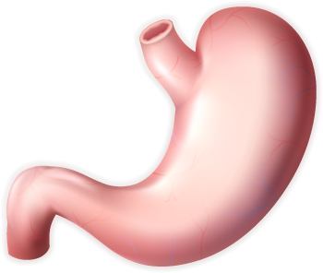
Supplemental Figure 2
A
B
Fundus
(n=49)
Fundus
(n=49)
Spindle
> 40 years old
Epithelioid
≤ 40 years old
Cardia
(n=20)
Cardia
(n=22)
Mixed
Lesser
Curvature
(n=64)
Lesser
Curvature
(n=65)
Greater Curvature
(n=57)
Greater Curvature
(n=57)
Antrum
(n=40)
Antrum
(n=40)

