Slide 1
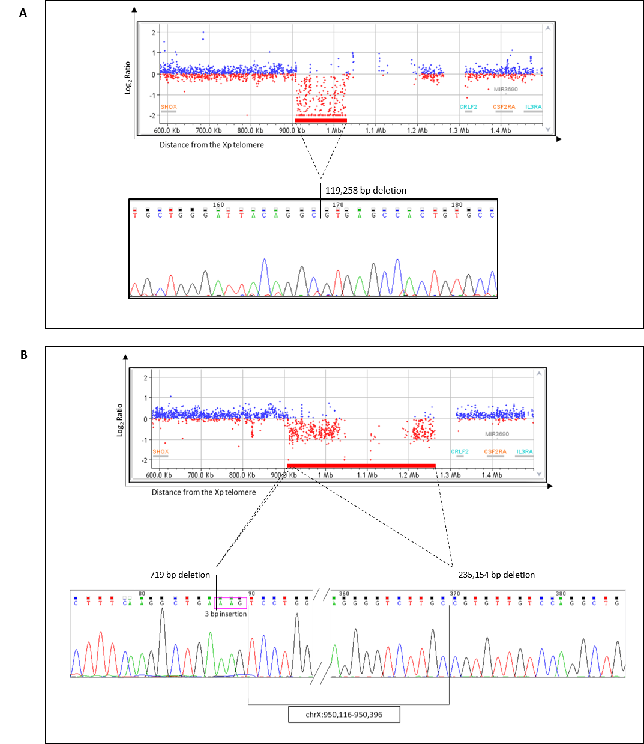
Supplementary Figure 1
(chrX:909,966-1,029,224)
(chrX:949,397-950,116 )
(chrX:950,396-1,185,550 )

Slide 2
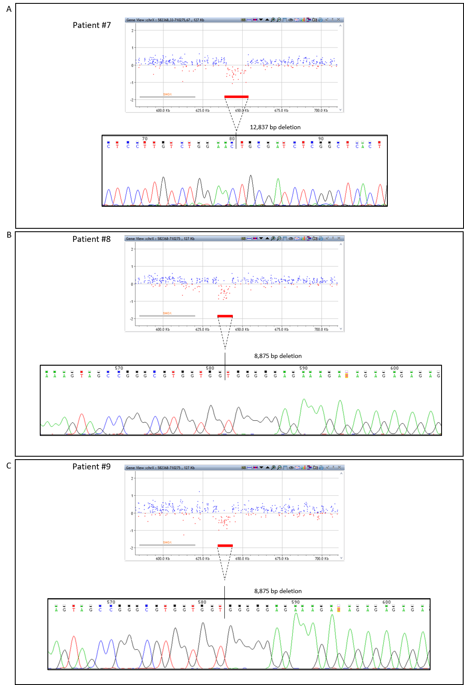
Supplementary Figure 2
(chrX:639,875-652,712 )
(chrX:634,213-643,088 )
(chrX:634,213-643,088 )

