Slide 1



Social Determinants of Health
Screening Project
Pre-Clinical Student
Volunteer Training

Slide 2
Context & Basic Plan
Impact of COVID-19 on the Bronx
What volunteers do:
  Call patients to screen for social determinants of health (SDOH) needs.
  Document prevalence and types of needs in our community.
  Build student service-based teams to respond to future community needs.
Future directions:
  Screen patients with food insecurity to determine eligibility for the student-run Grocery Delivery Program.
  Deliver groceries to eligible patients.

Slide 3
Red Flags and What to Do
If there is a clear medical emergency (crushing chest pain, eg.), instruct the patient to call 911 immediately. Some red flag examples:
  Are you worried that the place you are living now is making you sick eg. mold, bugs/rodents, water leaks, not enough heat? Positive response or concern about asthma attacks.
  In the last 12 months, did you worry that your food could run out before you got money to buy more? Any positive answer and patients with diabetes on insulin.
  Are you finding it so hard to get along with a partner, spouse, or family members that it is causing you stress? AND/OR Does anyone in your life hurt you, threaten you, frighten you or make you feel unsafe? Any indication of violence or of suicidal ideation.
Note- Phone numbers for attendings and chronic care nurses will be in Box “Emergency Contact” doc

Slide 4
Before you start making calls:
Open patient list in Box (Find where last volunteer left off)
Open Social Determinants of Health Volunteer Google doc
Open EPIC (Check for any follow-up messages)
Open Doximity

Slide 5
Overview of Screening Procedures
Open and review patient chart in EPIC
  Note- wait 2 weeks to call, if patient had contact with clinic in the past 4 weeks.
Place call Doximity
  - Use Interpreter line, if patient is designated as needing interpreter or if you are not fluent in the preferred language.
  - Leave message if no reply
Document call in EPIC
  - Use .sdohoutreachcalls dot phrase
  - Complete Social Determinants of Health under Screenings (Adult)
  - Route call to appropriate staff
  - Sign encounter
Enter notes from call into Box spreadsheet

Slide 6
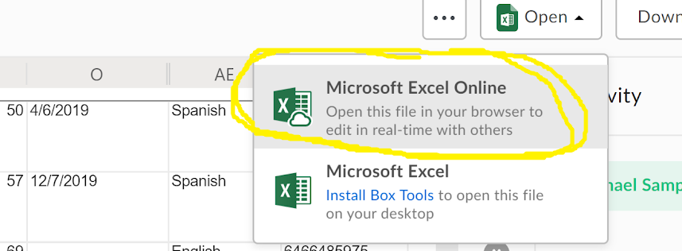
Part 1: Open patient list in Box
Go to https://account.box.com/login and enter your einsteinmed.org email to sign in (clear cookies/browsing history to log in).
Open FHC SDOH Screening Program
  Open the SHDmedstudent patient spreadsheet; in the upper right
  Select the drop-down for Open
  Choose Microsoft Excel Online to allow multiple volunteers to edit at the same time.
Locate the next patients to be called
  Note -Rows in white have not been screened; rows in gray are complete.

Slide 7
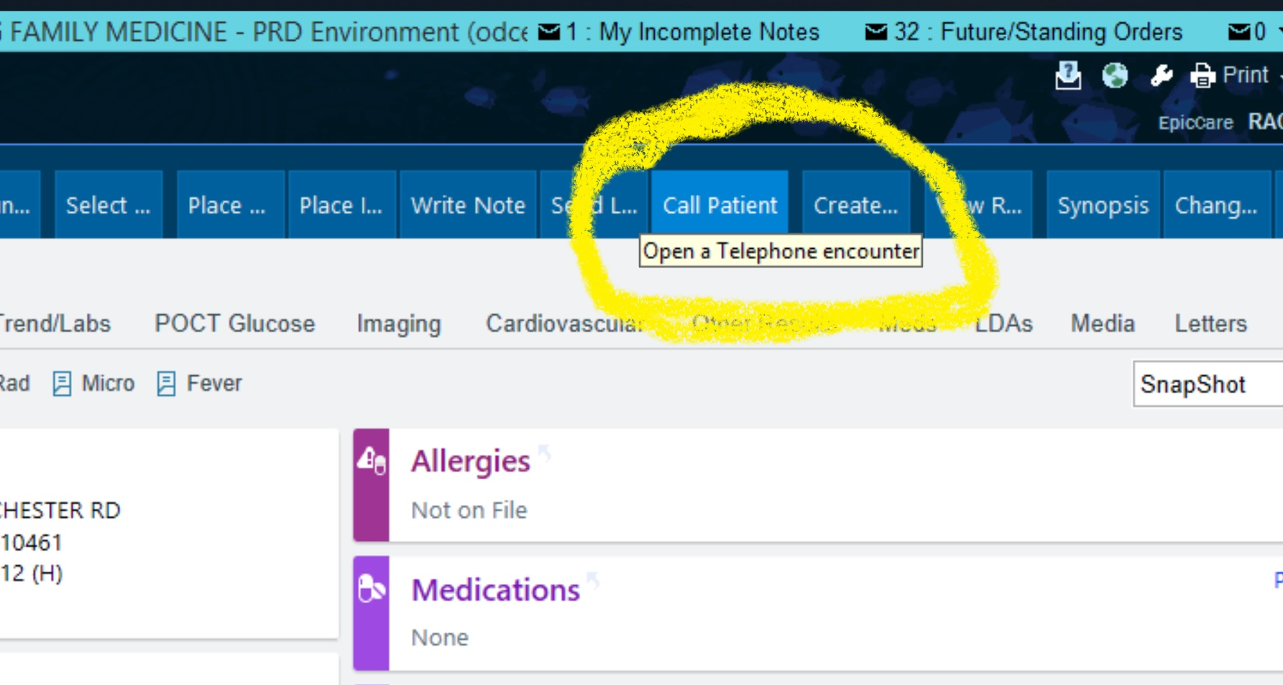
Part 2: Place a Call
Locate patient in EPIC: https://secureaccess.montefiore.org/logon/LogonPoint/index.html and log in with; open EPIC production (Dept: FAMILY HEALTH CENTER MG FAMILY MEDICINE [10371005]) using Patient Lookup in the upper left to open their chart
Review chart briefly for overview of health and social needs history.
Choose call patient in taskbar and select outgoing call.
Use Doximity to dial patient number.
Use call script to introduce yourself and purpose of call.

Slide 8
How to Use Doximity
Download Doximity app to your phone
Register for account and enter your einsteinmed.edu email address and follow prompts to verify identity as a medical student
  Once registered, under dialer select link my phone - call automated set up line or link phone manually
  When “choose the phone number appears enter 718-933-2400
  Edit Caller ID and replace Office with Montefiore Family Health and save.
  Verify your account: choose Upload license/ID - upload a photo of your medical school ID and choose submit license.
  Doximity verification team will review your info (within a few hours)
Once verified, choose dialer and enter patient phone number or Interpreter line number (800-264-1552, access code 830341#) as needed.

Slide 9
How to Use Interpreters
  Dial 800-264-1552 and enter code 830341#; follow instructions to select language.
  Interpreter will ask for the patient’s name and for phone and medical record numbers.
  Listen to interpreter’s introduction; introduce yourself and state that you are a medical student calling from the Department of Family Medicine.
  If patient is reached, ask the interpreter to introduce you.
  Working with interpreters --Speak directly to the patient using “you,” articulate clearly and in short sentences; ask 1 question at a time; thank the interpreter and patient at the end.
  In case of voicemail, provide script for interpreter– the script content will be discussed later.

Slide 10
Introduction Script
Good morning/afternoon/evening Ms/Mr ____ (patient’s name). My name is ________ and I’m a Medical Student from the Family Health Center at Montefiore calling on behalf of your Doctor, Dr_________. How are you doing today?
We are calling all of our patients to check in on how you are doing with basic needs like food and housing during the COVID-19 pandemic, as we know that many people are facing hardships at this time. At the FHC, we recognize that basic needs can influence your health, so we are screening our patients for any needs they may have and connecting them with resources that may help. May I have a few minutes of your time to ask you some questions about this and see if there is any way that we can be of assistance?

Slide 11
If you get a voicemail...
Example script:
Good morning/afternoon/evening; this message is for (PATIENT NAME). My name is ____; I am a medical student calling from your primary care doctor’s office, Dr. ___. We are calling all of our patients to ask how you are doing with basic needs like food and housing during the COVID-19 pandemic, as we recognize that many people are facing hardships. We are able to connect patients with community resources through the clinic. If you would like to call me back, please contact the clinic at 718-933-2400 and ask the receptionist to connect you to the medical students conducting screenings. Thank you and have a good day.

Slide 12
Part 3 continued-- Documenting the Call
SDOH Screening Form:
  If pt does not wish to answer the questions, click declined”
  If pt agrees to screening, proceed with questions. Use comments for additional information (e.g., if patient states they have lost employment due to COVID, that landlord has threatened eviction, etc. - anything that may be relevant to staff connecting them to services)
Enter screening data into note
  Return to Documentation tab under Call Patient
  Within the dot phrase you’ve started, under “Social Determinants of Health” heading, enter .sdoh to have data from screening auto-transferred into your note. (You can also copy & paste)
Follow-Up
  Based on patient’s responses to screening, identify appropriate referrals. (See .sdohoutreachcalls dot phrase instructions under Follow Up)
  Inform patient who you will refer them to and why, and state in your note which referrals you are making.

Slide 13
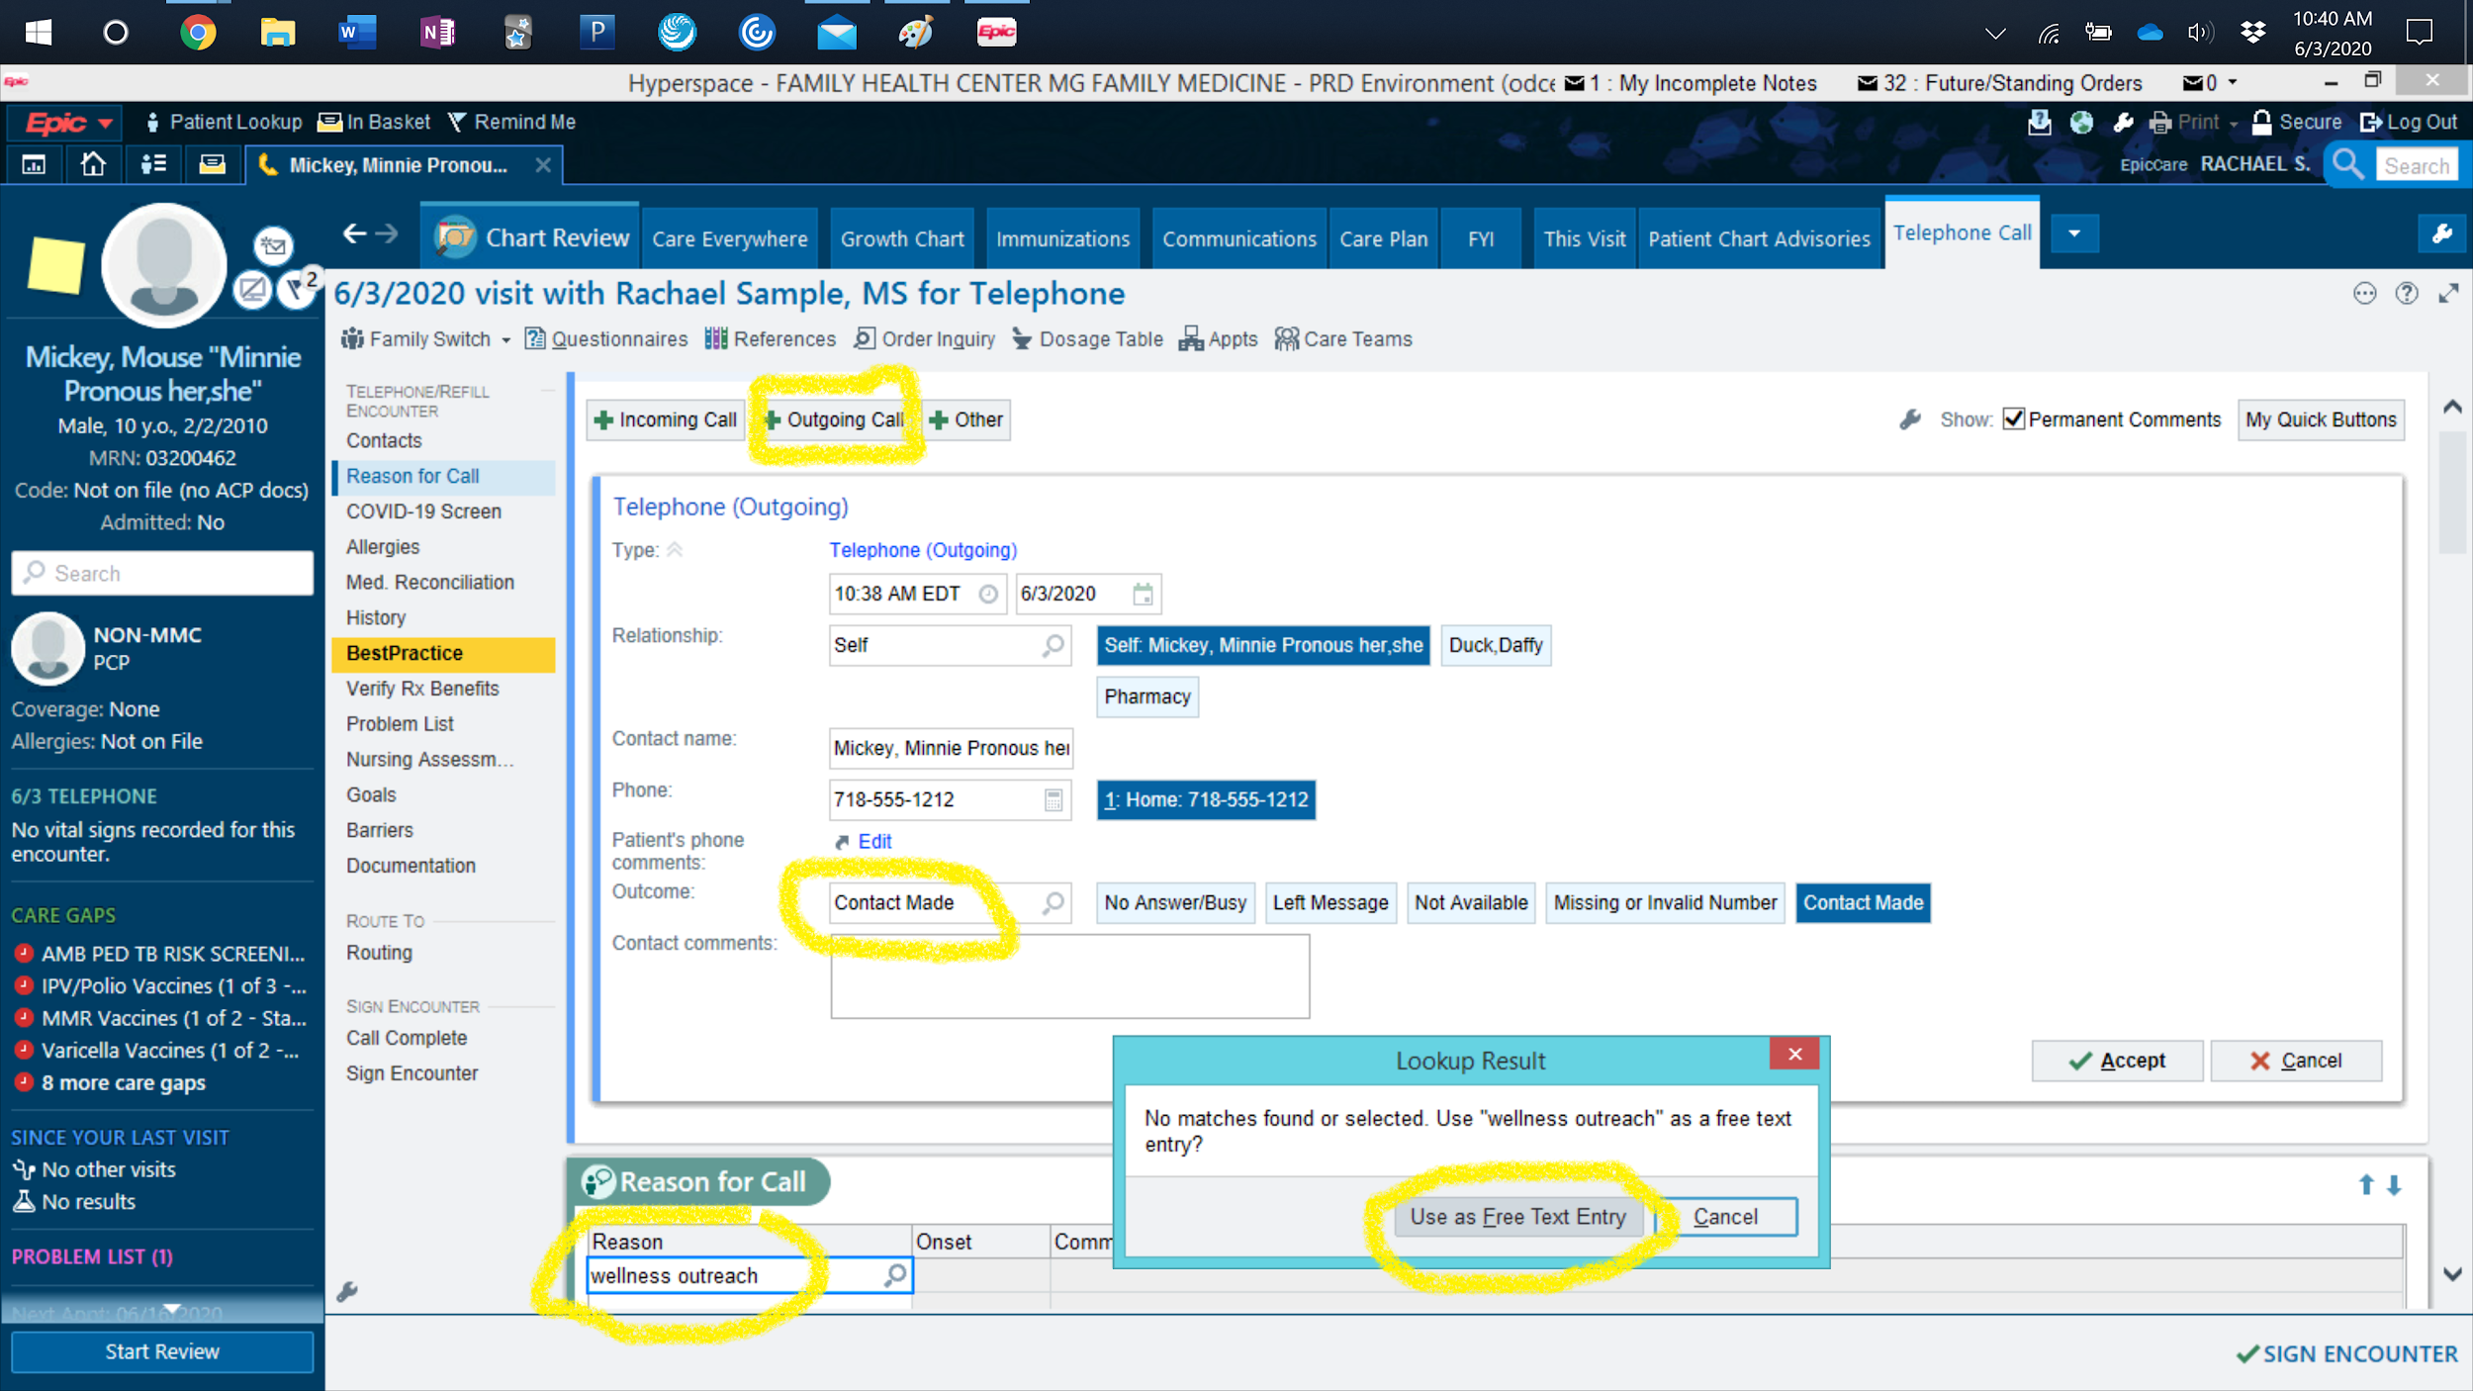

Slide 14
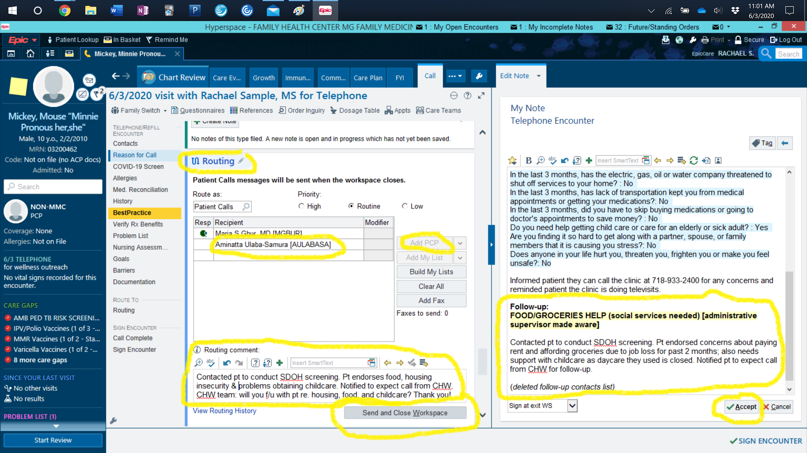

Slide 15
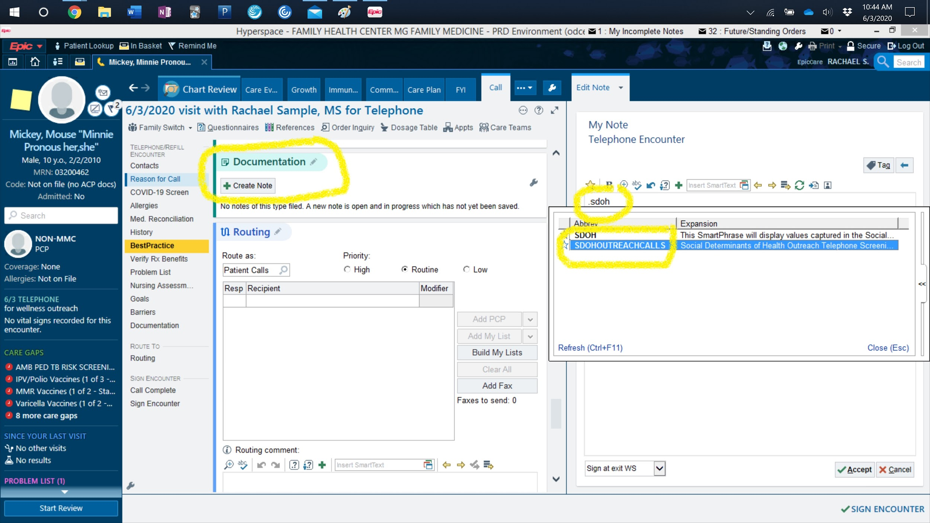

Slide 16
Part 4: Routing Patient to Services
After your Documentation note is complete, choose “Accept”
Use the Routing tab to connect patients to referrals and route message to the primary care provider:
Mark the note as “routine” or “high” priority and add community health worker or social worker if the screening identified needs.
Mark the note priority as “low” and write short message describing call and stating no follow up is needed:
- if no needs were identified.
- if there was no answer and you left voicemail.

Slide 17
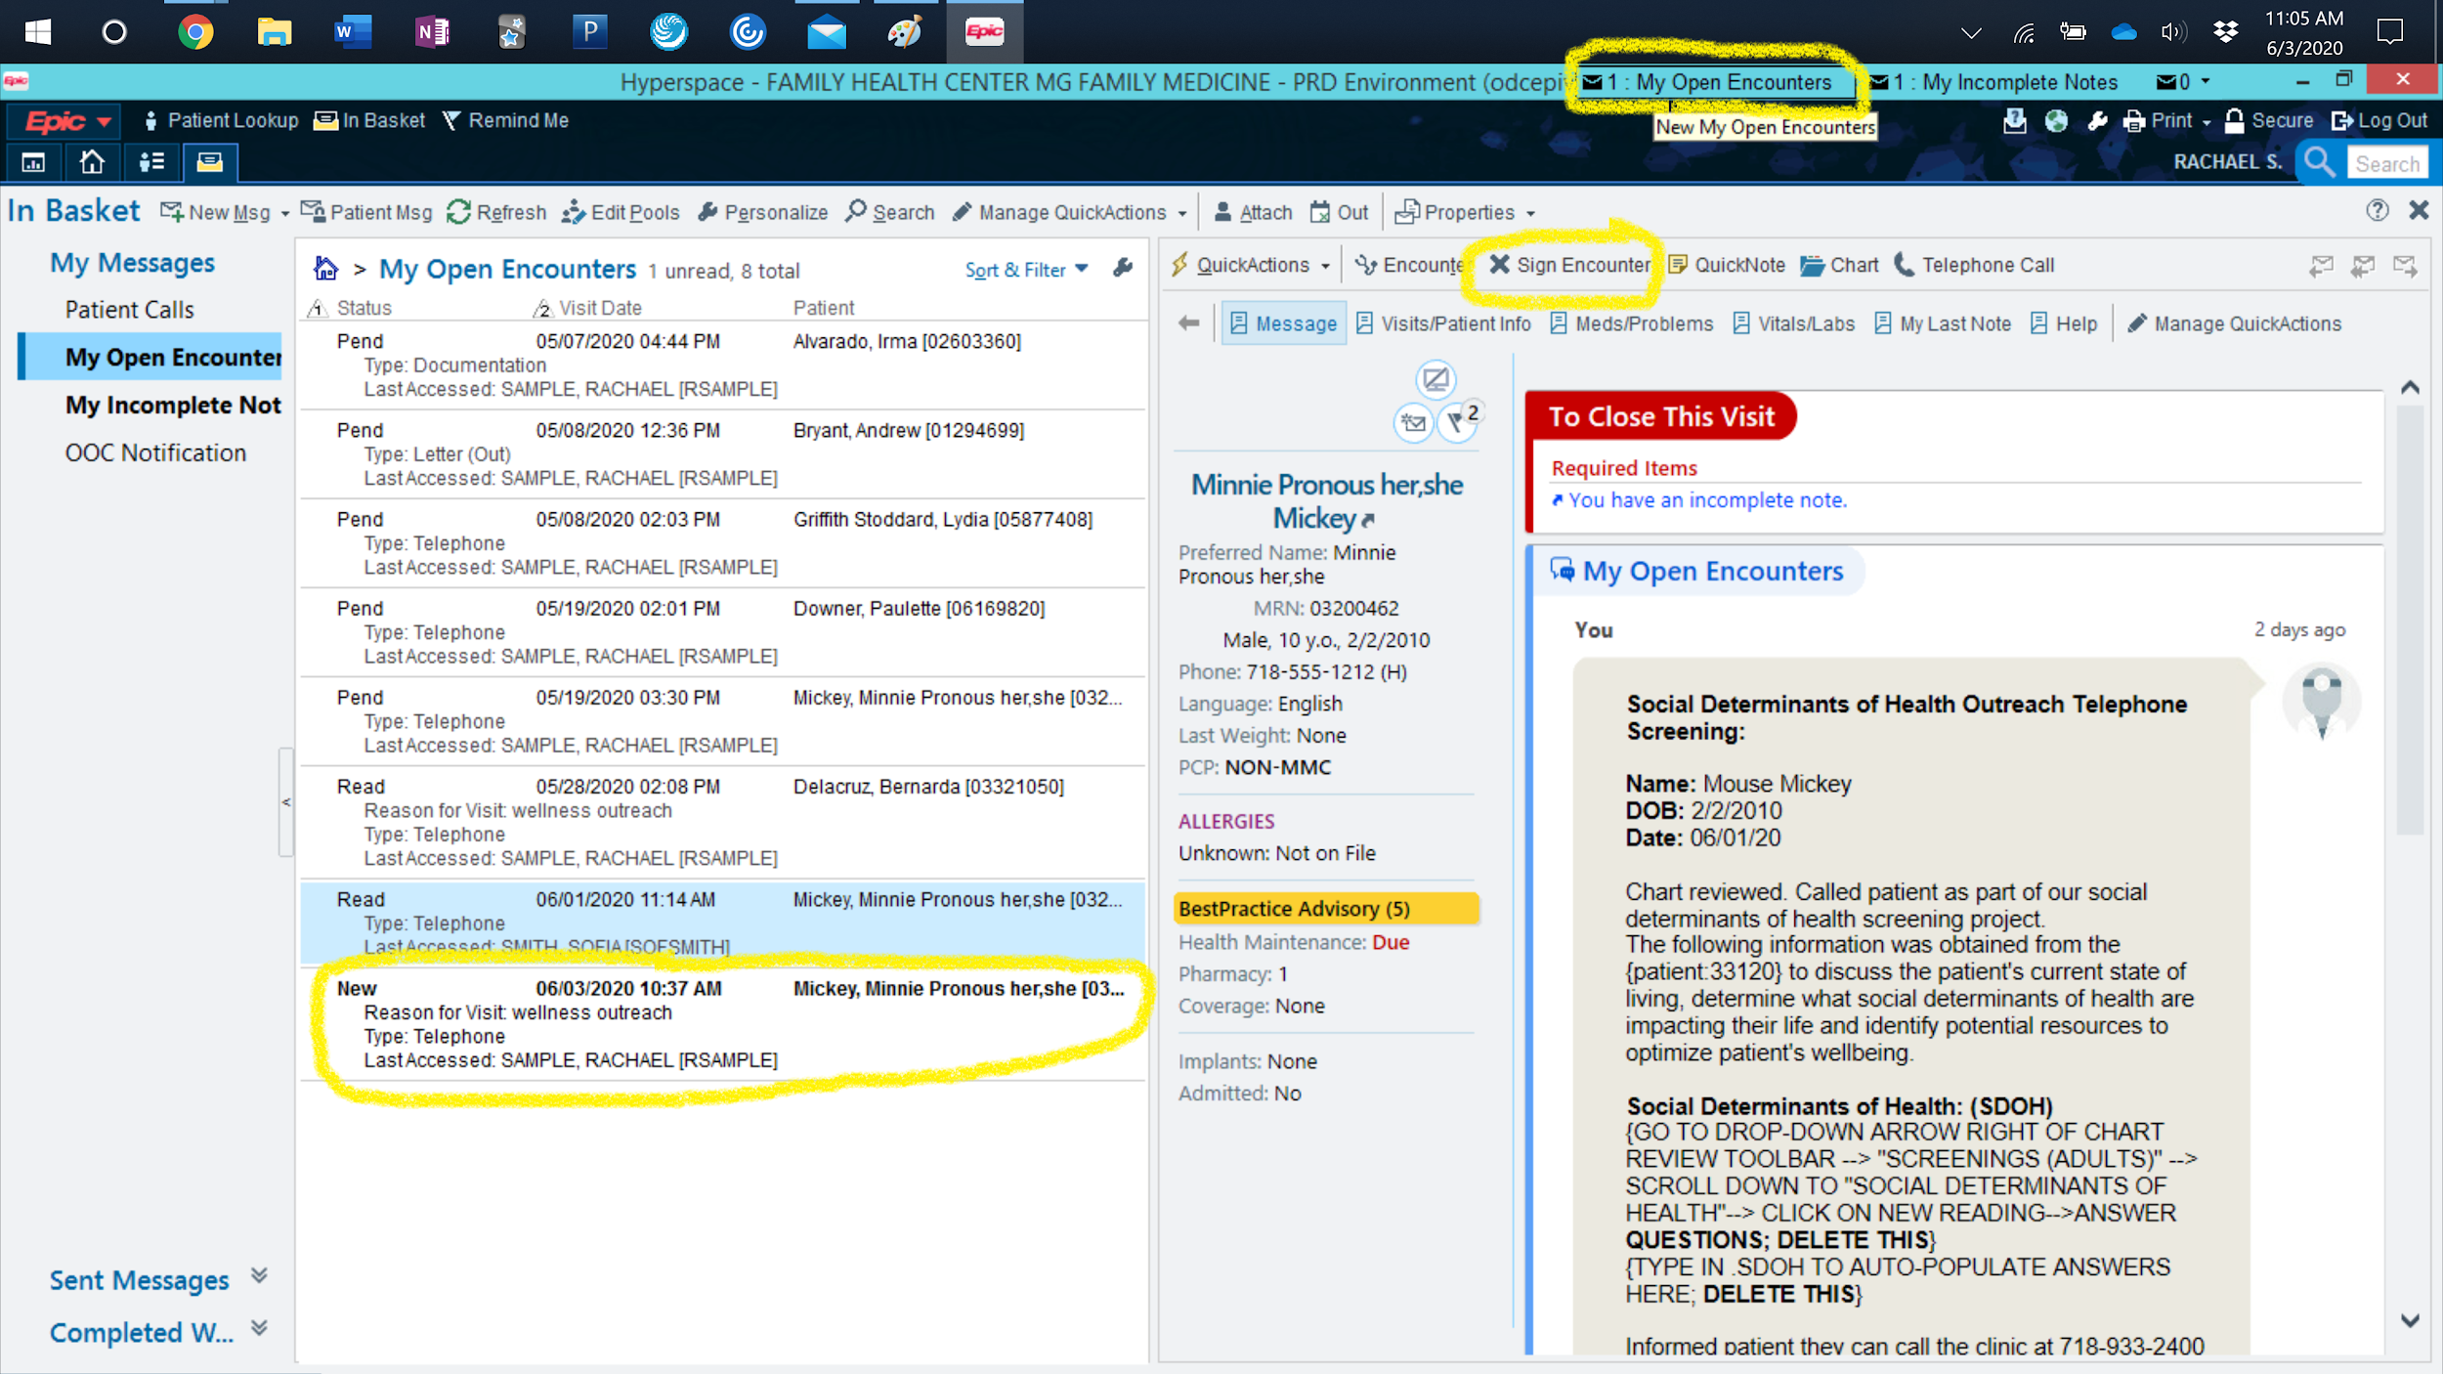

Slide 18
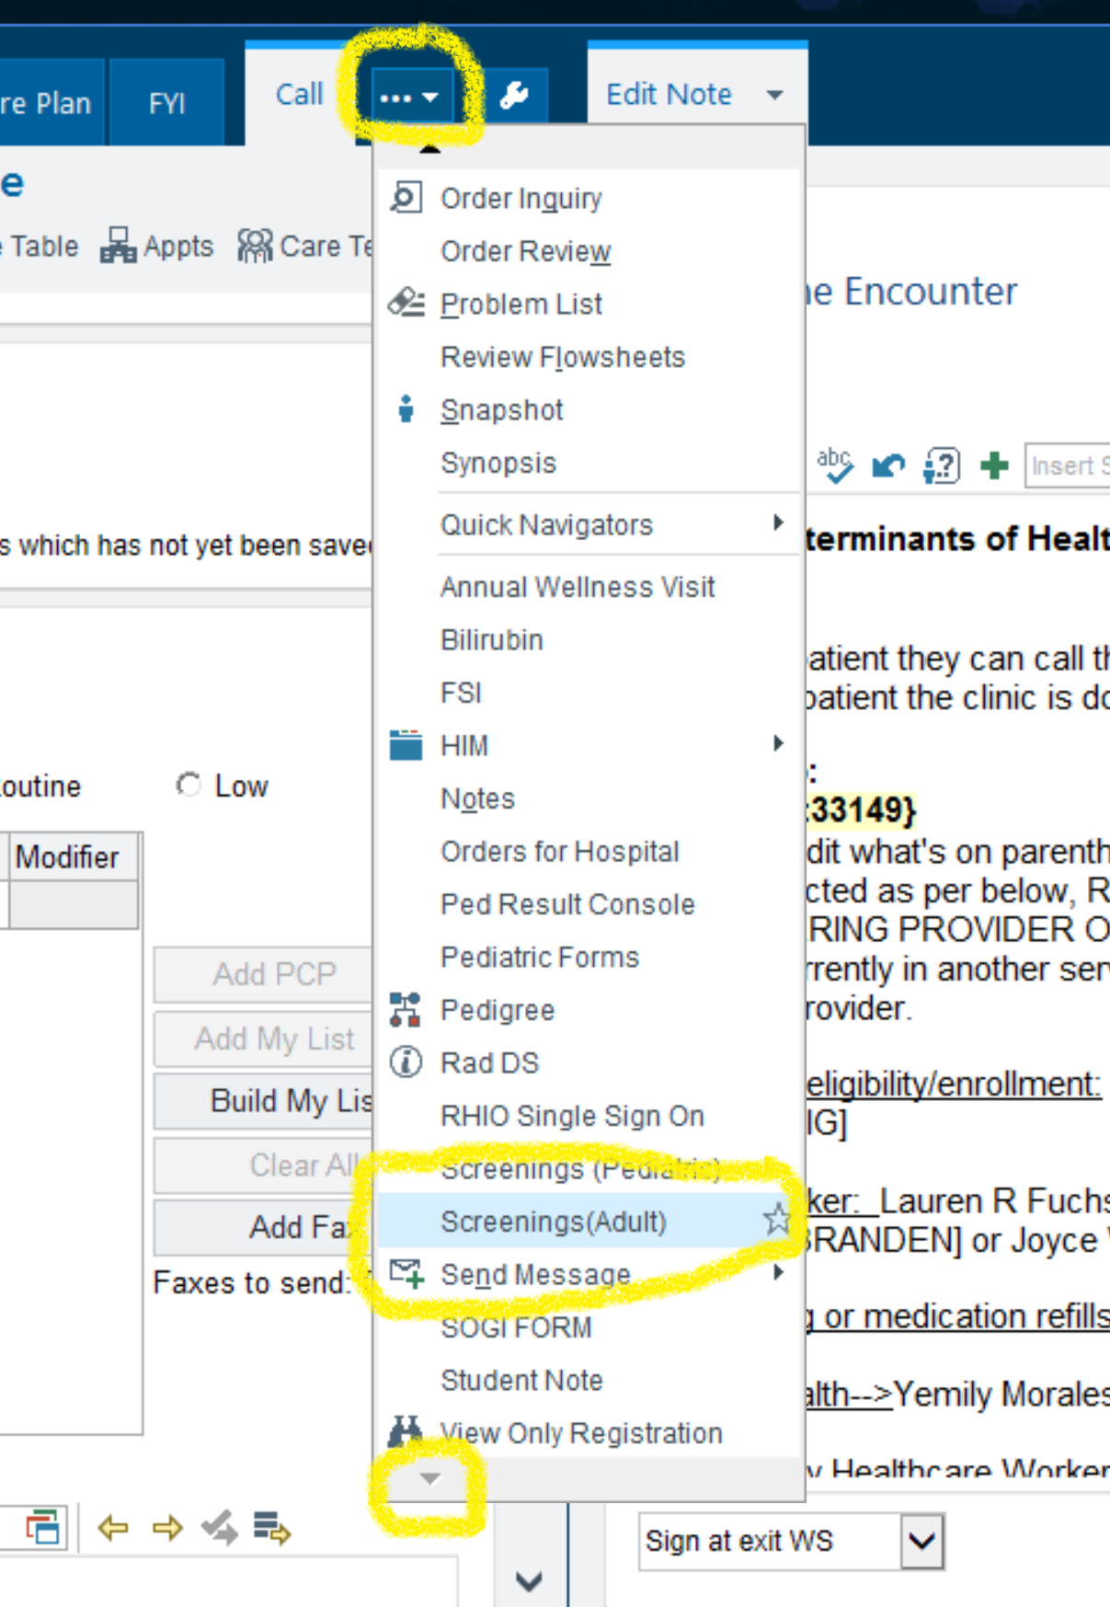
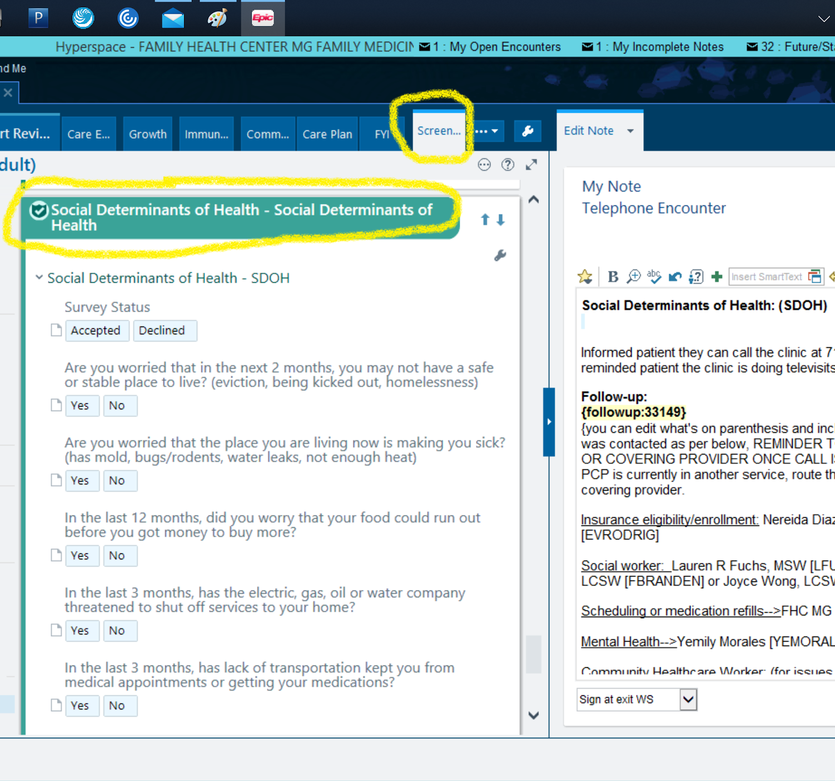

Slide 19
Part 4: Specifics for Routing Patient to Services
Chart note needs to describe the call and detail what you would like the community healthh worker or social worker to follow up on, for example:
  Contacted patient to conduct SDOH screening. Patient endorsed housing and food insecurity due to job loss 2 months ago as well as legal support needs. Notified pt to expect call back from CHW. CHW team: Will you please f/u with patient regarding needs related to housing, food, and legal support? Thank you!
Choose Send and close workspace - this sends your message and closes your note.
To complete call, go to My Open Encounters at the very top of the window and re-enter note; choose Sign Encounter.
In Box spreadsheet, fill in patient’s row with infomation from the call.
If screening has been completed, click to turn the row gray.

Slide 20
