Slide 1
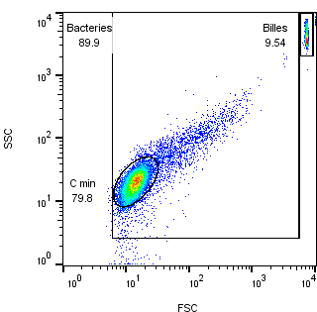
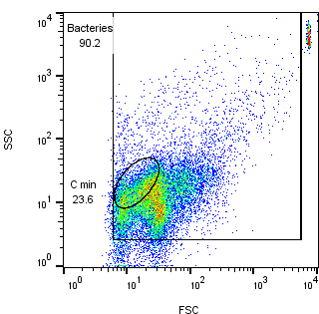
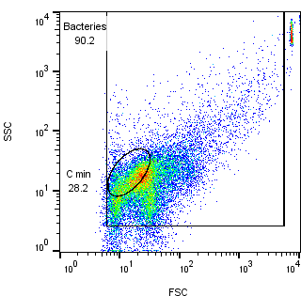
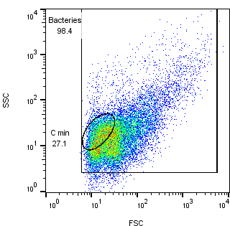
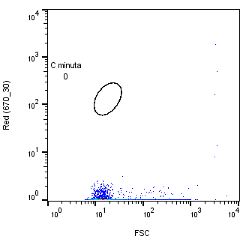
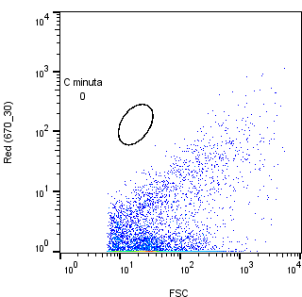
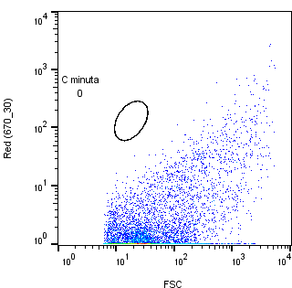
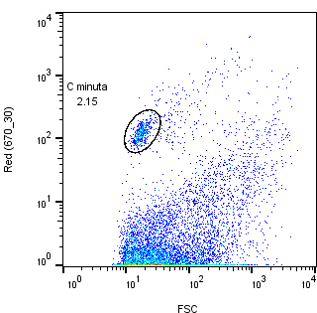
Unstained
C. minuta DSM 22607
for SSC/FSC reference
Unspiked healthy volunteer #2 hybridized with C.minuta-specific polyclonal Ab
Unspiked healthy volunteer #4 hybridized with C.minuta-specific polyclonal Ab
Pooled HV2 + HV4 spiked with
2% C. minuta DSM 22607 and hybridized with C.minuta-specific polyclonal Ab
SSC
FSC
Red 670/30 nm
FSC

