Slide 1



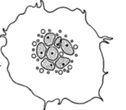
Term placenta
Isolation of Primary Human Trophoblast cells
Culture
0 hr
18 hr
42 hr
66 hr
90 hr
Transfection
Scramble siRNA
Raptor siRNA
(Inhibition of mTORC1)
Rictor siRNA
(Inhibition of mTORC2)
Raptor + DEPTOR siRNA
(Inhibition of mTORC1 and activation of mTORC2)
Cdc42 or Rac1 siRNA
Measurement of system A and L activity.
Isolation of microvillus and basal plasma membrane.
Protein expression of System A (SNAT2) and System L (LAT1) transporter isoform by Western Blot.
Assay of F-actin and G-actin.
Immunoprecipitation of F-actin with SNAT2/LAT1.
Proximity ligation assay to study interaction of F-actin with SNAT2.
Supplementary Figure 1

