Slide 1
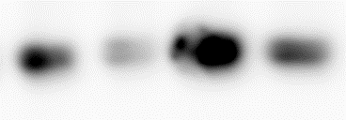

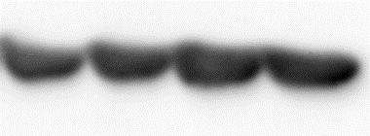

a)
b)
c)
d)
Cdc42 siRNA
LAT1
Rac1 siRNA
LAT1
Cdc42 siRNA
Rac1 siRNA
Scramble siRNA
Scramble siRNA
Scramble siRNA
Scramble siRNA
Relative density
Relative density
37 kDa
LAT1
37 kDa
LAT1
30 kDa
VDAC1
30 kDa
VDAC1
Supplemental Figure 5

