Slide 1
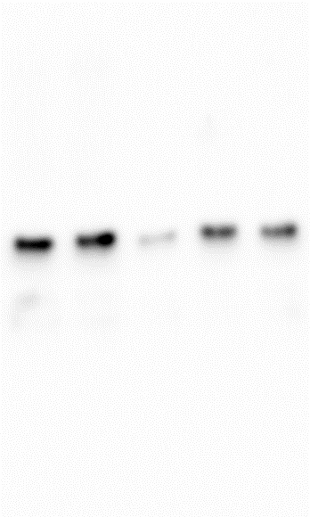
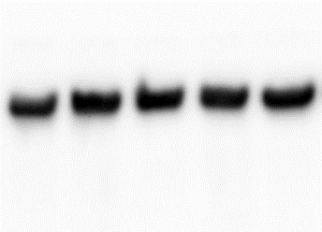
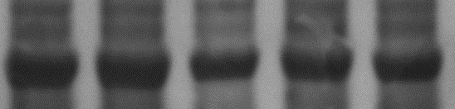
IUGR
IUGR
a)
AGA
IUGR
AGA
F-actin-SNAT2 interaction
b)
52 kDa
SNAT2
Relative density
42 kDa
F-actin
(Input)
Ponceau
(Total protein)
Supplemental Figure 9

