Slide 1
Supplementary Table 1
Oligo DNAs used in this study. The number 1-4 for amplification of mutated regions, the number 5-12 for RT-PCR, and the number 13-24 for qRT-PCR were used.
No. | Sequence of Oligo DNAs | Sense/ Antisense | Target gene
1 | 5’-AGAAAGTAACCAGTAGAACTGTTTCTCATA-3’ | Sense | GMD
2 | 5’-TACTGAATATCACTCTAATAATCAAACCAA-3’ | Antisense
3 | 5’-AACTTCACCCAAGCCATGTGACAATTGAAG-3’ | Sense | GFT
4 | 5’-GGCAGAGGTTATTGAAACTTATCATGCCAA-3’ | Antisense
5 | 5’-ATGGAATTGTACGGCGATCC-3’ | Sense | GMD
6 | 5’-CTTCAATATGAGCCTGTGGATTCTT-3’ | Antisense
7 | 5’-TGAGGAGGCAGATGAGGACA-3’ | Sense | GFT
8 | 5’-GACCCAGTAGAGAGAGACGACCA-3’ | Antisense
9 | 5’-ACCGTGAAAAGATGACCCAGA-3’ | Sense | ACTB
10 | 5’-AGGCATACAGGGACAGCACA-3’ | Antisense
11 | 5’-CAGATGGAGCAGGTGAGTGG-3’ | Sense | FUT8
12 | 5’-ACCAGCTTTCTGGCTTTGCT-3’ | Antisense
13 | 5’-AAGGACGAGGTGGTGGTGAA-3’ | Sense | FUC1
14 | 5’-TTGGTAAGCTGTGCGGTGTG-3’ | Antisense
15 | 5’-GTGAAGGGAAGCCACTGACC-3’ | Sense | FUC2
16 | 5’-GCAAGAGTCCATCCCCATTT-3’ | Antisense
17 | 5’-TGGCTTCCTCTACCCCAGAA-3’ | Sense | FUT4
18 | 5’-CTCATCCCAGTGGCTCACAA-3’ | Antisense
19 | 5’-CAGATGGAGCAGGTGAGTGG-3’ | Sense | FUT8
20 | 5’-ACCAGCTTTCTGGCTTTGCT-3’ | Antisense
21 | 5’-TTGGGCAGACCTTTGACCTT-3’ | Sense | FUT9
22 | 5’-GACCGCATGGGATTTGTTGT-3’ | Antisense
23 | 5’-CACATTGGAACAACGGAGGA-3’ | Sense | FPGT
24 | 5’-CATGGGAGTCTTCAGGCACA-3’ | Antisense

Slide 2
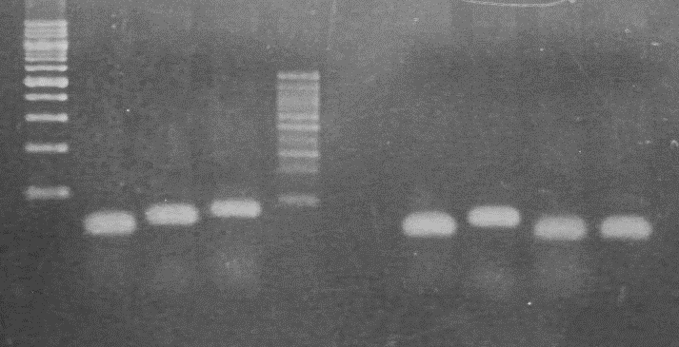
Supplementary Figure 1
ΔGMDΔGFT
Wild-type
β-Actin
GMD
β-Actin
GMD
Fut8
GFT
Fut8
GFT
bp
1,000
200
Examination of transcripts of GMD and GFT genes in IgG-producing CHO-K1 wild-type and ΔGMDΔGFT cells by RT-PCR.
Establishment of suspension-cultured Chinese hamster ovary cells with double knockout of GDP-mannose-4,6-dehydratase and GDP-fucose transporter
Cytotechnology
Ryo Misaki, Masashi Iwasaki, Hiroki Takechi, Noriko Yamano-Adachi, Takao Ohashi, Hiroyuki Kajiura, Kazuhito Fujiyama
International Center for Biotechnology, Osaka university
misaki@icb.osaka-u.ac.jp

Slide 3
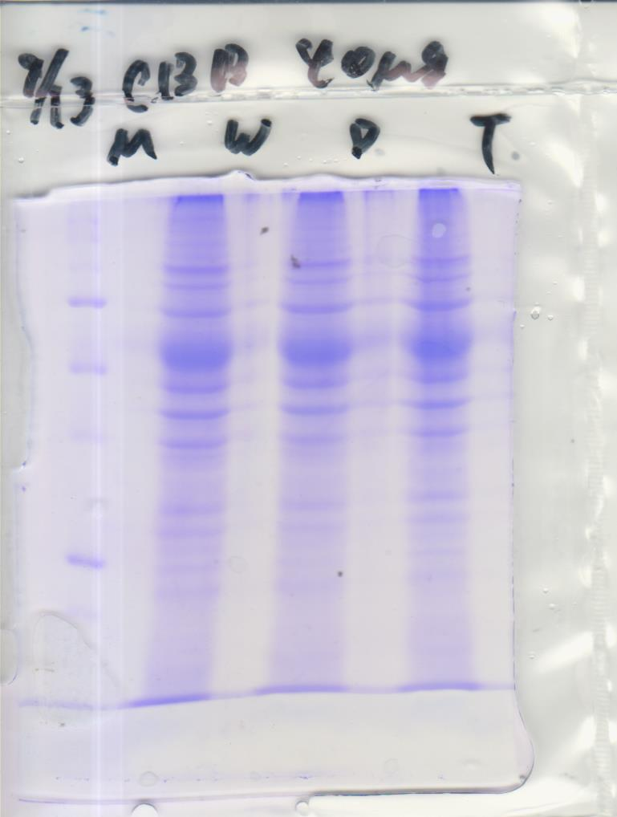
Supplementary Figure 2
A
B
Wild-type
ΔGMDΔGFT
Wild-type
ΔGMDΔGFT
ΔGMD
ΔGMD
kDa
kDa
100
100
75
75
50
50
35
35
Analysis of 40 μg total soluble proteins extracted from adherent wild-type CHO-K1 cells, ΔGMD cells, ΔGMDΔGFT cells. a Coomassie brilliant blue staining. b AAL-lectin blotting.
Establishment of suspension-cultured Chinese hamster ovary cells with double knockout of GDP-mannose-4,6-dehydratase and GDP-fucose transporter
Cytotechnology
Ryo Misaki, Masashi Iwasaki, Hiroki Takechi, Noriko Yamano-Adachi, Takao Ohashi, Hiroyuki Kajiura, Kazuhito Fujiyama
International Center for Biotechnology, Osaka university
misaki@icb.osaka-u.ac.jp

