Slide 1
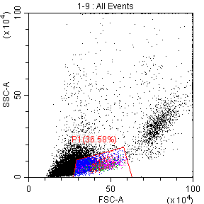
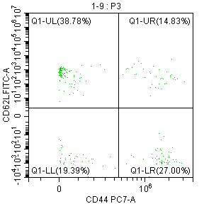
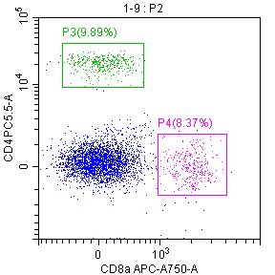
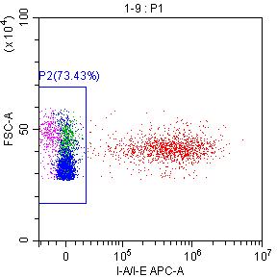
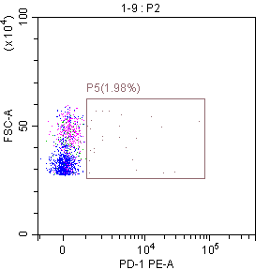
SUPPLEMENTARY FIGURE 1
CD62L
CD4
CD44
CD8a
I-A/I-E
PD-1

Slide 2
SUPPLEMENTARY FIGURE 2
SPLEEN
LN
TIL

Slide 3
SUPPLEMENTARY FIGURE 3
A
CD4
CD8a
Gr-1
B
C
D

Slide 4
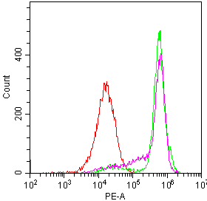
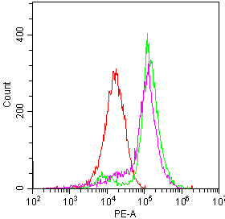
SUPPLEMENTARY FIGURE 4
isotype control
isotype control
HPC92Y
HPC92Y ＋ Dex
HSC4
HSC4 ＋ Dex
EGFR
EGFR

Slide 5
SUPPLEMENTARY FIGURE 5
A
CD4
CD8a
Gr-1
B
C

Slide 6
SUPPLEMENTARY FIGURE 6
SPLEEN
LN
TIL

