Slide 1
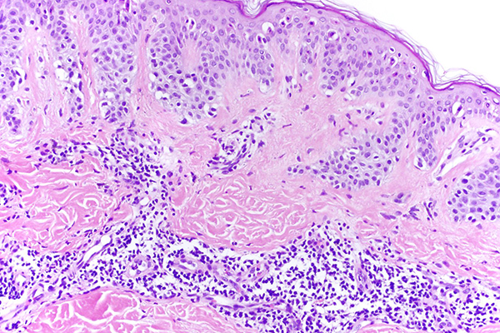
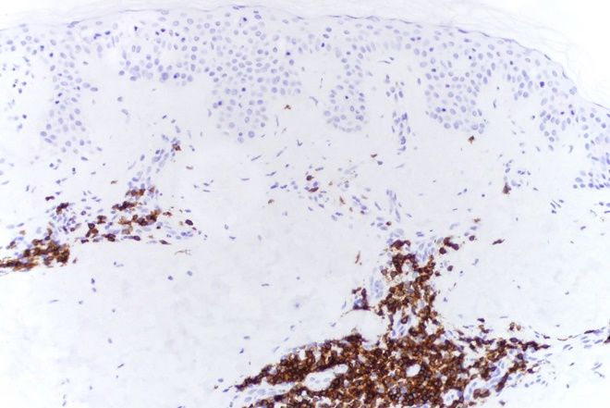
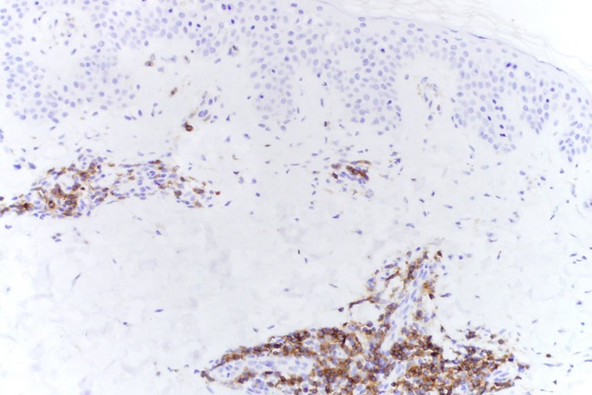
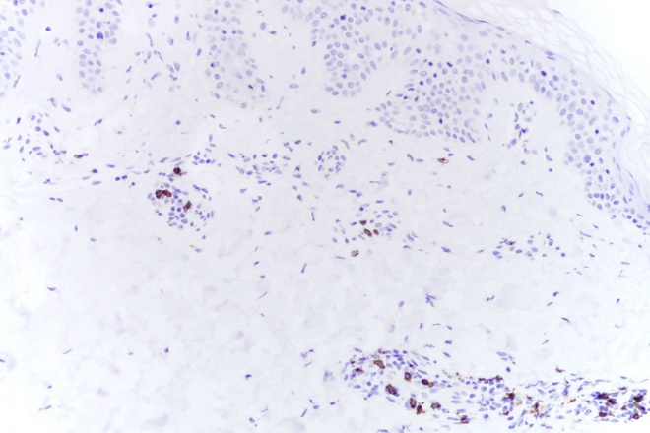
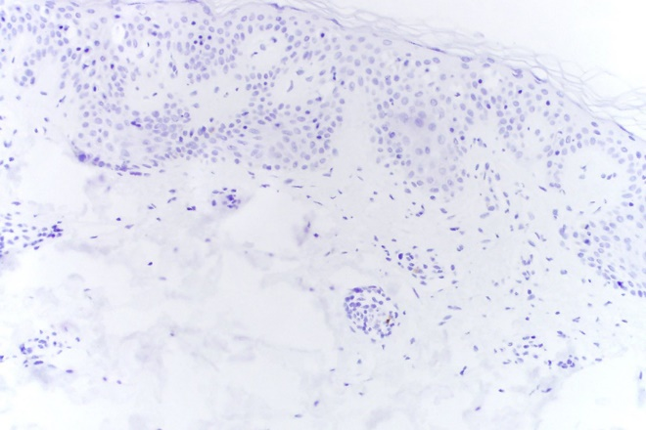
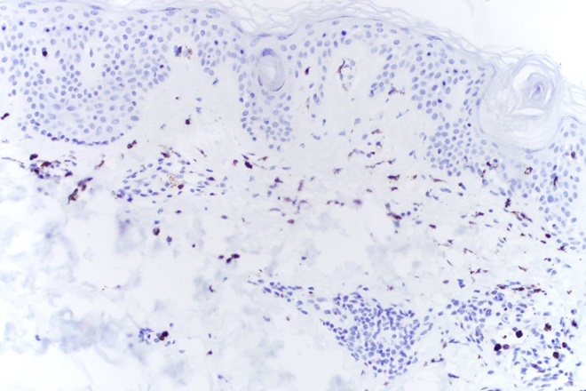
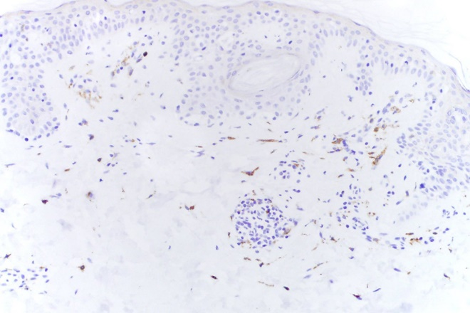
A
B
C
H&E
CD3
CD4
D
E
F
CD8
CD20
MPO
G
Figure S1. UV-induced inflammation in nevi. A, H&E-stained section of representative UV-treated nevus from subject in placebo group. B, CD3 staining. C, CD4 staining. D, CD8 staining. E, CD20 staining. F,
Myeloperoxidase (MPO) staining. G, CD163 staining.
CD163

