Slide 1
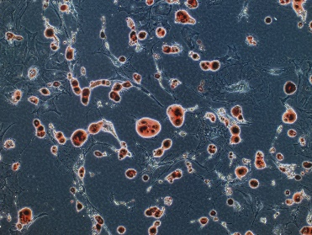
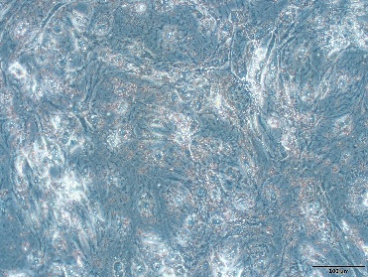

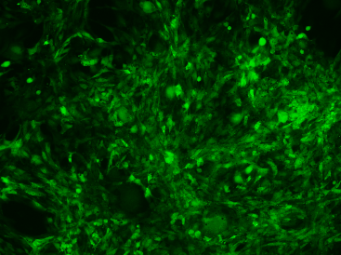
A
CD11B
CD29
CD44
CD90
B
C
Osteogenesis
differentiation
Chondrogenic
differentiation
MSCs
MSCs^{Ctrl}
MSCs^{P311}
P311/Tag
9KD
GAPDH
36KD
D
E
F
MSCs
MSCs^{P311}
98.5
GFP
Cell Counts
GFP-BL1
Supplementary Figure 1

Slide 2
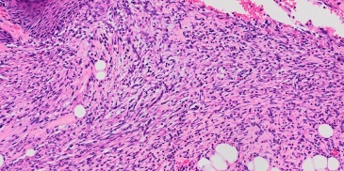
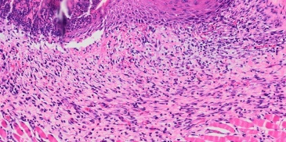
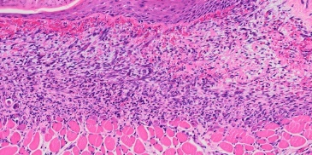
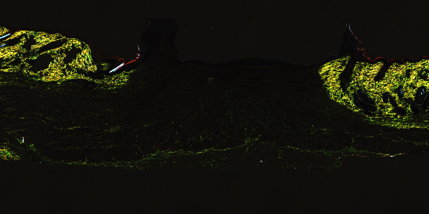
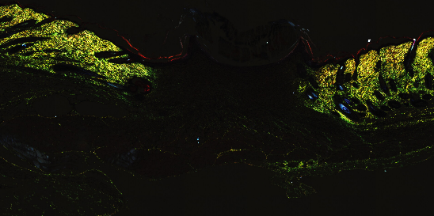
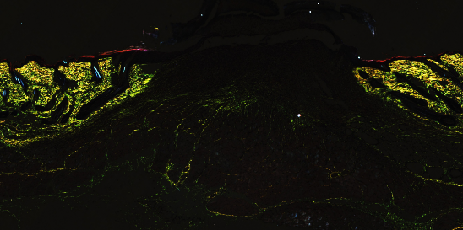
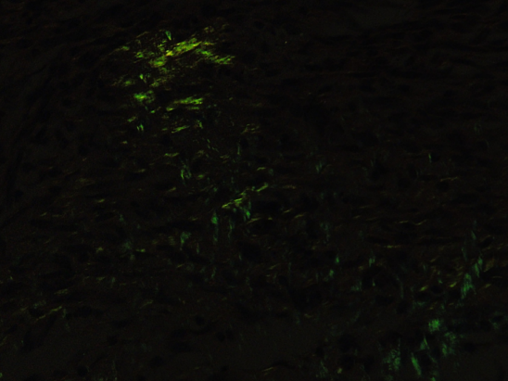
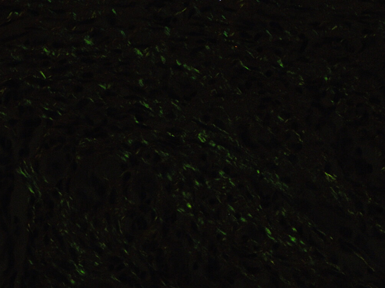
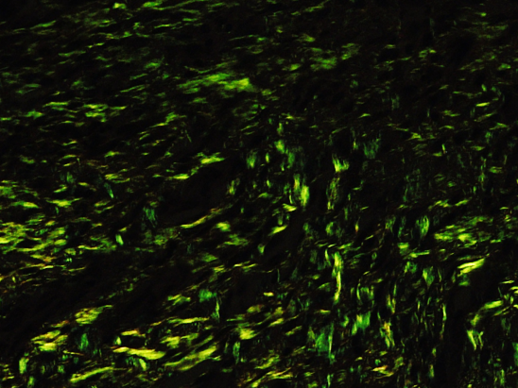
A
B
MSCs
MSCs^{Ctrl}
MSCs^{P311}
10Χ
200Χ
C
MSCs
MSCs^{Ctrl}
MSCs^{P311}
D
E
20Χ
F
G
200Χ
H
MSCs
MSCs^{Ctrl}
MSCs^{P311}
I
10Χ
200Χ
Supplementary Figure 2

Slide 3
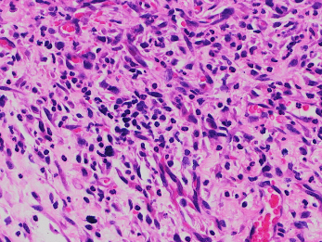
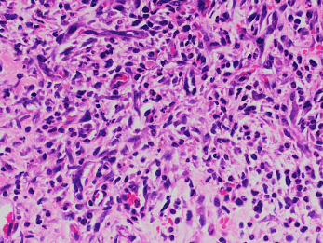
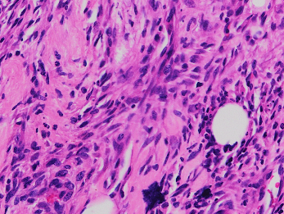
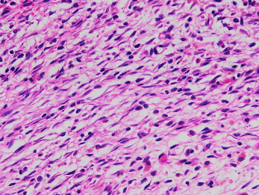
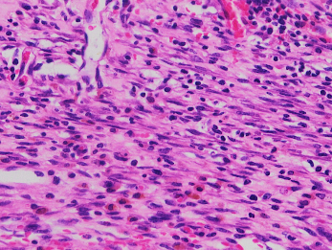
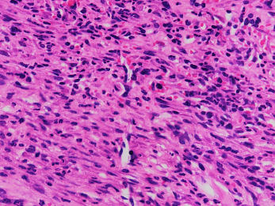
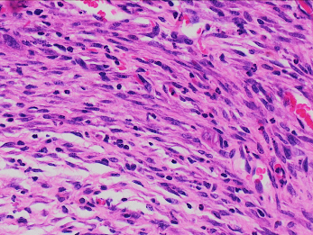
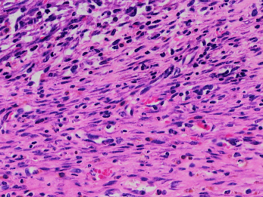
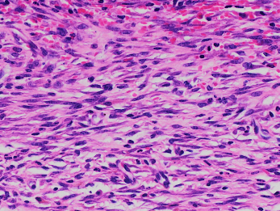
A
MSCs
MSCs^{Ctrl}
MSCs^{P311}
B
C
D
MSCs
MSCs^{Ctrl}
MSCs^{P311}
E
F
MSCs
MSCs^{Ctrl}
MSCs^{P311}
Supplementary Figure 3

Slide 4
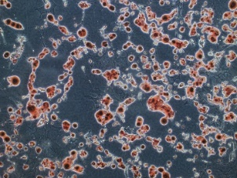
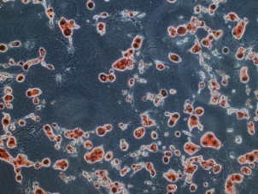
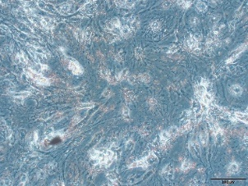
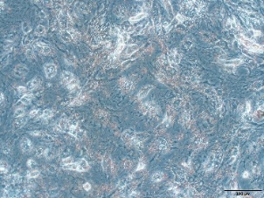
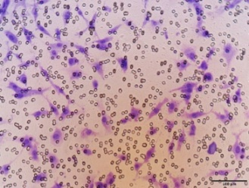
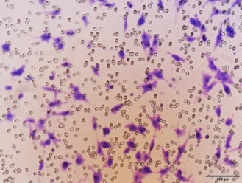
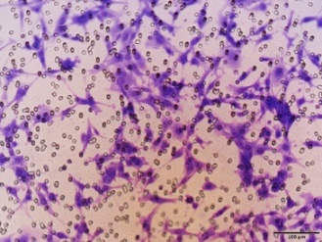
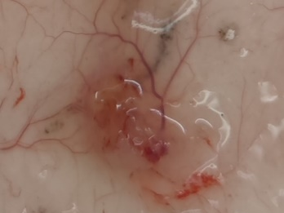
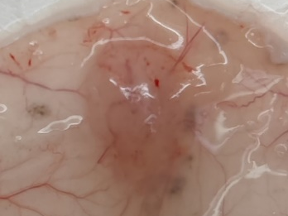
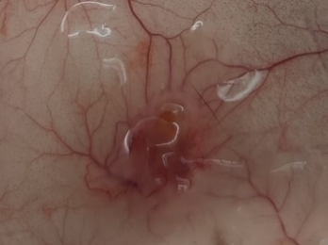
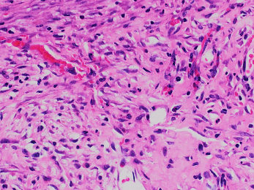
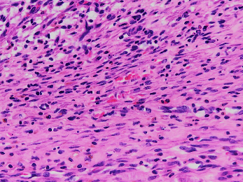
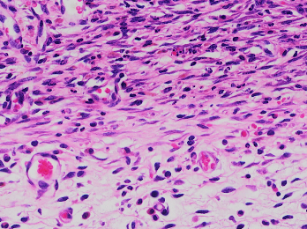
A
CD11B
CD29
CD44
CD90
B
MSCs^{Ctrl}
MSCs^{P311}
MSCs^{Ctrl}
Osteogenesis
differentiation
MSCs^{P311}
Chondrogenic
differentiation
C
D
E
MSCs
MSCs^{Ctrl}
MSCs^{P311}
F
MSCs
MSCs^{Ctrl}
MSCs^{P311}
G
H
I
MSCs
MSCs^{Ctrl}
MSCs^{P311}
Supplementary Figure 4

Slide 5
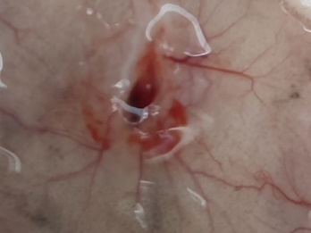
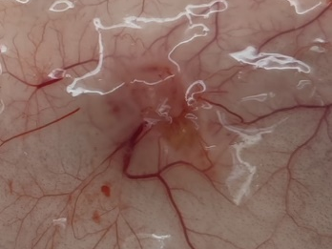
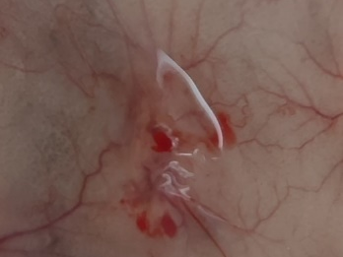
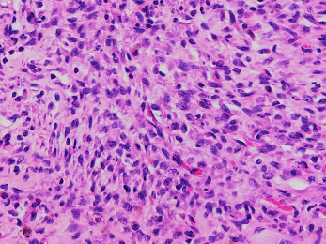
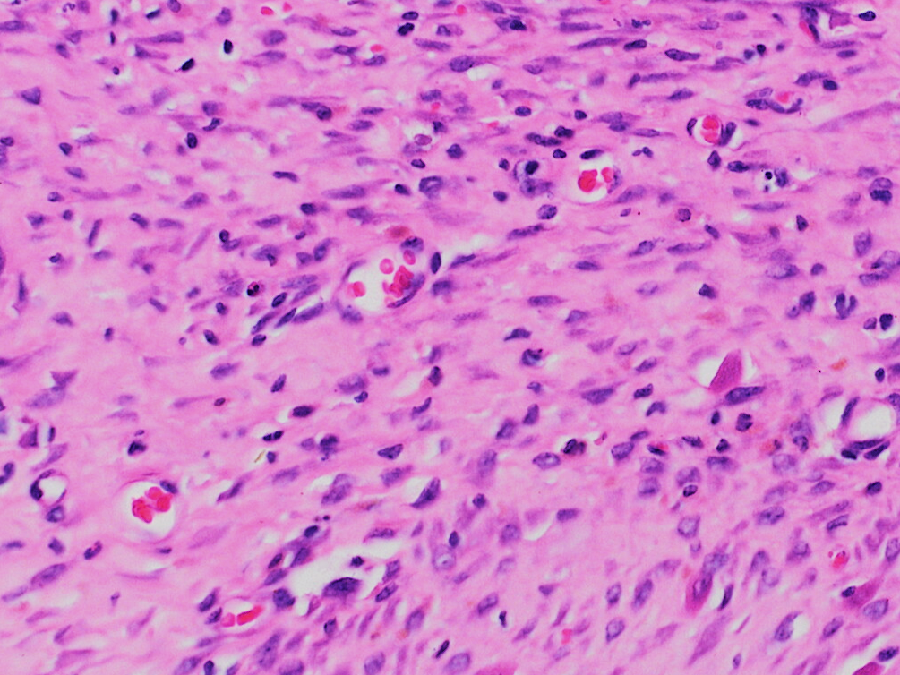
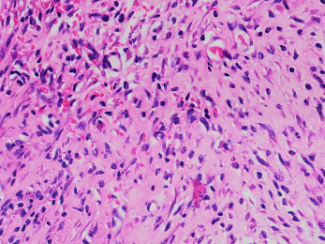
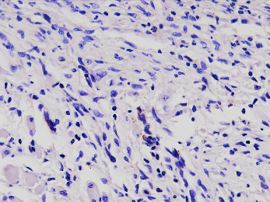
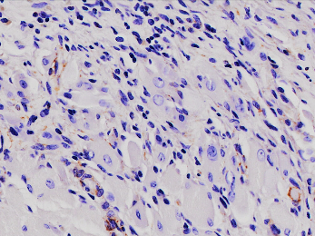
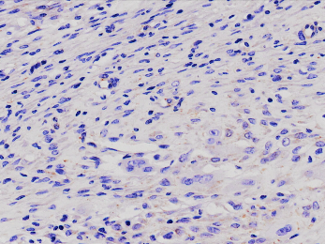
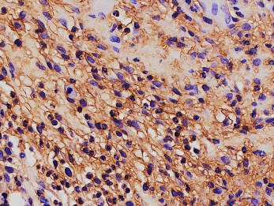
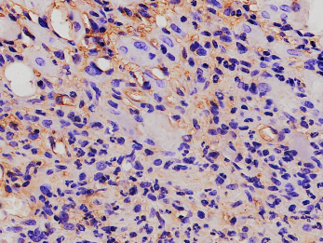
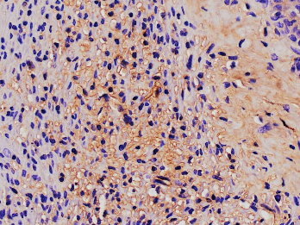
A
B
MSCs^{Ctrl}
MSCs^{P311+si-Ctrl}
MSCs^{P311+si-VEGF}
VEGF
12KD
GAPDH
36KD
C
MSCs^{P311+si-Ctrl}
MSCs^{P311+si-VEGF}
D
MSCs^{Ctrl}
E
MSCs^{Ctrl}
MSCs^{P311+si-Ctrl}
MSCs^{P311+si-VEGF}
F
G
MSCs^{Ctrl}
MSCs^{P311+si-Ctrl}
MSCs^{P311+si-VEGF}
H
I
VEGF
J
K
MSCs^{Ctrl}
MSCs^{P311+si-Ctrl}
MSCs^{P311+si-VEGF}
TNF-α
Supplementary Figure 5

Slide 6
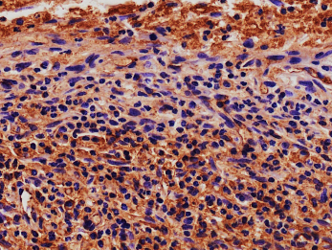
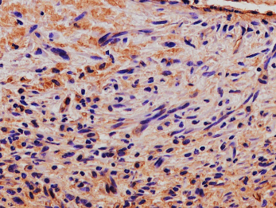
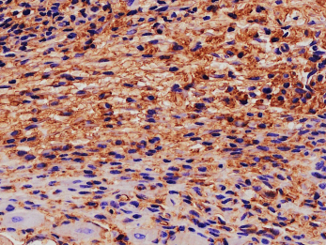
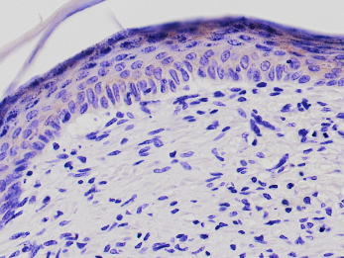





L
MSCs^{Ctrl}
MSCs^{P311+si-Ctrl}
MSCs^{P311+si-VEGF}
M
IFN-γ
N
O
MSCs^{Ctrl}
MSCs^{P311+si-Ctrl}
MSCs^{P311+si-VEGF}
IL-10
P
Q
MSCs^{Ctrl}
MSCs^{P311+si-Ctrl}
MSCs^{P311+si-VEGF}
Supplementary Figure 5

Slide 7
A
MSCs^{Ctrl}
MSCs^{P311}
B
C
MSCs
P-PI3K
85KD
PI3K
85KD
p-AKT
60KD
D
AKT
60KD
p-mTOR
289KD
mTOR
289KD
GAPDH
36KD
Supplementary Figure 6

Slide 8

















A
Heart
Liver
Spleen
Lung
Kidney
Normal
MSCs
MSCs^{Ctrl}
MSCs^{P311}
Supplementary Figure 7

