Slide 1
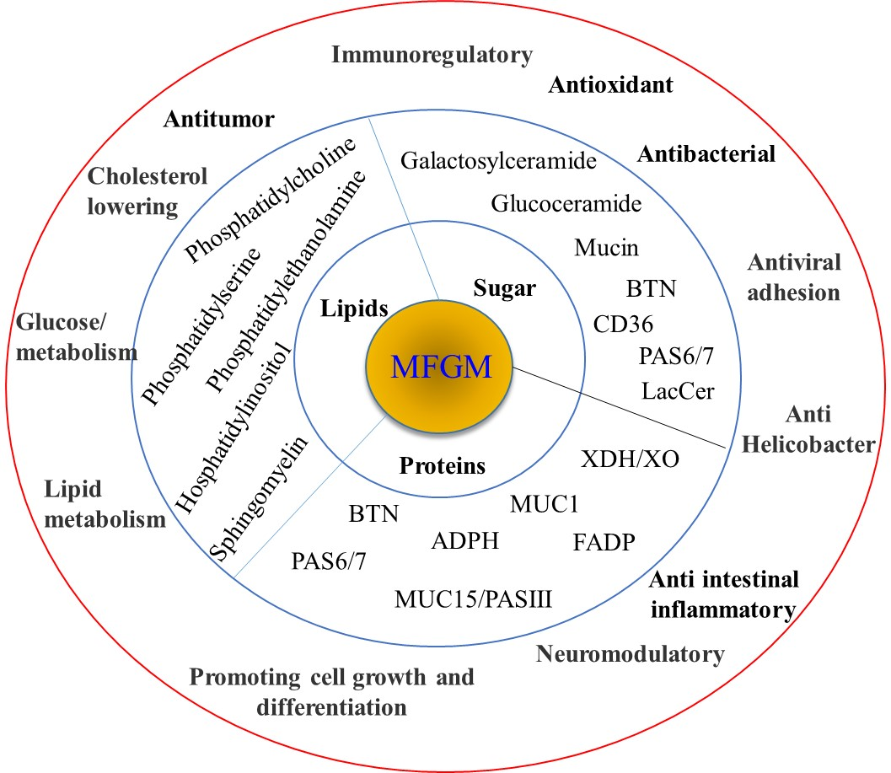
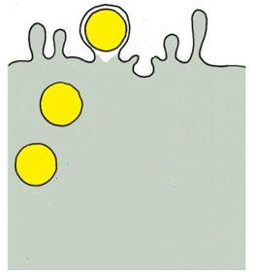
Milk fat
globule
MFGM
Milk
Isolation
Identification
Structure
Functions
Bioactivities
Applications

