Slide 1
Supplementary File 1. Single cell Allen Brain Map heatmap for the top 10 marker genes for each cluster (one per page) used to identify cell types (https://celltypes.brain-map.org/rnaseq/human/cortex).

Slide 2
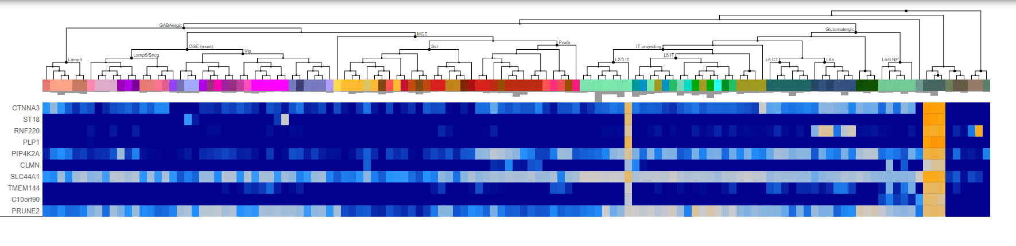
Cluster 0: Oligodendrocytes

Slide 3
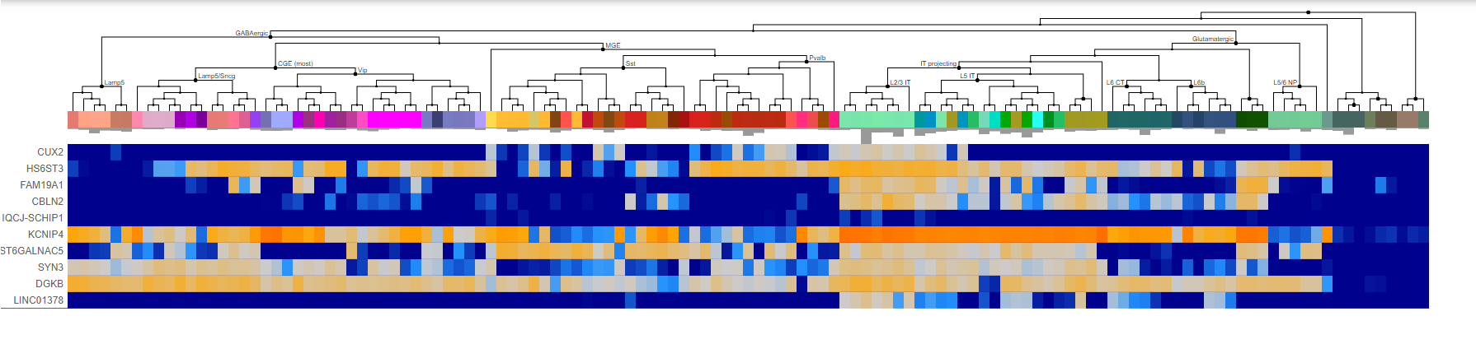
Cluster 1: Excitatory Neurons

Slide 4
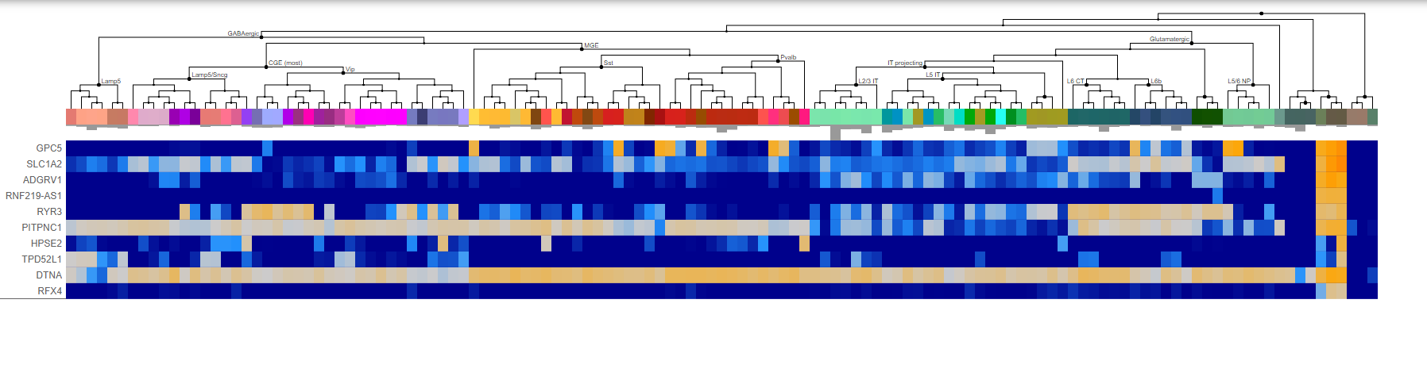
Cluster 2: Astrocytes

Slide 5
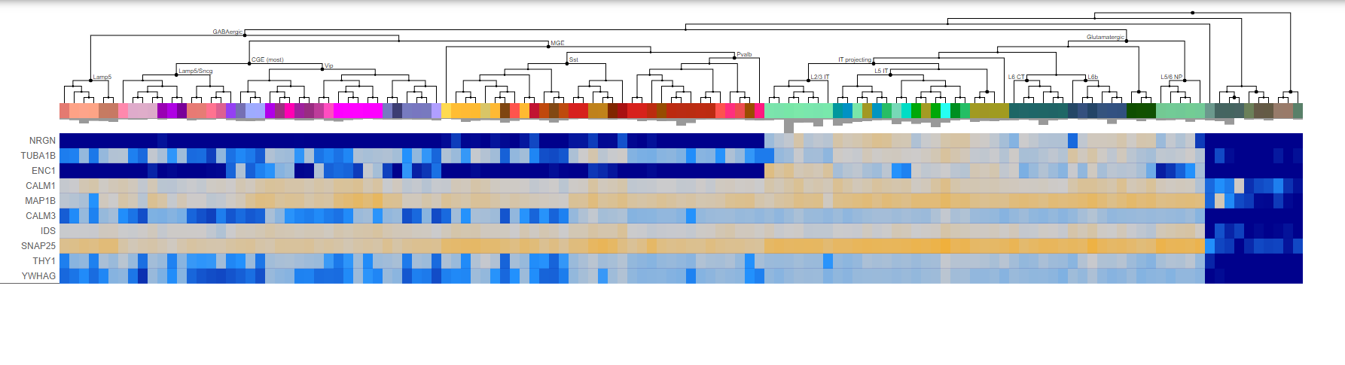
Cluster 3: Excitatory Neurons

Slide 6
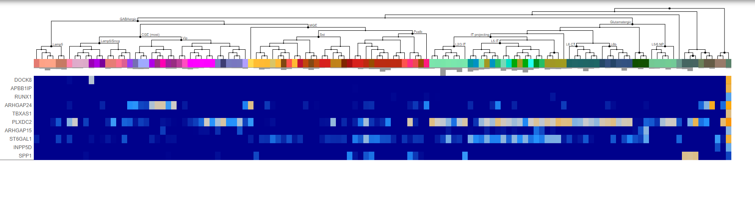
Cluster 4: Microglia

Slide 7
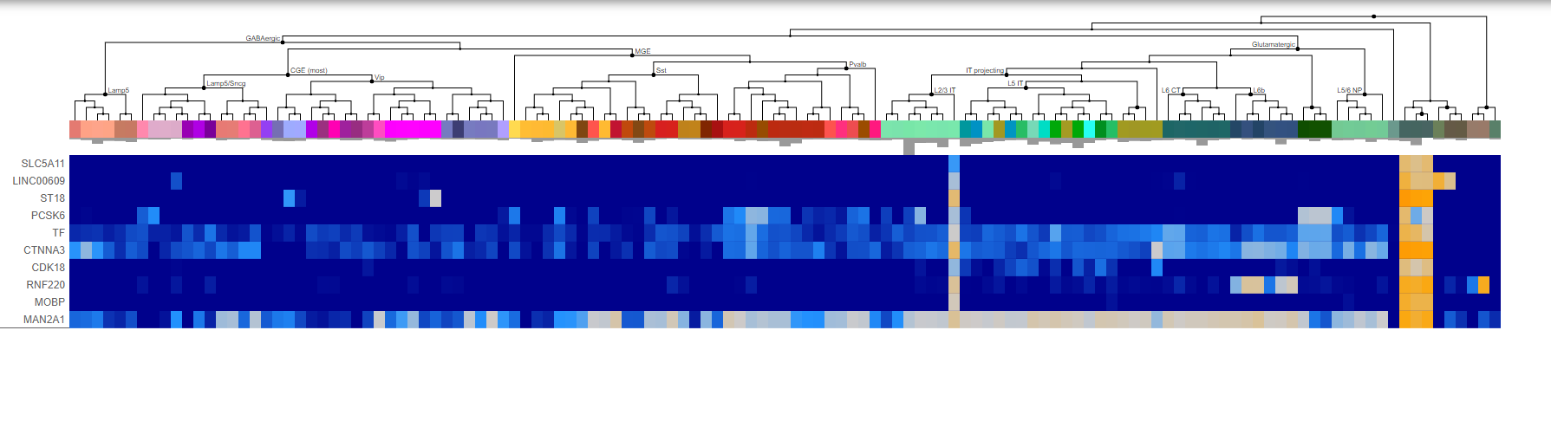
Cluster 5: Oligodendrocytes

Slide 8
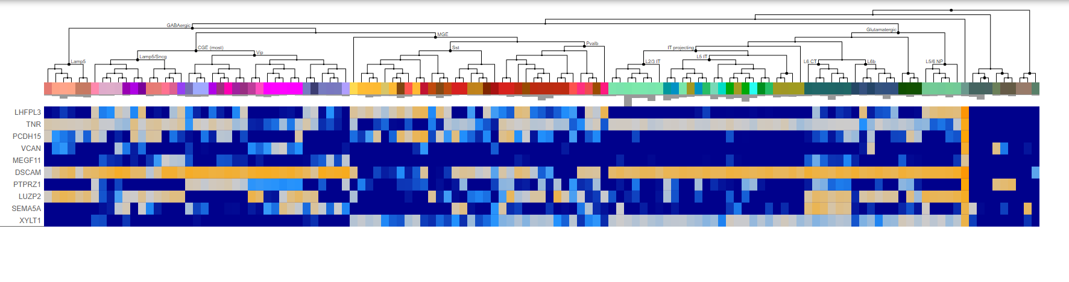
Cluster 6: OPC

Slide 9
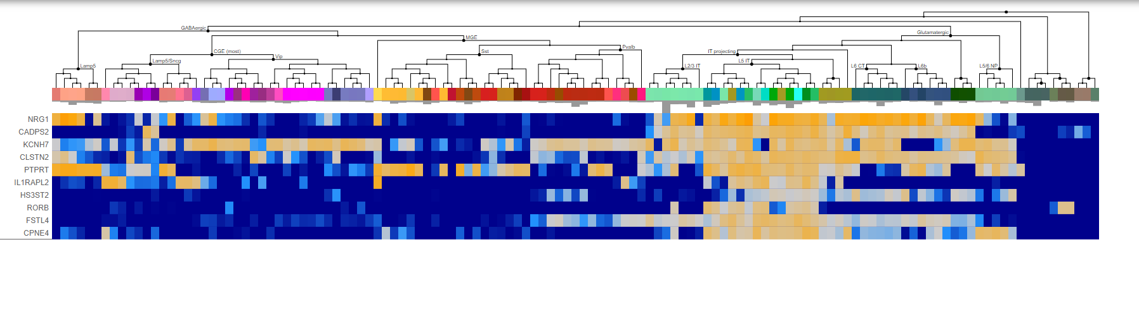
Cluster 7: Excitatory Neurons

Slide 10
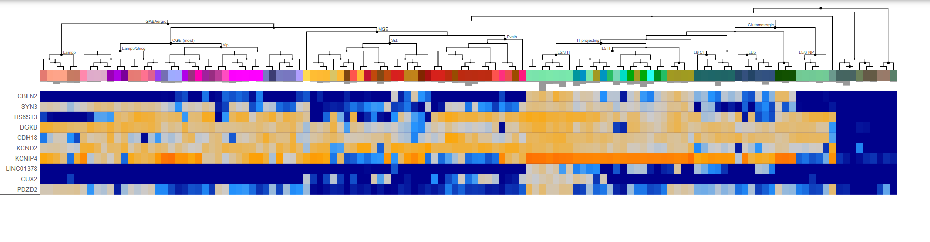
Cluster 8: Excitatory Neurons

Slide 11
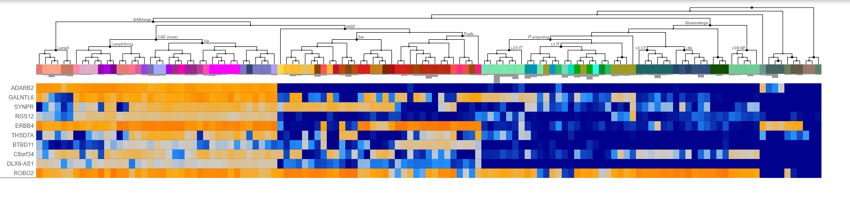
Cluster 9: Inhibitory Neurons

Slide 12
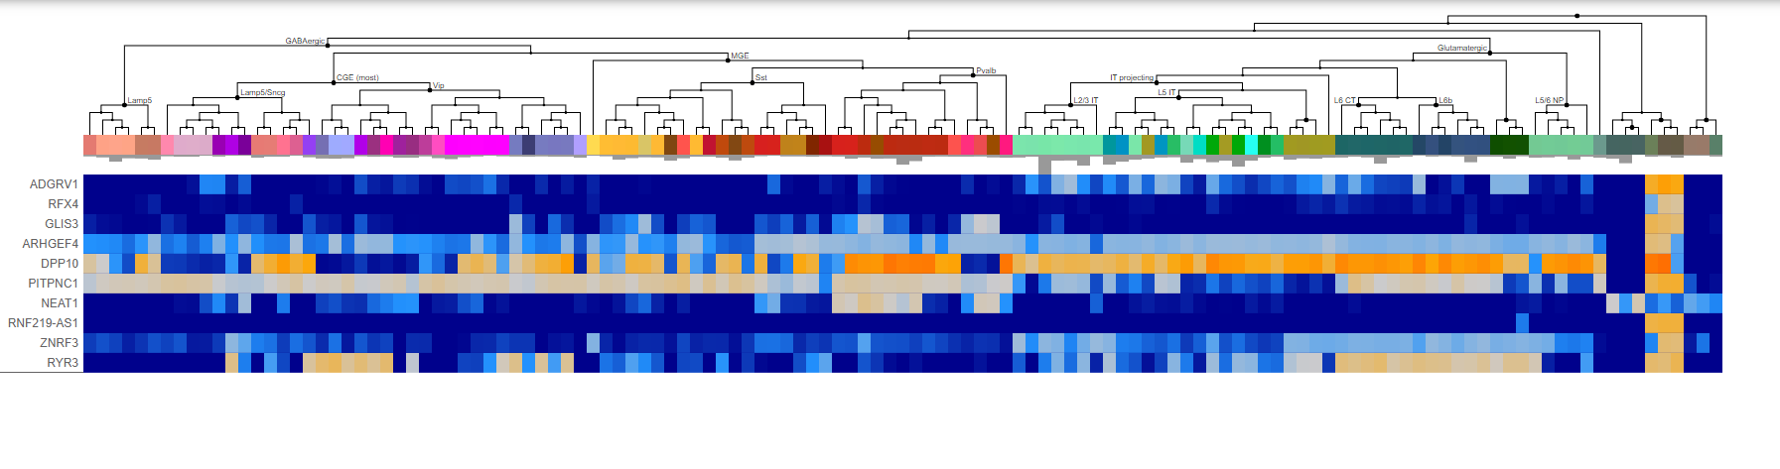
Cluster 10: Astrocytes

Slide 13
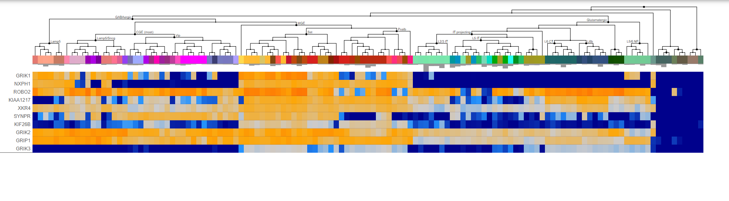
Cluster 11: Inhibitory Neurons

Slide 14
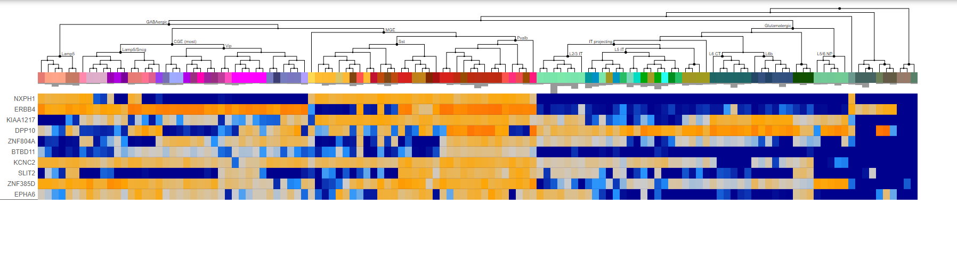
Cluster 12: Inhibitory Neurons

Slide 15
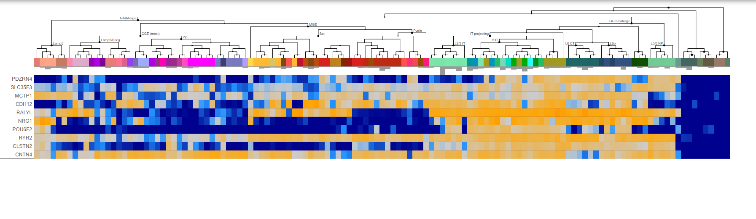
Cluster 13: Excitatory Neurons

Slide 16
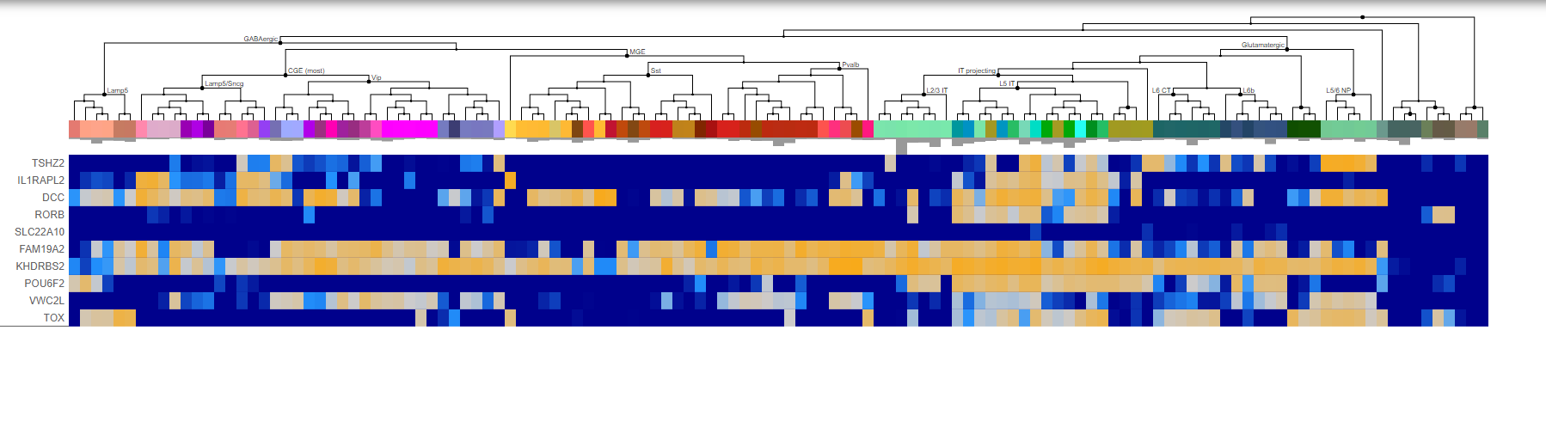
Cluster 14: Excitatory Neurons

Slide 17
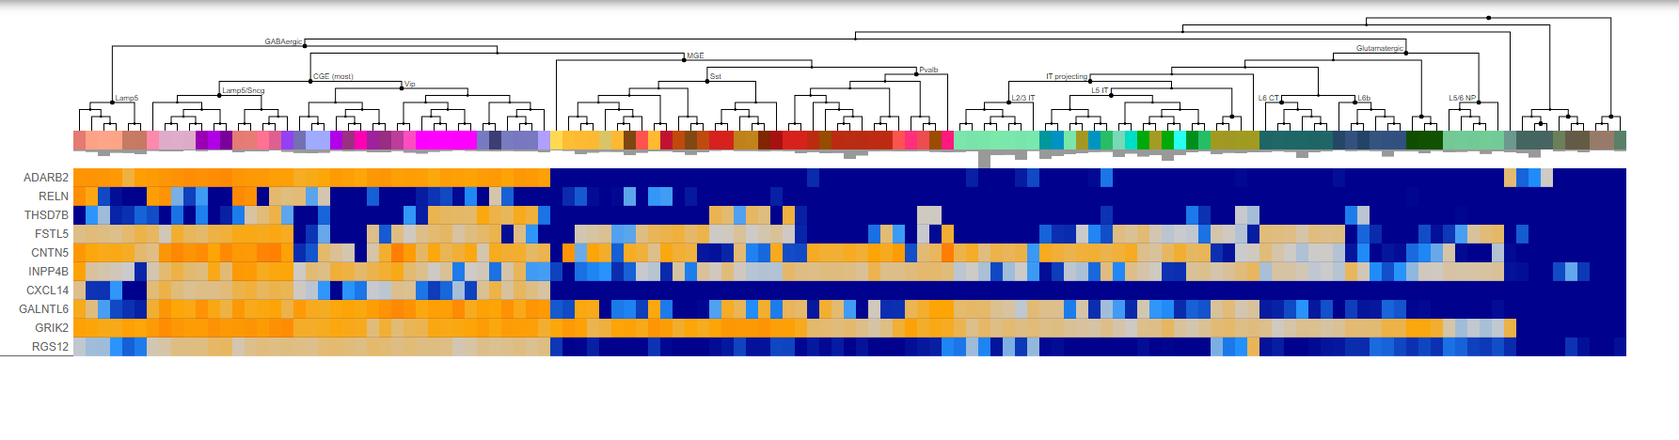
Cluster 15: Inhibitory Neurons

Slide 18
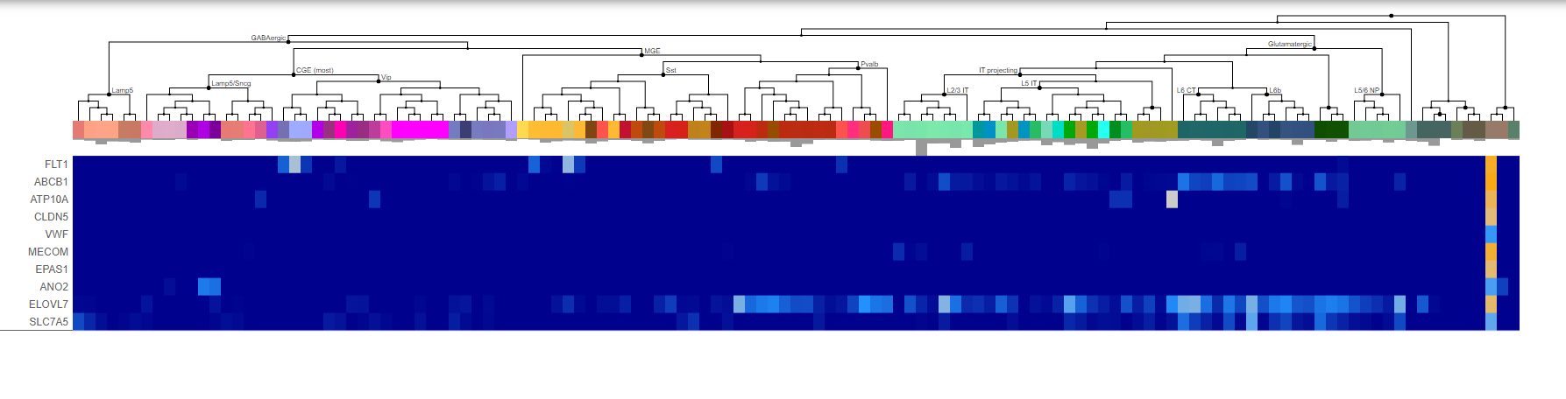
Cluster 16: Endothelial cells

Slide 19
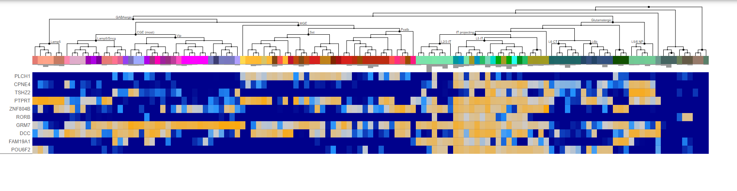
Cluster 17: Excitatory Neurons

Slide 20
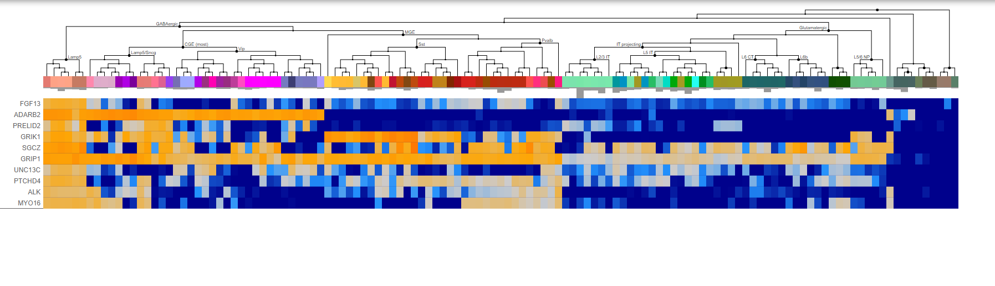
Cluster 18: Inhibitory Neurons

Slide 21
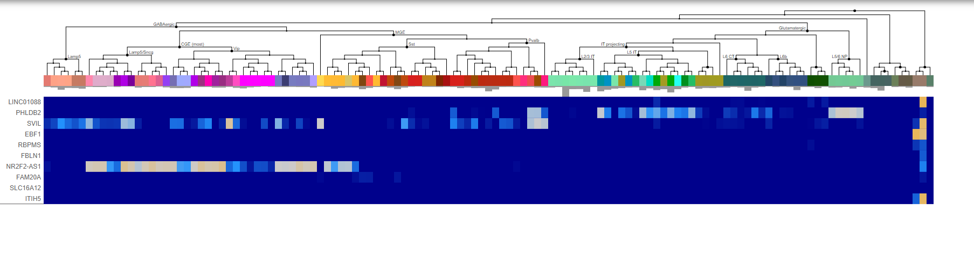
Cluster 19: Vascular Leptomeningeal Cells (VLMC)

Slide 22
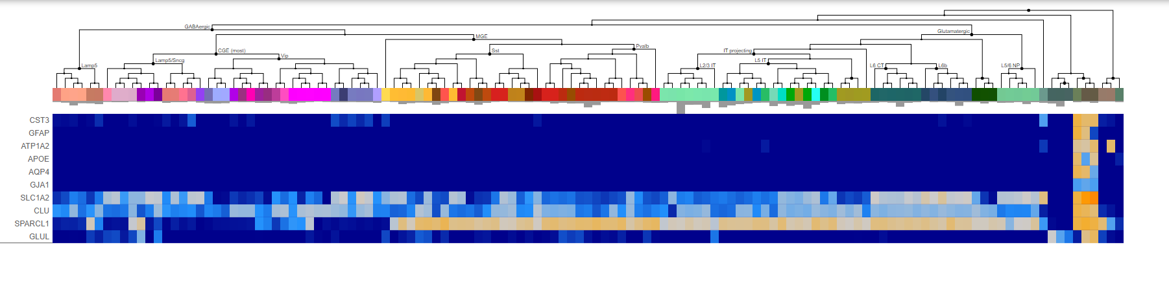
Cluster 20: Astrocytes

Slide 23
Cluster 20: Astrocytes

Slide 24
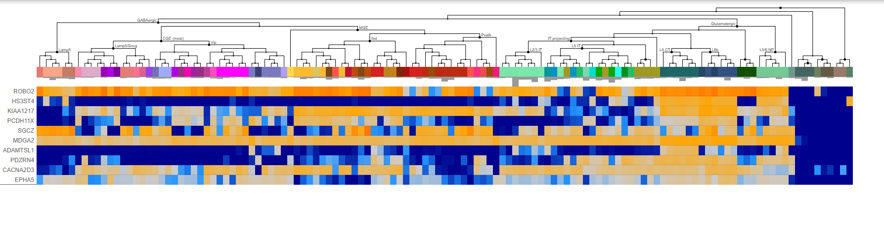
Cluster 21: Excitatory Neurons

Slide 25
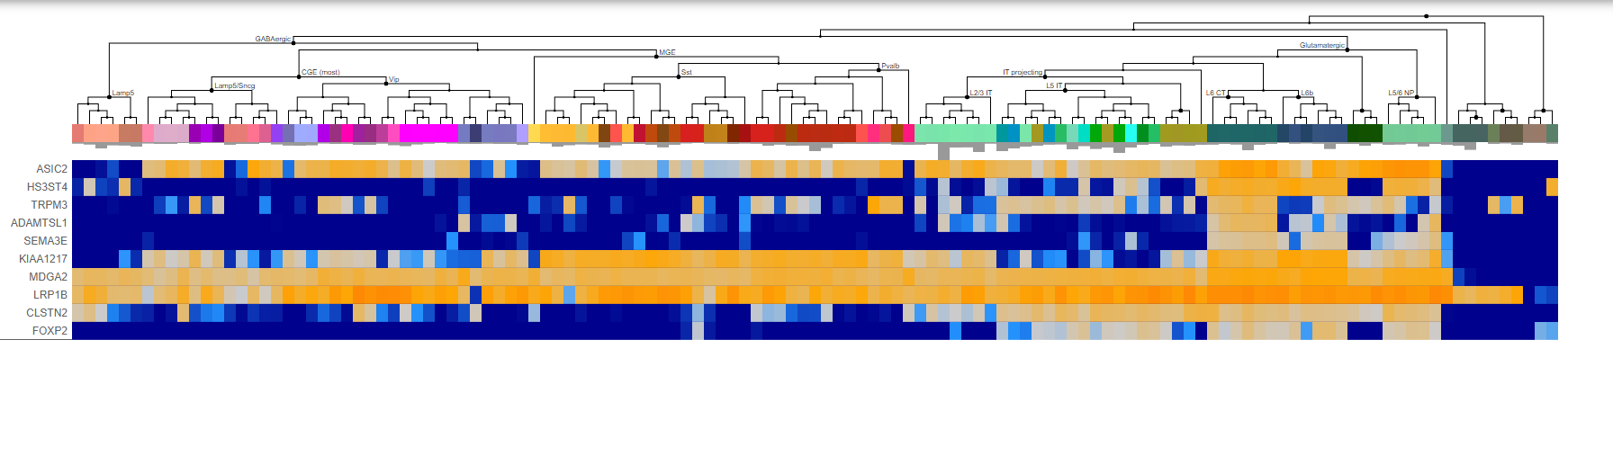
Cluster 22: Excitatory Neurons

Slide 26
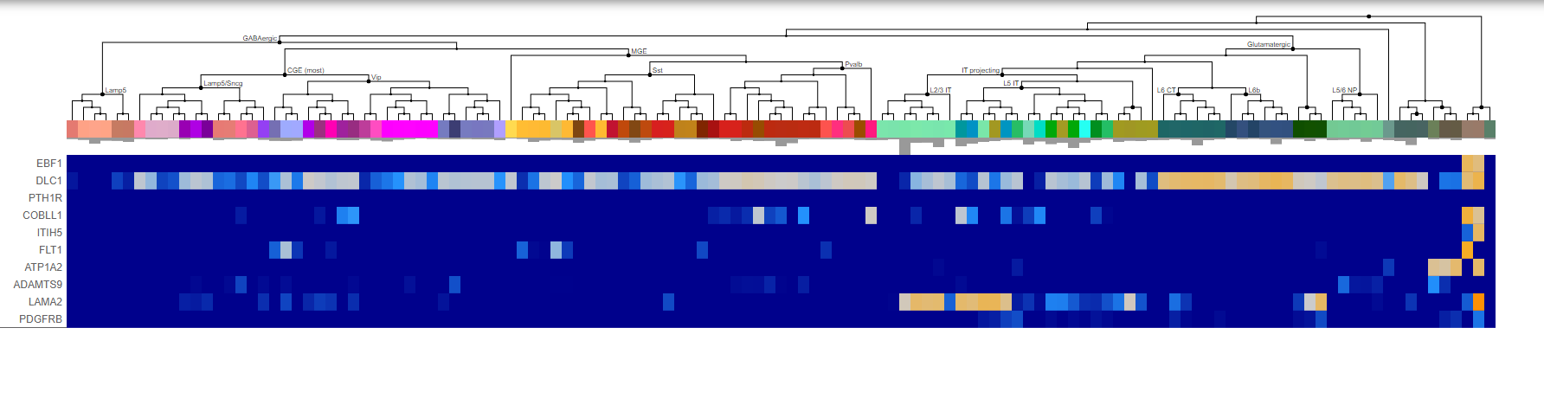
Cluster 23: Endothelial cells

Slide 27
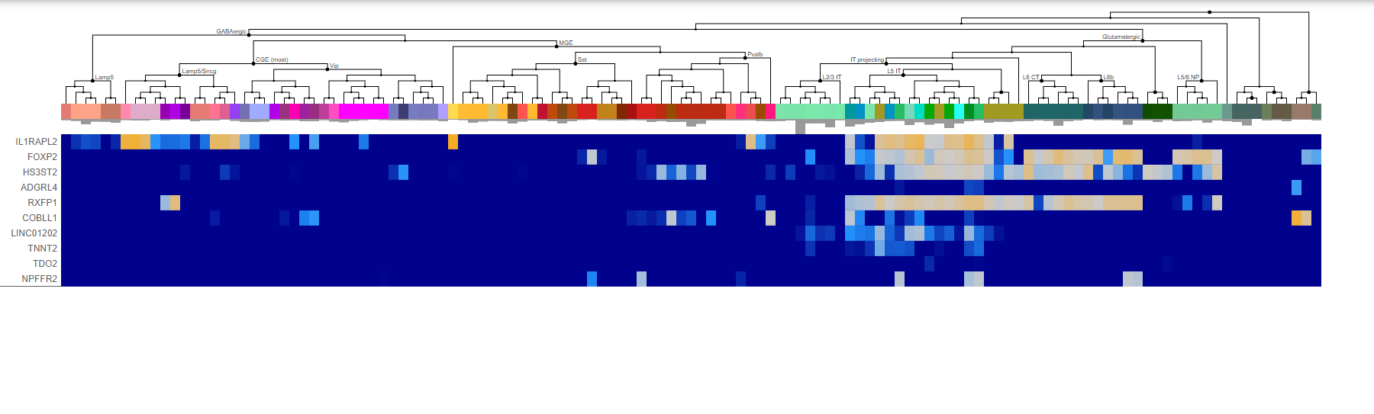
Cluster 24: Excitatory Neurons

Slide 28
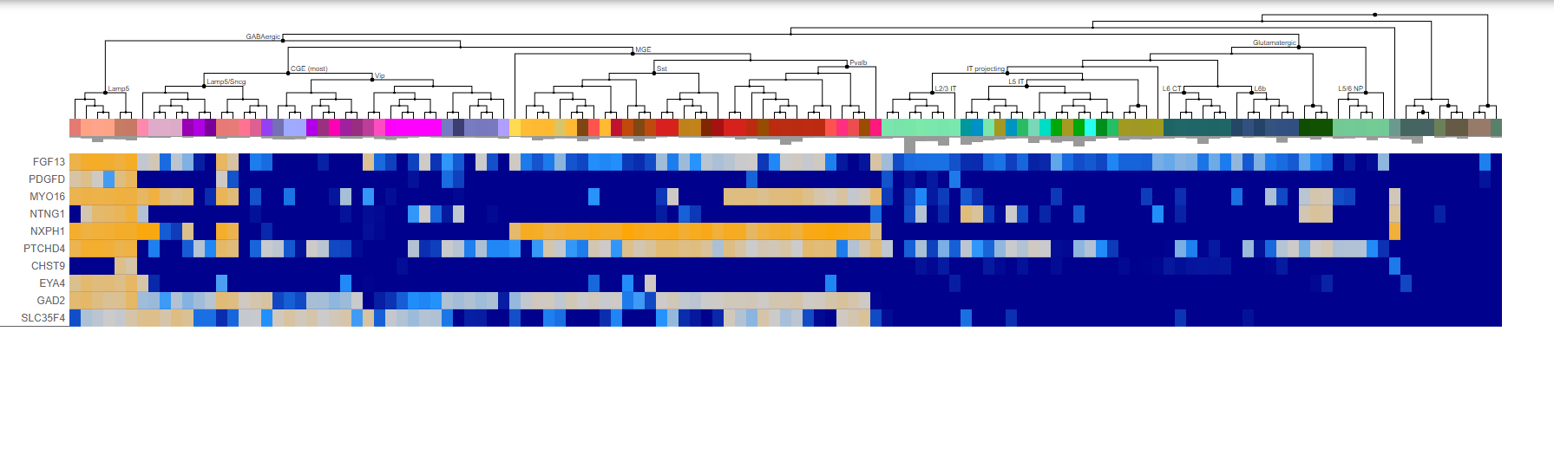
Cluster 25: Inhibitory Neurons

Slide 29
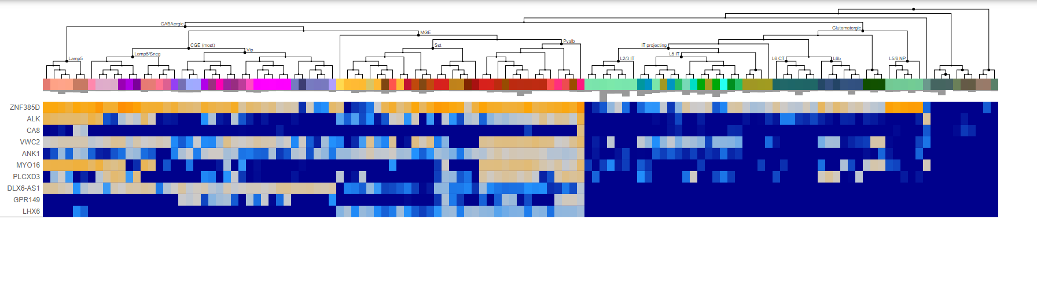
Cluster 26: Inhibitory Neurons

Slide 30
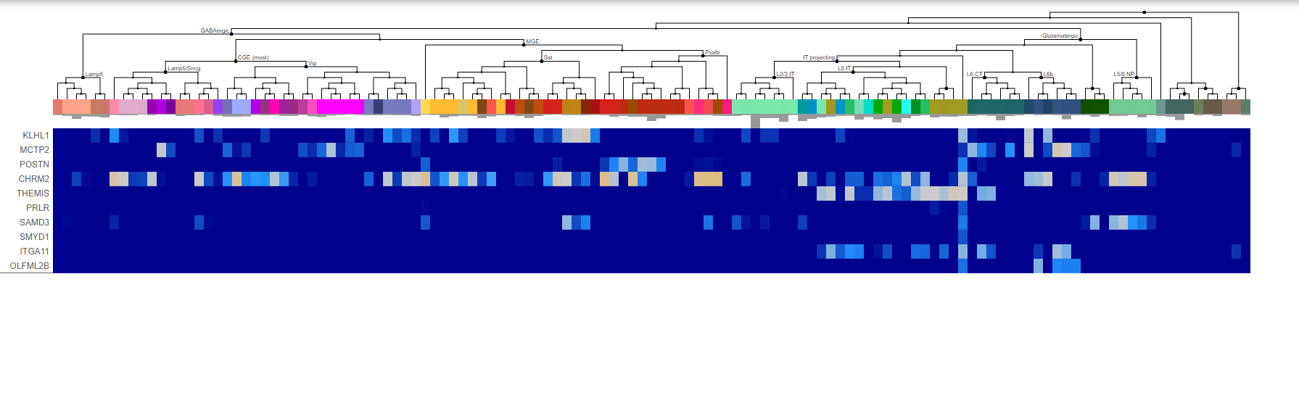
Cluster 27: Excitatory Neurons

Slide 31
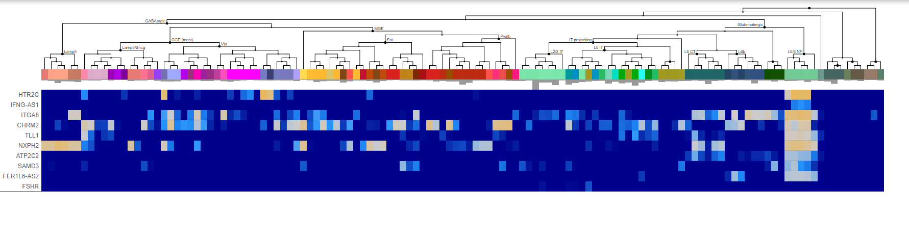
Cluster 28: Excitatory Neurons

Slide 32
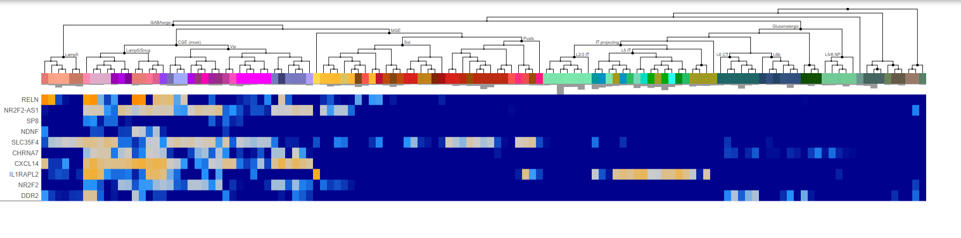
Cluster 29: Inhibitory Neurons

Slide 33
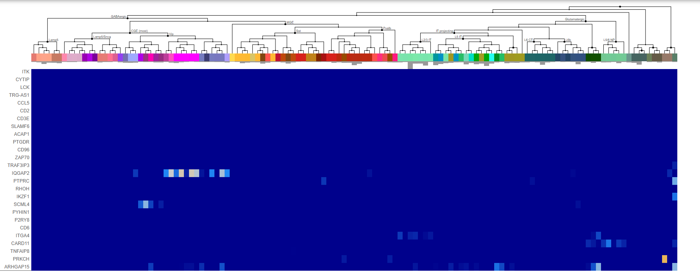
Cluster 30: Microglia

Slide 34
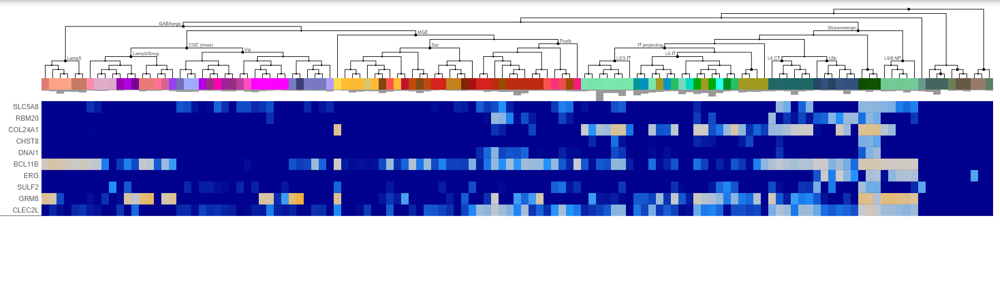
Cluster 31: Excitatory Neurons

