Slide 1
A
B

Slide 2
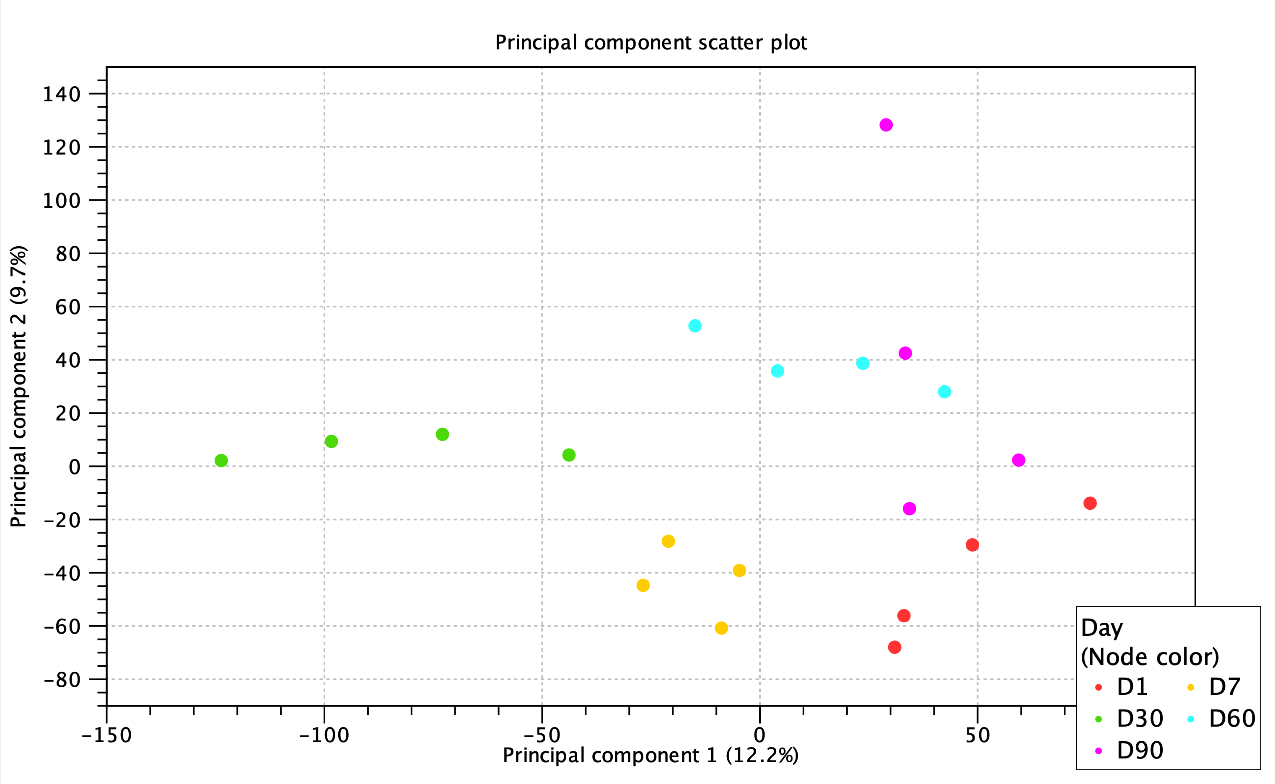
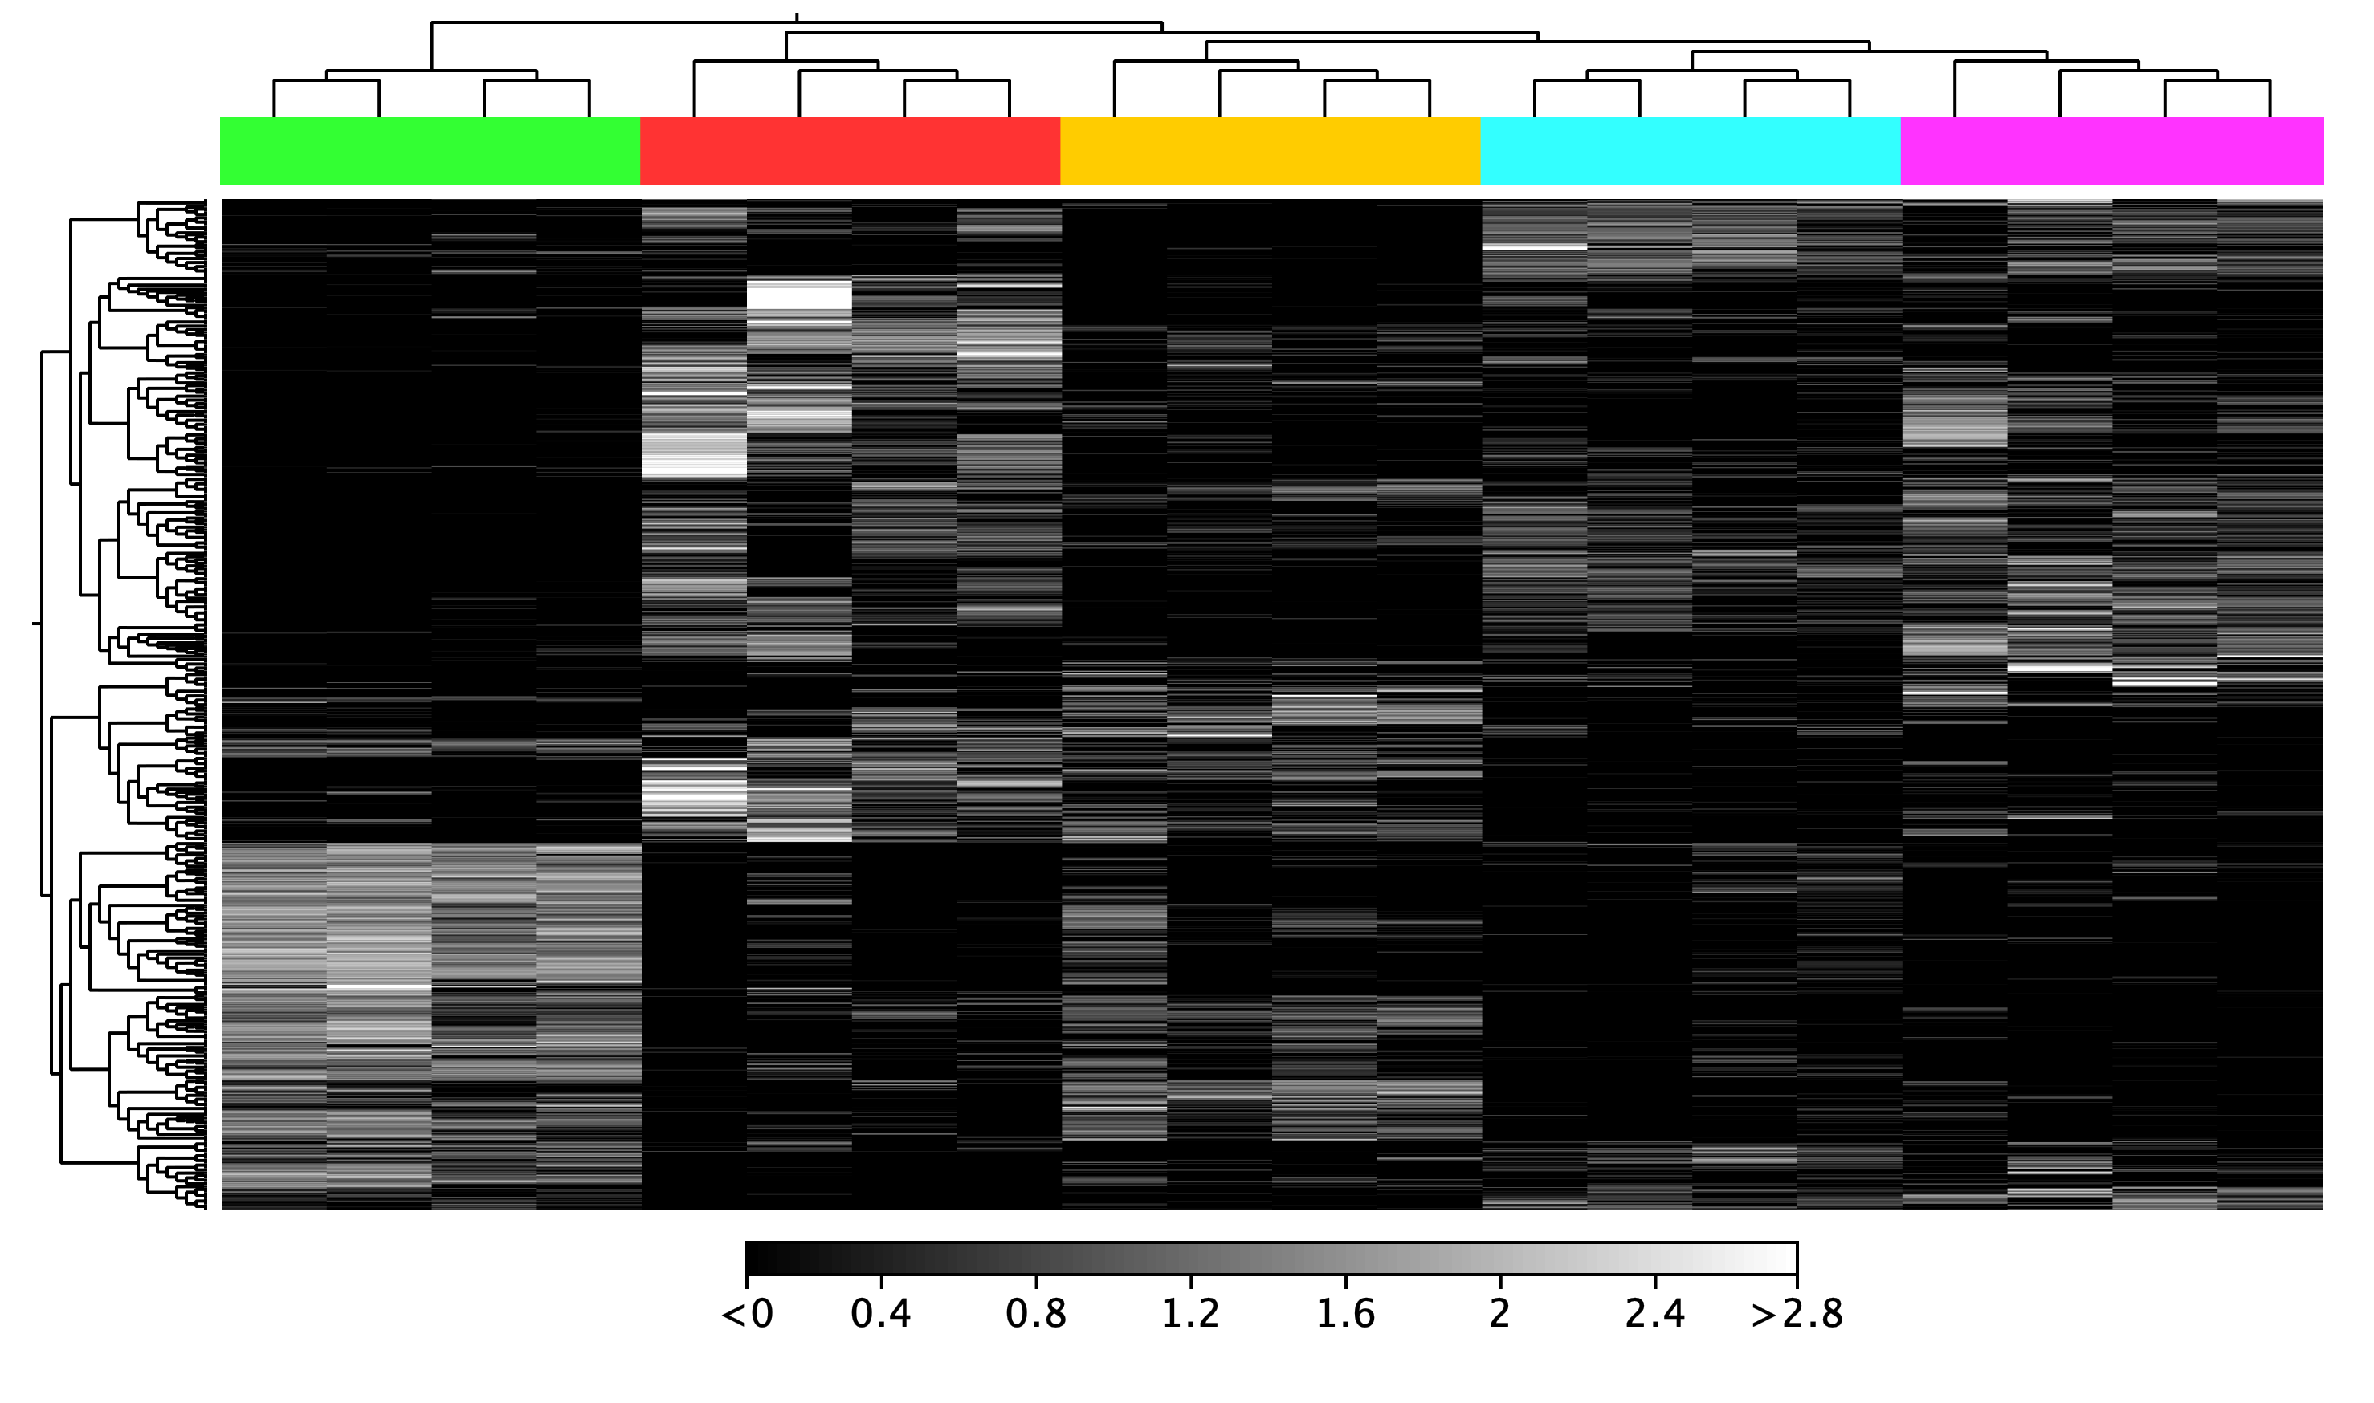
A
90.1
60.1
90.3
60.2
60.4
60.3
30.4
30.3
30.2
30.1
90.2
90.4
1.4
7.4
7.2
1.2
7.3
1.3
7.1
1.1
B
30.3
30.4
30.1
30.2
1.4
1.3
1.1
1.2
7.3
7.2
7.1
7.4
60.3
60.4
60.1
60.2
90.4
90.1
90.2
90.3
Timepoint:
D1, D7, D30, D60, D90

Slide 3
A
Confirmation of Gene Expression obtained from RNA Sequencing
Bar = RNAseq Line = RT-qPCR
B
Comparison of Fold Change and Significance
P-value
> 0.05
P-value
≤ 0.05

