Slide 1
A report of two cases of myocarditis following mRNA COVID-19 vaccination
December 2021
EHJ-CR-D-21-00594R3

Slide 2
Introduction
Cases of myocarditis have been reported as a rare adverse reaction to COVID-19 vaccines.
We report the cases of two young male patients who presented with chest pain and dyspnoea following the administration of doses of the mRNA COVID-19 vaccine. Cardiac investigations revealed findings typical of acute myocarditis.
Myocarditis may be an adverse reaction to mRNA COVID-19 vaccine.
Clinical suspicion of myocarditis should be high if patients present with chest pain or dyspnea after receiving COVID-19 vaccination.

Slide 3
Case 1
History and Examination Findings
A 23-year-old patient presented with retrosternal pain that had been present for one day
He had received the second dose of COVID-19 Vaccine Moderna
5 days prior
His blood pressure was 176/95, heart rate 96/min, temperature 37.2°C. Physical exam was normal

Slide 4
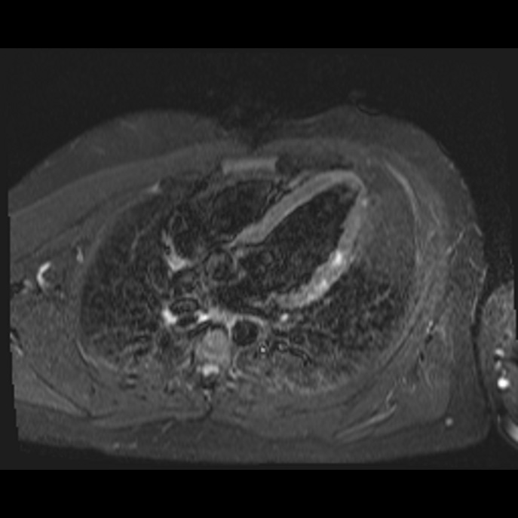
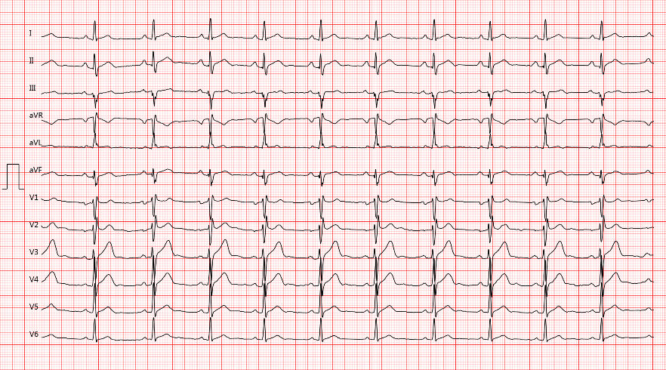
Case 1
Investigations
ECG: Sinus rhythm with an rSr’ configuration in V1-V3 and a slight notch in aVL
Cardiac MRI: increased subepicardial and intramyocardial signal intensity of the anterolateral segment

Slide 5
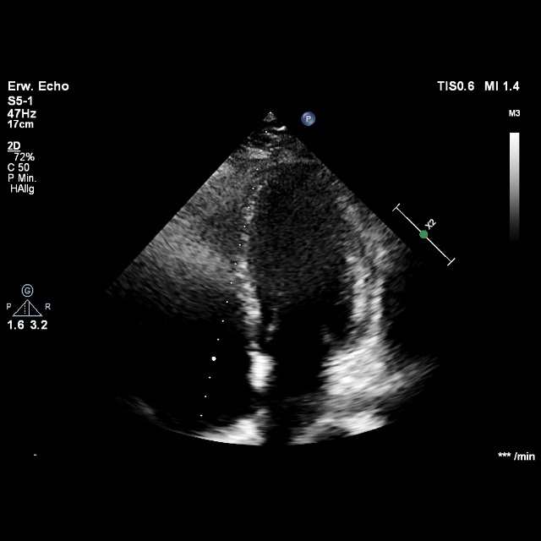
Case 1
Investigations
High-sensitivity cardiac troponin-T | 1086 pg/mL (normal: <14 pg/mL)
C-reactive protein | 19.8 mg/L (normal: 0–5 mg/L)
SARS-CoV-2 antispike titre | >2080 BAU/mL (normal: <33.8 BAU/mL)
TTE: Normal systolic LV-function

Slide 6
Case 1
Management
Patient was monitored for 4 days
No relevant heart rhythm anomalies
Repeat echocardiography showed no wall motion abnormalities
Total resolution of symptoms without specific medical therapy
Recommendation to avoid exercise for the next 6 months

Slide 7
Case 2
History and Examination Findings
A 20-year-old patient presented with anterolateral ST segment elevation. Epigastric pain had been present for one day
He had received the second dose of COVID-19 Vaccine Moderna 3 days prior
His blood pressure was 120/70, heart rate 87/min, temperature 37.1°C. Physical exam was normal
He had a history of attention-deficit/hyperactivity disorder and was on methylphenidate 40 mg q.d. since 8 years of age

Slide 8
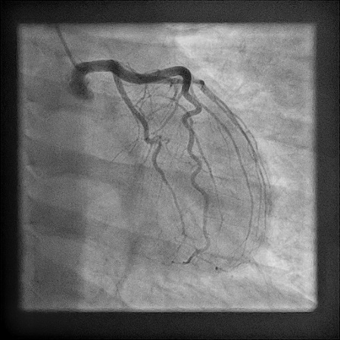
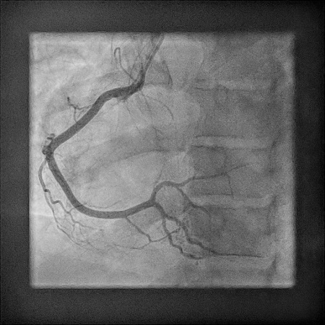
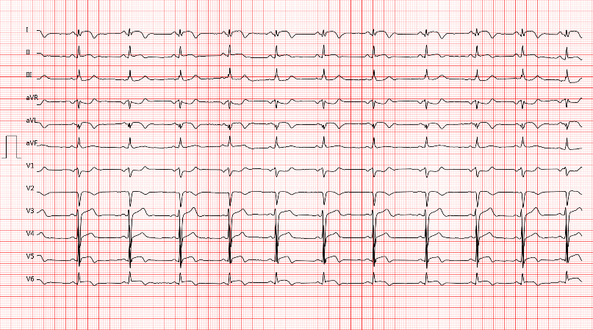
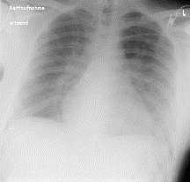
Case 2
Investigations
Coronary angiography: Normal coronary arteries
ECG: Sinus rhythm, ST-elevation in I, aVL, V4-V6; ST-depression in V1, aVR
High-sensitivity cardiac troponin-T | 606 pg/mL (normal: <14 pg/mL)
C-reactive protein | 44.2 mg/L (normal: 0–5 mg/L)
SARS-CoV-2 antispike titre | >2080 BAU/mL (normal: <33.8 BAU/mL)
Chest X-ray:
Pulmonary
congestion

Slide 9
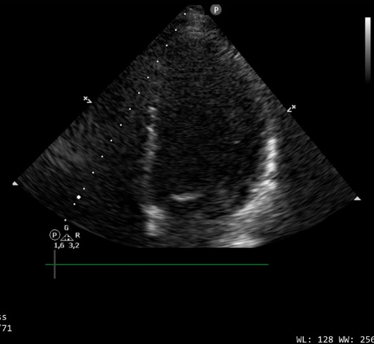
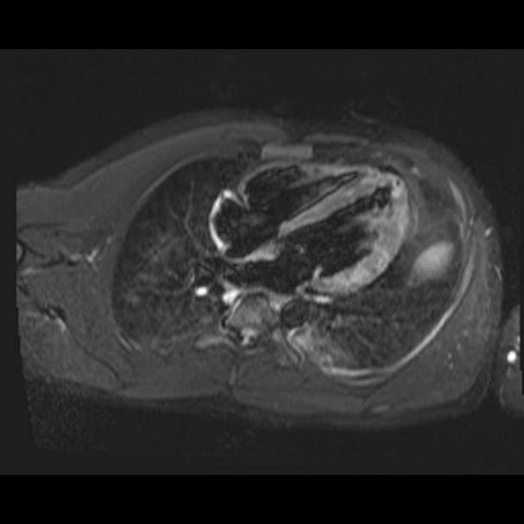
Case 2
Investigations
TTE: Moderately reduced systolic LV-function, EF 40%
Cardiac MRI: increased subepicardial and intramyocardial signal intensity of the anterolateral and apical segments

Slide 10
Case 2
Management
Coronary angiography ruled out CAD
Patient was monitored for 5 days
Heart failure therapy including I.V. loop diuretics, beta blockers, mineralocorticoid receptor antagonists and an angiotensin-converting-enzyme inhibitor
No relevant heart rhythm anomalies
Repeat echocardiography showed resolution of wall motion abnormalities
Resolution of symptoms with heart failure therapy
Recommendation to avoid exercise for the next 6 months

Slide 11
Discussion
Recently published cases of myocarditis after COVID-19 vaccination reported similar clinical courses
Myocarditis is a rare complication following mRNA COVID-19 vaccine
A substantial pathophysiological explanation of mRNA COVID-19 vaccine myocarditis has not yet been described. Possible drug-induced hypersensitivity reaction?
Because of the novelty of mRNA vaccine technology, more investigation of the subject matter is needed

Slide 12
Learning Points
Myocarditis is a rare complication of vaccination
Myocarditis may be a complication of Covid-19 vaccination
Suspect myocarditis in cardiovascular symptoms after Covid-19 vaccination!

Slide 13
References
1 Rosner CM, Genovese L, Tehrani BN, Atkins M, Bakhshi H, Chaudhri S et al. Myocarditis temporally associated with COVID-19 vaccination. Circulation 2021;144:502-505. doi: 10.1161/CIRCULATIONAHA.121.055891. Epub ahead of print. PMID: 34133885.
2 Muthukumar A, Narasimhan M, Li QZ, Mahimainathan L, Hitto I, Fuda F et al. In depth evaluation of a case of presumed myocarditis following the second dose of COVID-19 mRNA vaccine. Circulation 2021;144:487-498. doi: 10.1161/CIRCULATIONAHA.121.056038. Epub ahead of print. PMID: 34133883.
3 D’Angelo T, Cattafi A, Carerj ML, Booz C, Ascenti G, Cicero G et al. Myocarditis after SARS-CoV-2 vaccination: A vaccine-induced reaction? Can J Cardiol 2021;21:S0828-282X. doi: 10.1016/j.cjca.2021.05.010. Epub ahead of print. PMID: 34118375; PMCID: PMC8187737.
4 Montgomery J, Ryan M, Engler R, Hoffman D, McClenathan B, Collins L et al. Myocarditis following immunization with mRNA COVID-19 vaccines in members of the US military. JAMA Cardiol 2021:e212833. doi: 10.1001/jamacardio.2021.2833. Epub ahead of print. PMID: 34185045; PMCID: PMC8243257
13 Bozkurt B, Kamat I, Hotez PJ. Myocarditis with COVID-19 mRNA vaccines. Circulation 2021;144:471-484. doi: 10.1161/CIRCULATIONAHA.121.056135. Epub 20 July 2021. PMID: 34281357; PMCID: PMC8340726

