Slide 1
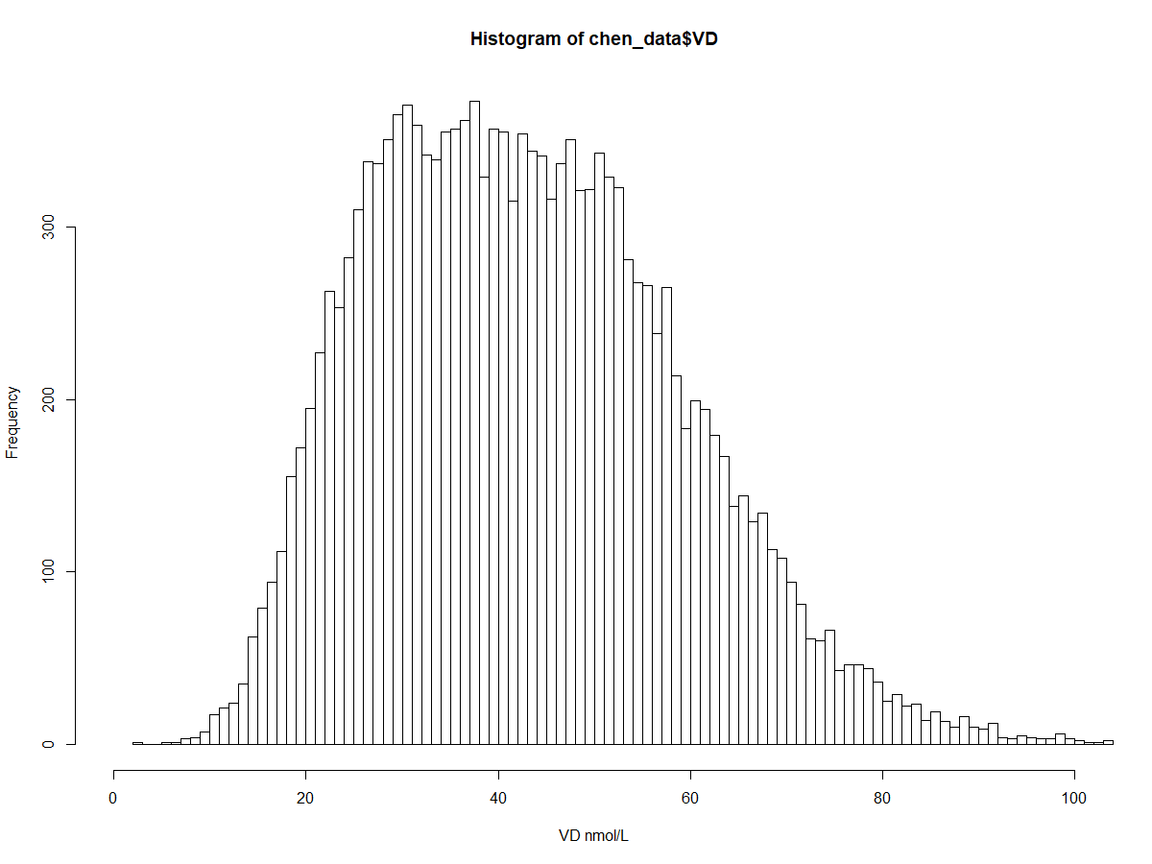
Frequency (n)
First-trimester vitamin D (nmol/L）
Supplemental Figure 1. Vitamin D concentration distribution in this general population database.

Slide 2
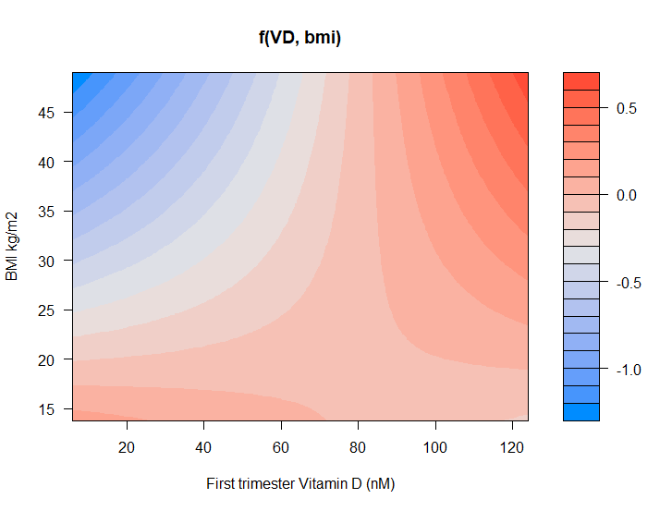
A
B
BMI (kg/m²)
BMI (kg/m²)
CRL (SD)
CRL (SD)
P for interaction=0.03
P for interaction =0.10
First-trimester vitamin D (nmol/L）
First-trimester vitamin D (nmol/L）
Supplemental Figure 2. Gender differences in early fetal growth response to maternal first-trimester vitamin D and prepregnancy BMI.
The figure displays a heat map for the association of first-trimester CRL (red color indicates higher CRL, blue color indicates lower CRL) according to the interaction of vitamin D-BMI in female fetuses (A) and male fetuses (B).
n=15,651, P values are based on the ordinal linear regression model by adding a product interaction term to the model (First trimester Vitamin D × BMI).

Slide 3
First-trimester vitamin D (nmol/L）
P<0.0001
BMI (kg/m²)
Supplemental Figure 3. The association of prepregnancy BMI with maternal vitamin D in early pregnancy.
Plot shows the linear regression models for prepregnancy BMI and first-trimester vitamin D as predicted mean (blue line) with confidence intervals, CI (gray area).
P values are based on the ordinal linear regression model with 3 knots of restricted cubic spline.
Analyses were adjusted for maternal age, BMI, parity, season of vitamin D testing, and fetal sex.

