Slide 1
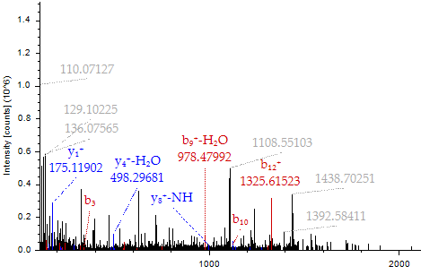
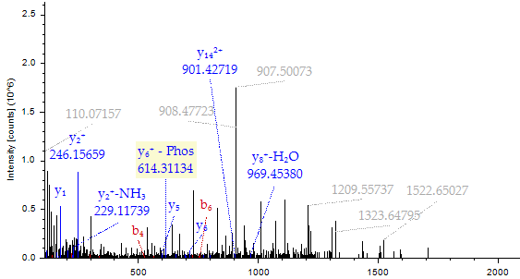
A
B
LEPVEA EEVEEANKGE NNCLLHPVS(p)L HGIEDPEREV LR
HC LLHPMNQHGA EDADREVLMW KFDS(p)ALAR
m/z
m/z
Figure S7. Nef detection in HAND samples by LC-MS/MS. A and B - MS/MS spectra of the Nef peptides in the HAND samples 6, 16 and 3, 7, 11, respectively. The colored peaks indicate matched MS/MS fragments. Blue and red colors indicate y and b ions, respectively. The spectrum gives positive identification of peptides LEPVEA EEVEEANKGE NNCLLHPVS(p)L HGIEDPEREV LR (panel A) and HC LLHPMNQHGA EDADREVLMW KFDS(p)ALAR (panel B) with the indicated phosphorylation sites. The peptides matched to the Nef proteins with accession numbers C8C8S7 and A0A0S3QM10, respectively.

Slide 2
Fig. S6
A
HC LLHPMNQHGA EDADREVLMW KFDS(p)ALAR
B
LEPVEA EEVEEANKGE NNCLLHPVS(p)L HGIEDPEREV LR

