Slide 1
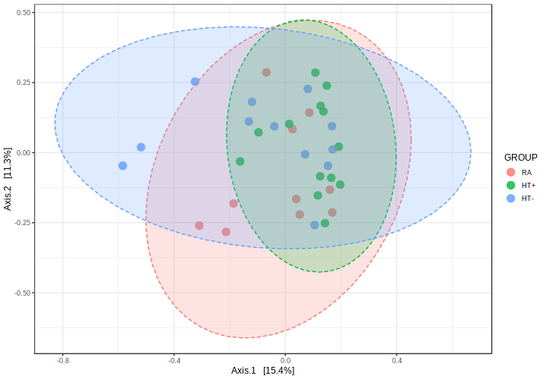
Supplemental Figure 1. Duodenal microbial beta diversity in reproductive age participants not taking exogenous hormones (RA group) (red), postmenopausal participants not taking HT (HT- group) (blue), and postmenopausal participants taking HT (HT+ group) (green). Ellipse represents 95% confidence interval in each group.

