Slide 1
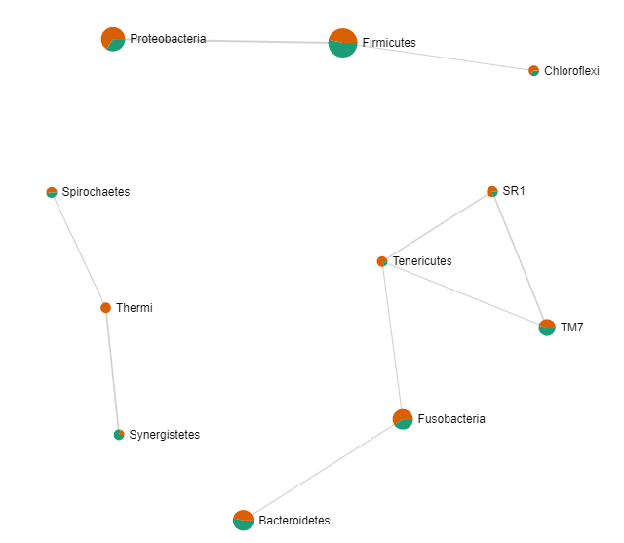
Supplemental Figure 2. Spearman correlations and relative abundances in the HT-group (orange) and the HT+ group (green) at the phylum level.

