Slide 1
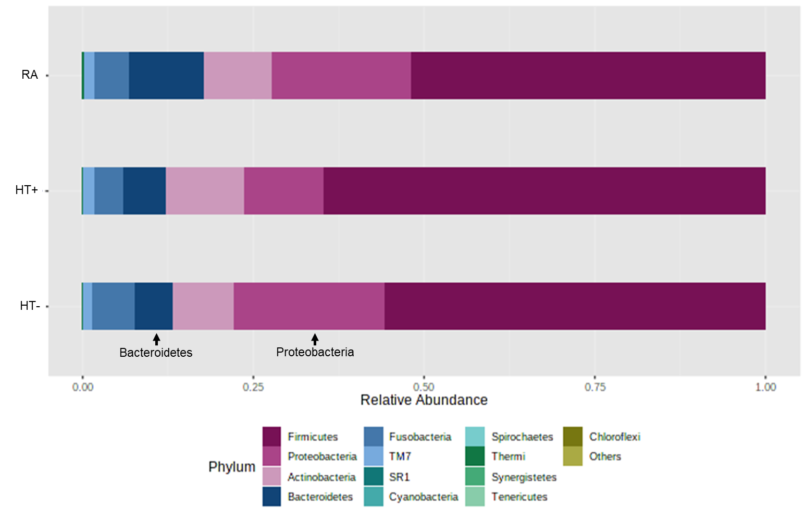
Supplemental Figure 3. Relative abundance of different phyla in the duodenal microbiomes of the RA group, the HT- group, and the HT+ group.

