Slide 1
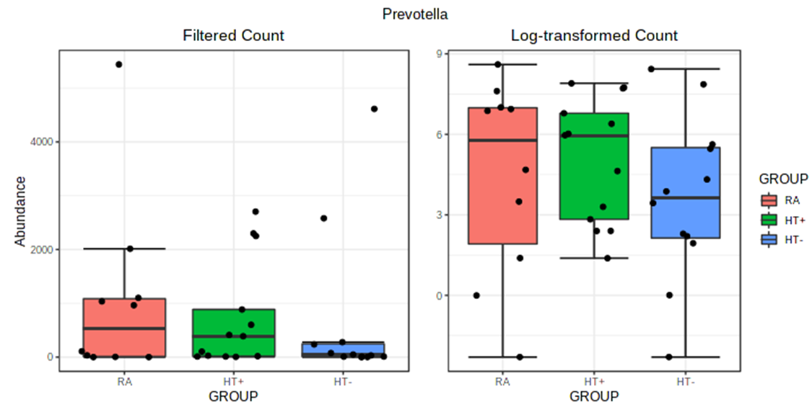
Supplemental Figure 4. Actual abundance and log-transformed (relative) abundance of the genus Prevotella in the duodenal microbiome of the RA group, the HT- group, and the HT+ group.

