Slide 1
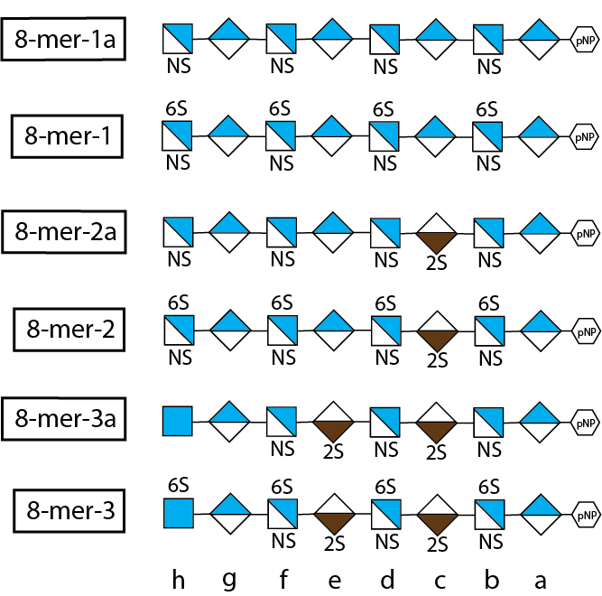
A.
B.
Suppl. Fig. S1. Determination of the reactivity of different 8-mers to 3-OST-5 modification. A) Six octasaccharides were chemoenzymatically synthesized, which varied in 6-O-sulfation and Ido2A content. B) Radioactivity analysis was used to assess the activity of 3-OST-5 toward substrates varying in sulfation pattern. Results show the enzyme requires 6-O-sulfation to act on a substrate.

Slide 2
A.
8-mer-1a, MW = 1808.46
B.
C.
451.26
[M-4H]⁴⁻
601.72
[M-3H]³⁻
Suppl. Fig S2. HPLC and ESI-MS analysis of 8-mer-1a. A) 8-mer-1a structure B) Anion exchange HPLC chromatogram of 8-mer-1a. C) ESI-MS spectrum of 8-mer-1a. The compound was observed in its quadruple and triple charged states. The measured molecular weight of 8-mer-1a was 1808.16, which is very close to the calculated value (1808.46). Additional peaks are the result of sodium adducts.

Slide 3
A.
8-mer-1, MW = 2128.69
B.
C.
424.66
[M-5H]⁵⁻
353.80
[M-6H]⁶⁻
Suppl. Fig S3. HPLC and ESI-MS analysis of 8-mer-1. A) 8-mer-1 structure B) Anion exchange HPLC chromatogram of 8-mer-1. C) ESI-MS spectrum of 8-mer-1. The compound was observed in its quintuple and sextuple charged states. The measured molecular weight of 8-mer-1 was 2128.8, which is very close to the calculated value (2128.69). Additional peaks are the result of sodium adducts.

Slide 4
A.
8-mer-2a, MW = 1888.52
B.
C.
471.03
[M-4H]⁴⁻
635.84
[M-4H+Na]³⁻
Suppl Fig S4. HPLC and ESI-MS analysis of 8-mer-2a. A) 8-mer-2a structure B) Anion exchange HPLC chromatogram of 8-mer-2a. C) ESI-MS spectrum of 8-mer-2a. The compound was observed in its quadruple and triply charged states. The measured molecular weight of 8-mer-2a was 1888.12, which is very close to the calculated value (1888.52). Additional peaks are the result of sodium adducts.

Slide 5
A.
8-mer-2, MW = 2208.75
B.
C.
440.72
[M-5H]⁵⁻
550.72
[M-4H]⁴⁻
Suppl Fig S5. HPLC and ESI-MS analysis of 8-mer-2. A) 8-mer-2 structure B) Anion exchange HPLC chromatogram of 8-mer-2. C) ESI-MS spectrum of 8-mer-2. The compound was observed in its quadruple and triply charged states. The measured molecular weight of 8-mer-2 was 2208.6, which is very close to the calculated value (2208.75). Additional peaks are the result of sodium adducts.

Slide 6
A.
8-mer-3a, MW = 1930.56
B.
C.
481.77
[M-4H]⁴⁻
642.41
[M-3H]³⁻
Suppl Fig S6. HPLC and ESI-MS analysis of 8-mer-3a. A) 8-mer-3a structure B) Anion exchange HPLC chromatogram of 8-mer-3a. C) ESI-MS spectrum of 8-mer-3a. The compound was observed in its quadruple and triply charged states. The measured molecular weight of 8-mer-3a was 1930.23, which is very close to the calculated value (1930.56). Additional peaks are the result of sodium adducts.

Slide 7
A.
8-mer-3, MW = 2250.78
B.
C.
374.28
[M-6H]⁶⁻
449.16
[M-5H]⁵⁻
Suppl Fig S7. HPLC and ESI-MS analysis of 8-mer-3. A) 8-mer-3 structure B) Anion exchange HPLC chromatogram of 8-mer-3. C) ESI-MS spectrum of 8-mer-3. The compound was observed in its quintuple and sextuple charged states. The measured molecular weight of 8-mer-3 was 2250.8, which is very close to the calculated value (2250.78). Additional peaks are the result of sodium adducts.

Slide 8
A.
¹³C-labeled 8-mer-1, MW = 2140.60
= ¹³C
B.
C.
427.05
[M-5H]⁵⁻
533.95
[M-4H]⁴⁻
Suppl Fig S8. HPLC and ESI-MS analysis of ¹³C-labeled 8-mer-1. A) ¹³C-labeled 8-mer-1 structure B) Anion exchange HPLC chromatogram of ¹³C-labeled 8-mer-1. C) ESI-MS spectrum of ¹³C-labeled 8-mer-1. The compound was observed in its quadruple and quintuple charged states. The measured molecular weight of ¹³C-labeled 8-mer-1 was 2140.25, which is very close to the calculated value (2140.60). Additional peaks are the result of sodium adducts.

Slide 9
A.
¹³C-labeled 8-mer-4, MW = 2300.71
= ¹³C
B.
C.
459.04
[M-5H]⁵⁻
Suppl Fig S9. HPLC and ESI-MS analysis of ¹³C-labeled 8-mer-4. A) ¹³C-labeled 8-mer-4 structure B) Anion exchange HPLC chromatogram of ¹³C-labeled 8-mer-4. C) ESI-MS spectrum of ¹³C-labeled 8-mer-4. The compound was observed in its quintuple charged state. The measured molecular weight of ¹³C-labeled 8-mer-4 was 2300.2, which is very close to the calculated value (2300.71). Additional peaks are the result of sodium adducts.

Slide 10
A.
8-mer-4, MW = 2250.78
458.00
B.
C.
[M-7H+2Na]⁵⁻
374.16
[M-6H]⁶⁻
Suppl Fig S10. HPLC and ESI-MS analysis of 8-mer-4. A) 8-mer-4 structure B) Anion exchange HPLC chromatogram of 8-mer-4. C) ESI-MS spectrum of 8-mer-4. The compound was observed in its quintuple and sextuple charged states. The measured molecular weight of 8-mer-4 was 2250.96, which is very close to the calculated value (2250.78). Additional peaks are the result of sodium adducts.

Slide 11
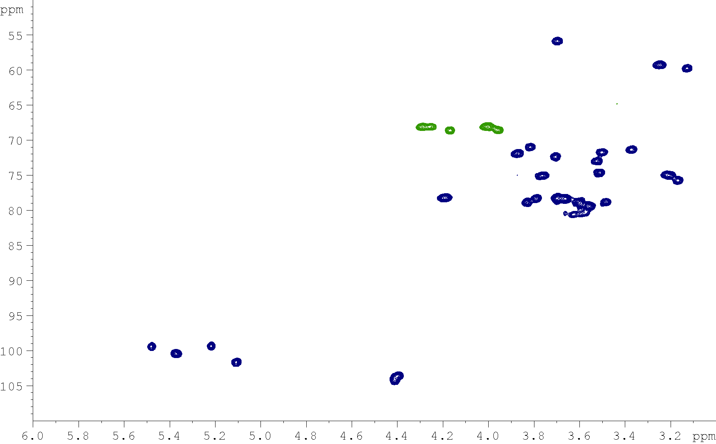
8-mer-4
d2
b2
h
f2
g
f
e
d
d6’
f6’
d6’’
f6’’
c
b6’
b6’’
b5
b3
b
a
d5
f5
d4
d3
f4
b4
f3
a4
b1
d1
f1
Suppl Fig S11. Determination the structure of 8-mer-4 by HSQC. Difference in proton and carbon chemical shifts of b3 and d3/f3 confirmed that both residue d and f carry 3-O-sulfation.
Notes:
Red assignments: reducing side GlcNS
Blue assignments: middle GlcNS
Black assignment: anomeric carbon of far reducing side GlcA
This shows the distinct shifts between d/f3 and b3 as well as d/f4 and b4, confirming that both d and f are 3-O-sulfated while b is not.
Get assignment table from Eduardo

Slide 12

h
g
f
e
d
c
b
a
8-mer-4
J₄ Long Range
b1-a4
a4
b1
Suppl Fig S12. Determination of the structure of 8-mer-4 by HMBC. The long-range correlation between the carbon-4 proton of saccharide a and the anomeric proton of saccharide b allowed to confirm that residue b does not carry 3-O-sulfation.
Notes:
Red assignments: reducing side GlcNS
Blue assignments: middle GlcNS
Black assignment: anomeric carbon of far reducing side GlcA
This shows the connection between b1 and the anomeric carbon of the reducing end glucosamine, verifying b1 as the reducing end GlcNS

Slide 13
A.
8-mer-5, MW = 2288.80
B.
C.
456.58
[M-5H]⁵⁻
380.45
[M-6H]⁶⁻
Suppl Fig S13. HPLC and ESI-MS analysis of 8-mer-5. A) 8-mer-5 structure B) Anion exchange HPLC chromatogram of 8-mer-5. C) ESI-MS spectrum of 8-mer-5. The compound was observed in its quintuple and sextuple charged states. The measured molecular weight of 8-mer-5 was 2288.7, which is very close to the calculated value (2288.80). Additional peaks are the result of sodium adducts.

Slide 14
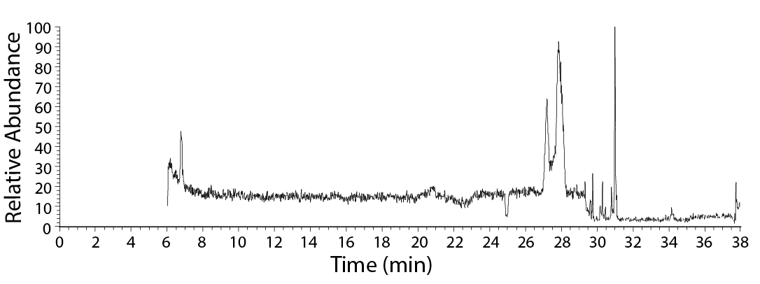
A
B
C
8-mer-5, MW = 2288.80
Disaccharide Analysis for structure verification
LC-MS/MS
A
MW: 495.93
[B-H]¹⁻
MW: 456.94
[A-2H]²⁻
MW: 916.74
MW: 435.96
[C-2H]²⁻
B
MW: 497.40
C
MW: 874.67
Suppl Fig S14. Disaccharide analysis for structure verification of 8-mer-5. Following purification, 8-mer-5 was digested by heparin lyase enzymes and subjected to LC-MS/MS analysis. Three fragments were detected which span the whole length of the oligosaccharide. In particular, detection of fragment A confirmed the site of modification as the glucosamine on the non-reducing side.

Slide 15
A.
8-mer-6, MW = 2368.86
393.75
[M-6H]⁶⁻
B.
C.
472.61
[M-5H]⁵⁻
Suppl Fig S15. HPLC and ESI-MS analysis of 8-mer-6. A) 8-mer-6 structure B) Anion exchange HPLC chromatogram of 8-mer-6. C) ESI-MS spectrum of 8-mer-6. The compound was observed in its quintuple and sextuple charged states. The measured molecular weight of 8-mer-6 was 2368.5, which is very close to the calculated value (2368.86). Additional peaks are the result of sodium adducts.

Slide 16
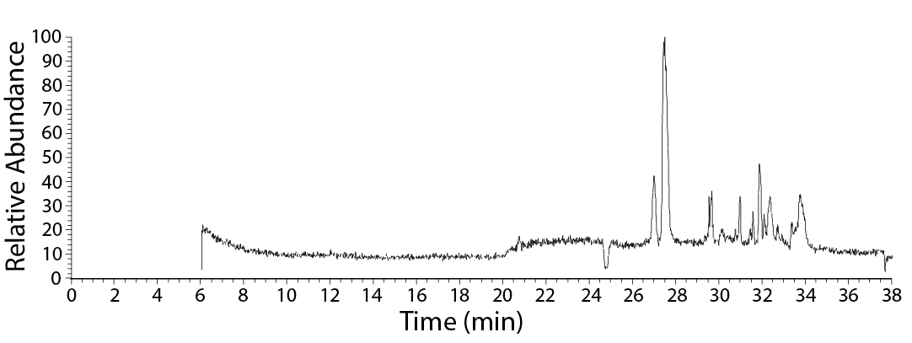
A
B
8-mer-6, MW = 2368.86
Disaccharide Analysis for structure verification
A
B
MW: 1494.19
MW: 874.67
LC-MS/MS
MW: 436.08
[B-2H]²⁻
MW: 762.81
[A-2H+NH₃]¹⁻
Suppl Fig S16. Disaccharide analysis for structure verification of 8-mer-6. Following purification, 8-mer-6 was digested by heparin lyase enzymes and subjected to LC-MS/MS analysis. Two fragments were detected which span the whole length of the oligosaccharide. In particular, detection of fragment A confirmed the two sites of modification to be the two central glucosamines.

Slide 17
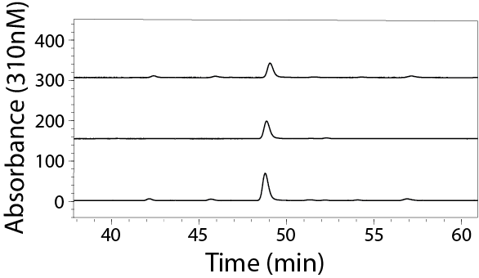
8-mer-7, MW = 2330.84
Co-elution for structure verification
1: 8-mer-3 + 3-OST-5 reaction
2: Purified 8-mer-7 standard
3: Mix of 1 and 2
Suppl Fig S17. Co-elution analysis for structure verification of 8-mer-7. 8-mer-3 was incubated with 3-OST-5 and the resulting reaction was analyzed by HPLC. A structurally defined 8-mer-7 standard was also analyzed by HPLC and appeared to have the same retention time as the primary product in the reaction. Mixing of the two samples and subsequent co-elution verified the primary product of this reaction to be 8-mer-7.

Slide 18
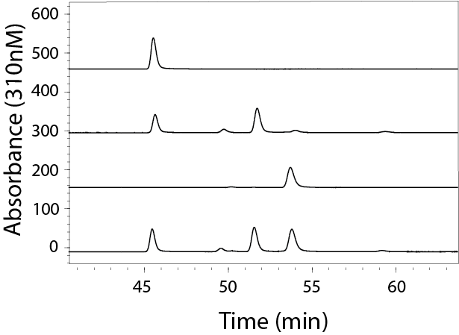
8-mer-8, MW = 2412.87
8-mer-8*, MW = 2448.92
*8-mers in this assay carried N-sulfation on the non-reducing end glucosamine instead of N-acetylation
Co-elution for structure verification
8-mer-3*
1: Purified 8-mer-3* standard
8-mer-7*
8-mer-8*
8-mer-9*
2: 8-mer-3* + 3-OST-5 reaction
3: Purified 8-mer-8* standard
4: Mix of 2 and 3
Suppl Fig S18. Co-elution analysis for structure verification of 8-mer-8. 8-mer-3*, a version of 8-mer-3 carrying an additional N-sulfation, was incubated with 3-OST-5 and the resulting reaction was analyzed by HPLC. A structurally defined 8-mer-8* standard was also analyzed by HPLC and appeared to have the same retention time as the product of interest. Mixing of the two samples and subsequent co-elution verified the product of interest to be 8-mer-8*, carrying both 3-O-sulfations on the central glucosamines.

Slide 19
A.
8-mer-9, MW = 2410.90
B.
C.
401.02
[M-6H]⁶⁻
481.04
[M-5H]⁵⁻
Suppl Fig S19. HPLC and ESI-MS analysis of 8-mer-9. A) 8-mer-9 structure B) Anion exchange HPLC chromatogram of 8-mer-9. C) ESI-MS spectrum of 8-mer-9. The compound was observed in its quintuple and sextuple charged states. The measured molecular weight of 8-mer-9 was 2410.2, which is very close to the calculated value (2410.90). Additional peaks are the result of sodium adducts.

Slide 20
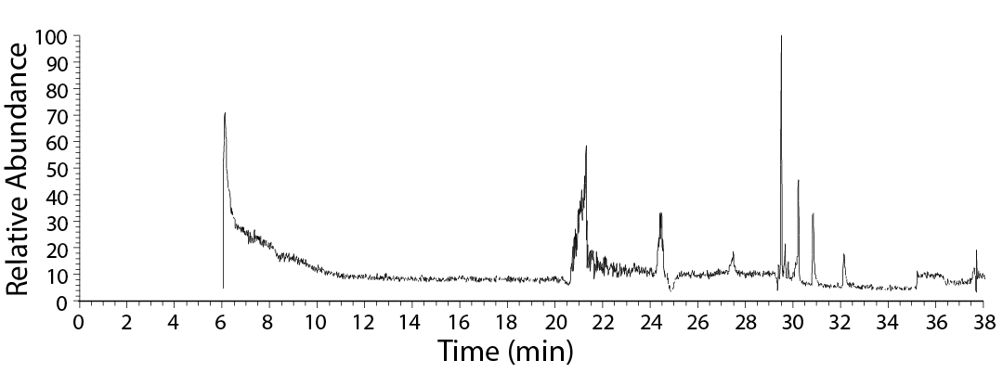
A
B
C
8-mer-9, MW = 2410.90
Disaccharide Analysis for structure verification
LC-MS/MS
A
MW: 476.05
[C-2H]²⁻
MW: 880.69
MW: 438.07
[A-2H]²⁻
B
MW: 764.35
[B-2H]²⁻
MW: 1532.18
C
MW: 954.73
Suppl Fig S20. Disaccharide analysis for structure verification of 8-mer-9. Following purification, 8-mer-9 was digested by heparin lyase enzymes and subjected to LC-MS/MS analysis. Three fragments were detected which span the whole length of the oligosaccharide. In particular, detection of fragments A and C confirmed the two sites of modification as the non-reducing end glucosamine and the terminal, reducing end glucosamine, resulting in a “gapped” 3-O-sulfated structure.

Slide 21
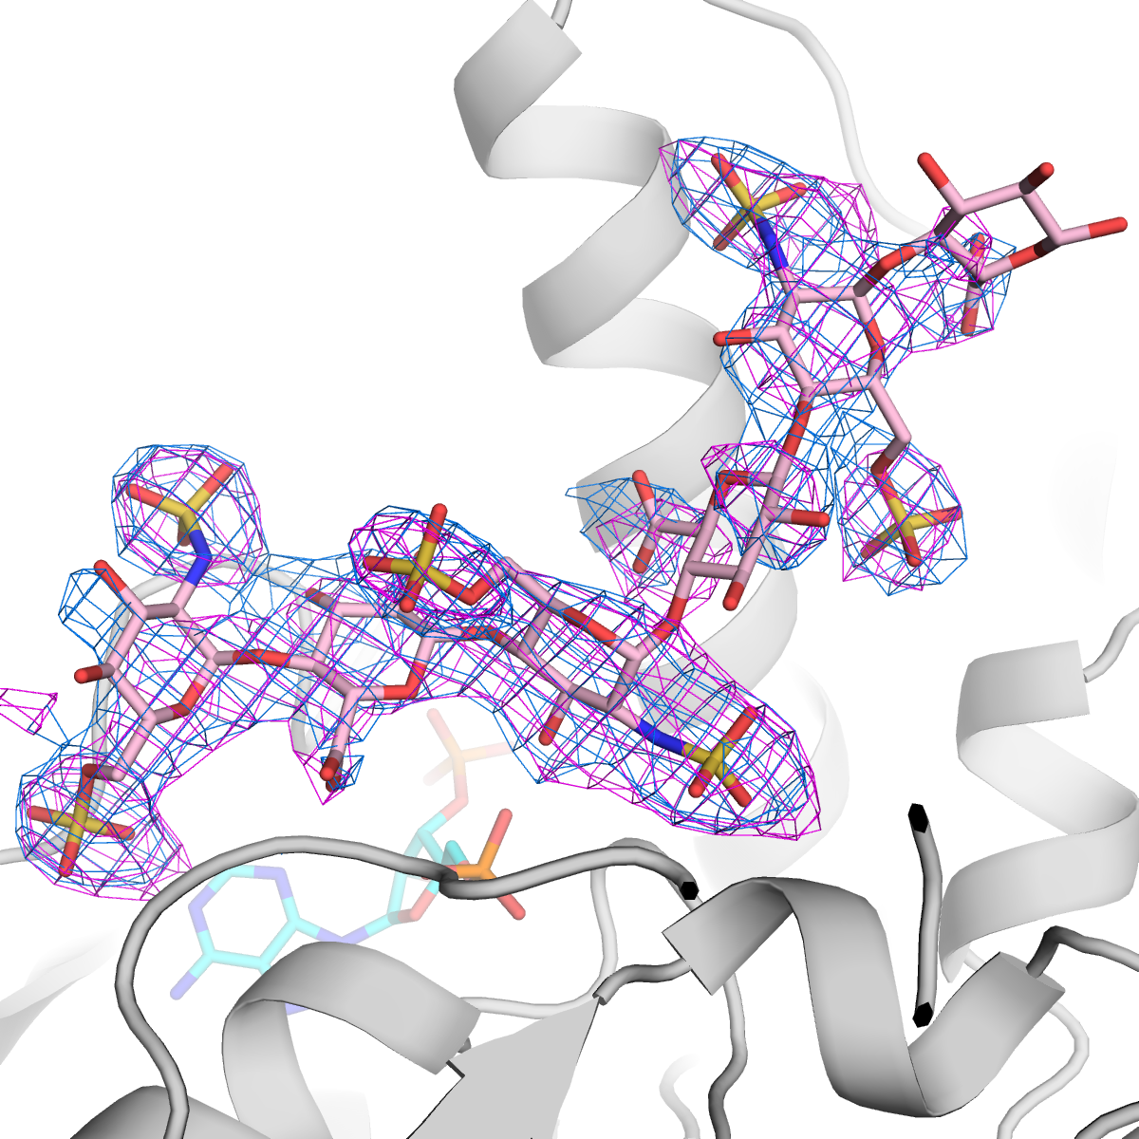
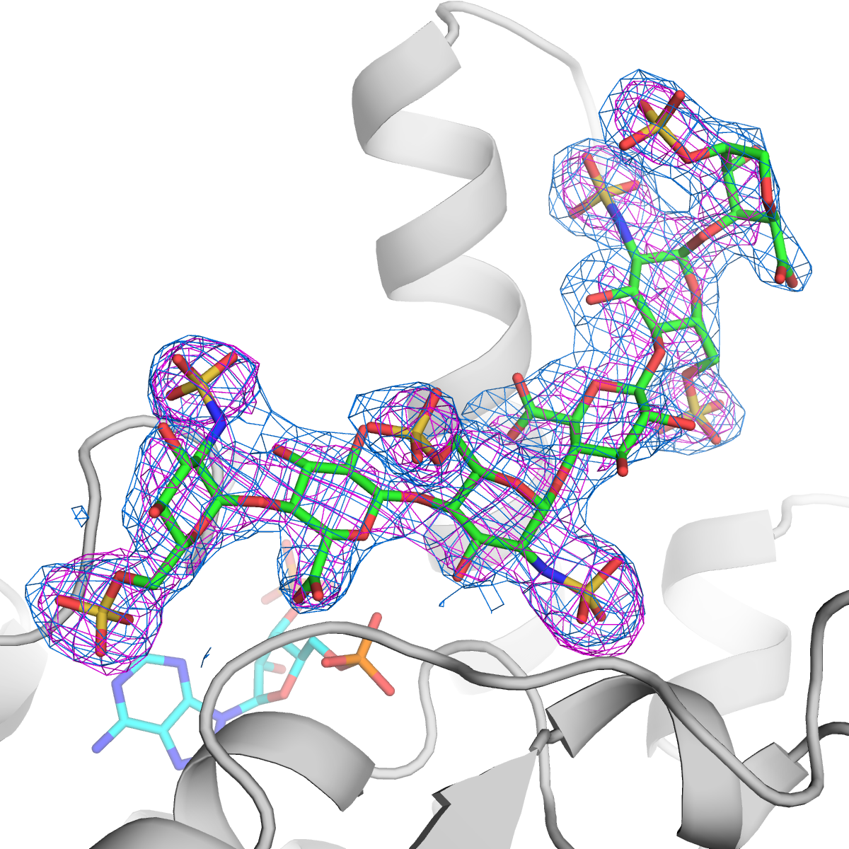
A.
B.
Suppl Fig S21. Electron density for the 3-OST-5 substrates A) Electron density for the fo-fc simulated annealing omit map (magenta, contoured at 2.25σ) and 2fo-fc map (marine blue, contoured at 1σ) for substrate 8-mer-1 (light pink). B) Electron density for the fo-fc simulated annealing omit map (magenta, contoured at 3σ and 2fo-fc map (marine blue, contoured at 1σ) for the 8-mer-2 (green) bound. PAP in both panels is shown in cyan and 3-OST-5 in grey.

Slide 22
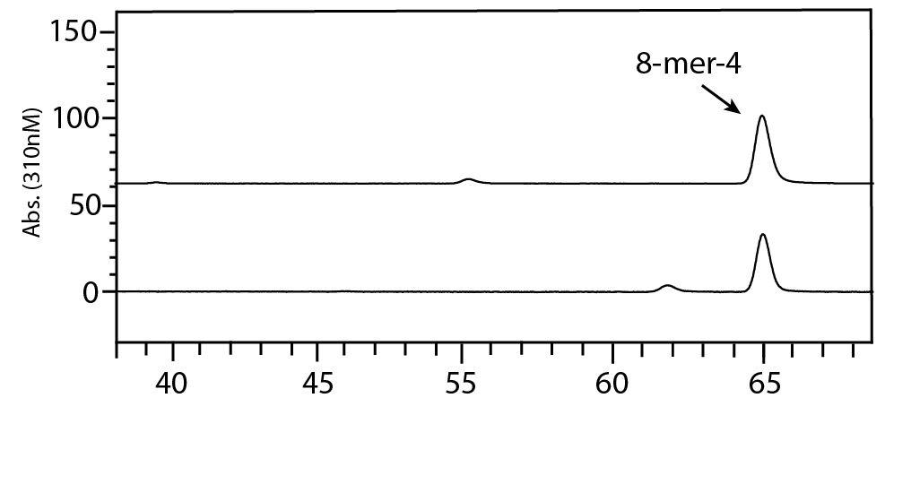
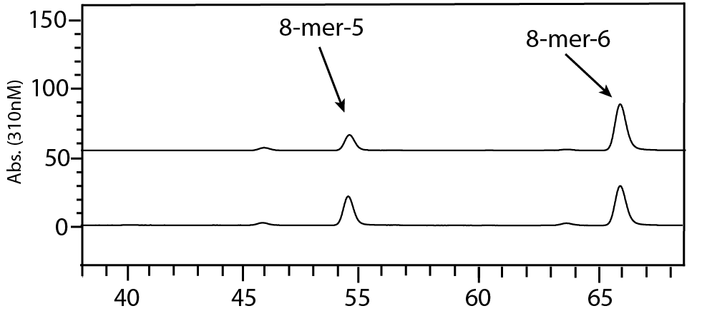
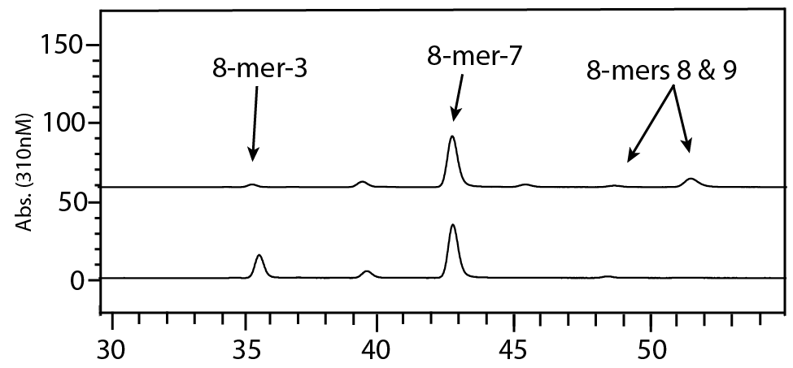



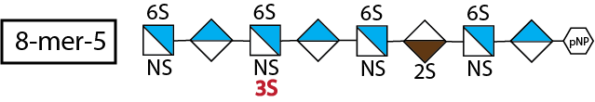
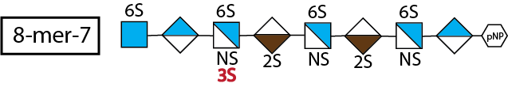
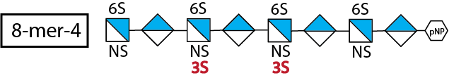
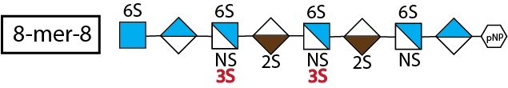
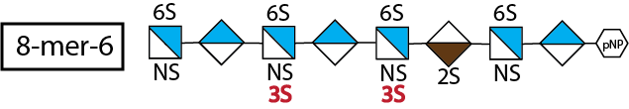
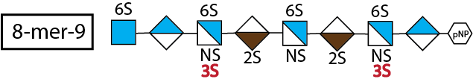
8-mer-1
8-mer-2
8-mer-3
3-OST-5
WT
3-OST-5
A306H
Retention Time (min)
Retention Time (min)
Retention Time (min)
Suppl Fig S22. Mutation of 3-OST-5 A306 alters di-3-O-sulfation ability in the presence of IdoA2S. 3-OST-5 WT and the gate mutant A306H (800nM) were screened against 8-mers 1-3 to identify differences in reaction profiles. Mutation at this position did not affect the enzyme’s ability to generate 8-mer-4 but did cause a decrease in conversion to both 8-mer-6 and 8-mers 8 and 9.

Slide 23
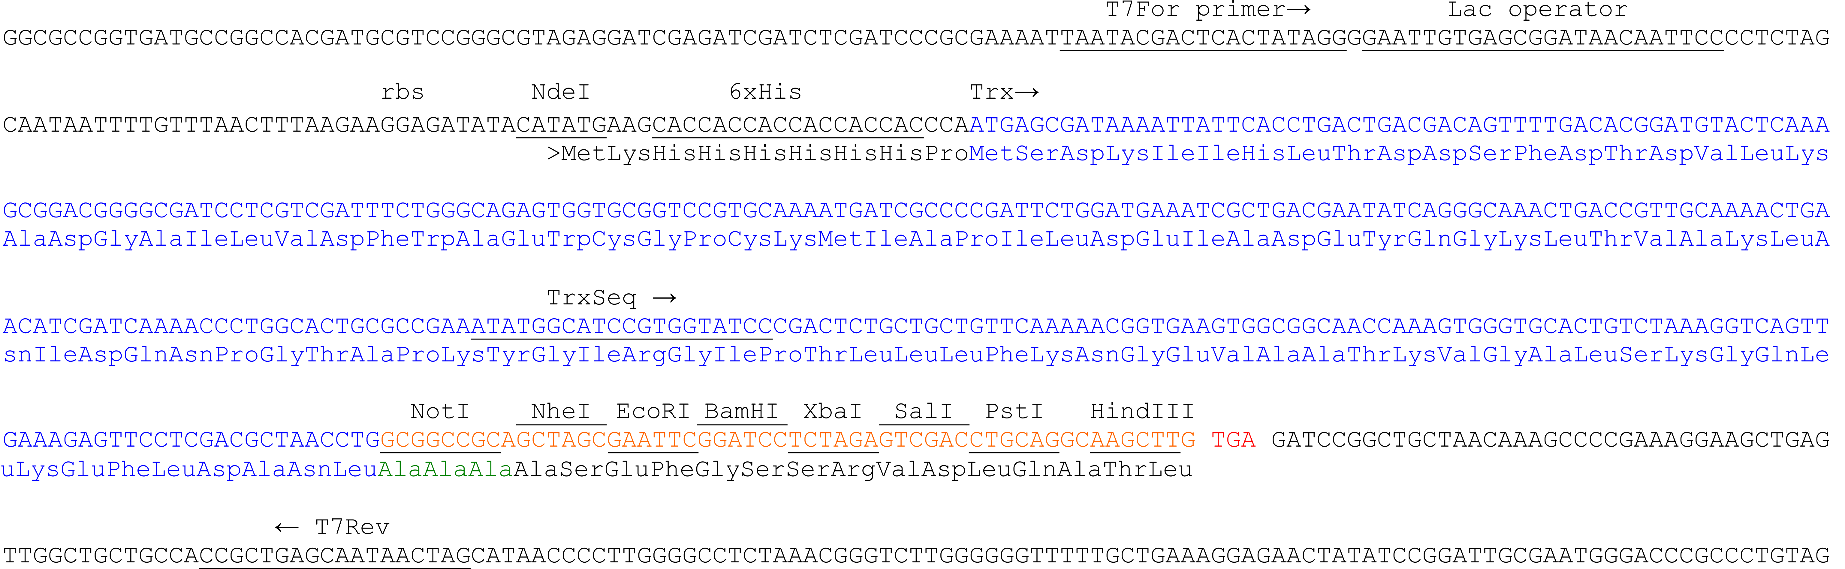
Suppl Fig S23. Multicloning site for pET32bX fixed-arm thioredoxin fusion expression vector. The pET32(b) vector backbone (black) was used to generate the pET32bX fixed-arm fusion vector. A 6xHis tag was inserted immediately upstream of the thioredoxin (Trx) coding sequence (blue). The original 6xHis tag, S-tag, thrombin cleavage site, enterokinase cleavage site, and the multicloning site (MCS) were removed from the vector and replaced with the MCS from the pMALX fixed-arm MBP vector (orange)^{4.}. A stop codon (red) was added to the 3ʹ-end of the MCS. Optimally, protein gene targets of interest are cloned into the vector using the NotI site on the 5ʹ-end, fusing the target to the C-terminus of Trx via a linker comprised of three alanine residues (green). Clones should be sequenced using the Trx-specific TrxSeq upstream primer and the vector-specific T7Rev downstream primer.

