Slide 1
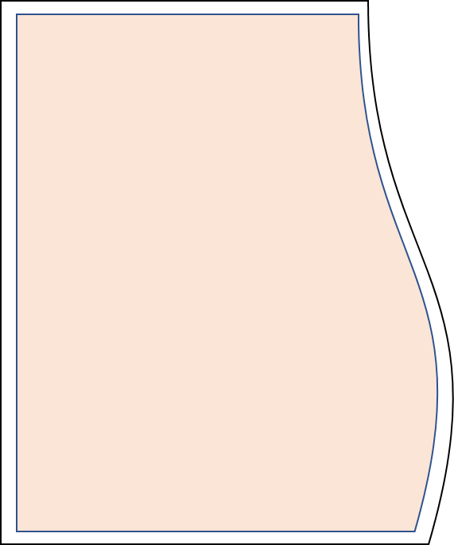
supplementary material
OCLN
OCLN
epithelial cells
CD4+T Cell
CD4+T
Cell
Occludin
OCLN
Activated by PMA and A23187
OCLN
epithelial cells
CD8+T Cell
OCLN
Actin filament
OCLN
CD8+T Cell
ZO-1
Claudins
Xenopus embryo
endothelial cells
endothelial cells
OCLN
OCLN
Exogenous
Chicken Occludin
ZO-2/3
keratinocyte
keratinocyte
OCLN
OCLN
intestinal epithelial cells
RhoGEFs
Jam
γδ T Cell
In tight junction
In non-tight junction

