Slide 1
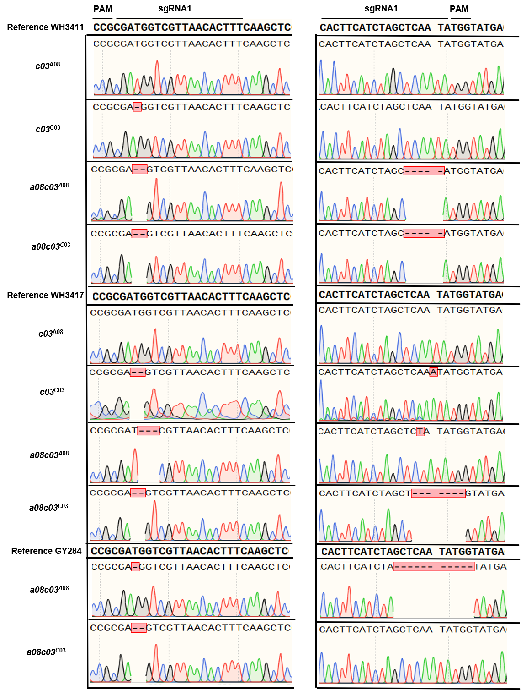
FIGURE S1 Sequencing analysis of each mutant in A08 and C03 copies respectively.

Slide 2
FIGURE S2 Amino acid sequence alignment of WT and BnaFAE1 mutants. Red font indicates amino acids that differ from the reference genome. Red "*" means terminating amino acid.

