Slide 1




Assessment of different quantification metrics of [¹⁸F]-NaF PET/CT images of patients with abdominal aortic aneurysm
Journal of Nuclear Cardiology | Official Journal of the American Society of Nuclear Cardiology
Akerele M.I.¹, Mushari N.A.¹, Forsythe R.O.^{2,3}, Syed M.^{2,3}, Karakatsanis N.A.⁴, Newby D. E.³, Dweck M.R.^{2,3}, Tsoumpas C.¹
Biomedical Imaging Science Department, University of Leeds, UK
2. British Heart Foundation Centre for Cardiovascular Science, University of Edinburgh, UK
3. Edinburgh Imaging Facility, University of Edinburgh, UK
4. Department of Radiology, Weil Cornell Medical College of Cornell University, NY, USA
Copyright American Society of Nuclear Cardiology

Slide 2
Spill in Effects in Abdominal Aortic Aneurysm (AAA)
Journal of Nuclear Cardiology | Official Journal of the American Society of Nuclear Cardiology
1- [¹⁸F]-NaF is being explored as a marker for micro-calcifications in AAA.
2- The high [¹⁸F]-NaF uptake in the bone affects quantification in the adjacent aneurysm (spill in effects)
3- spill-in effect is prominent in SUV_{max} which is mostly used in clinical settings.
4- Efficient quantification and patient management may benefit from exploring alternative quantification metrics.
Copyright American Society of Nuclear Cardiology

Slide 3
METHODS
Journal of Nuclear Cardiology | Official Journal of the American Society of Nuclear Cardiology
Study type: cohort
Study subjects: Seventy-two (72) patients older than 50 years and diagnosed with asymptomatic AAA (larger than 40 mm anteroposterior diameter)
Study endpoints:
  AAA expansion and rates of repair or rupture
Copyright American Society of Nuclear Cardiology

Slide 4
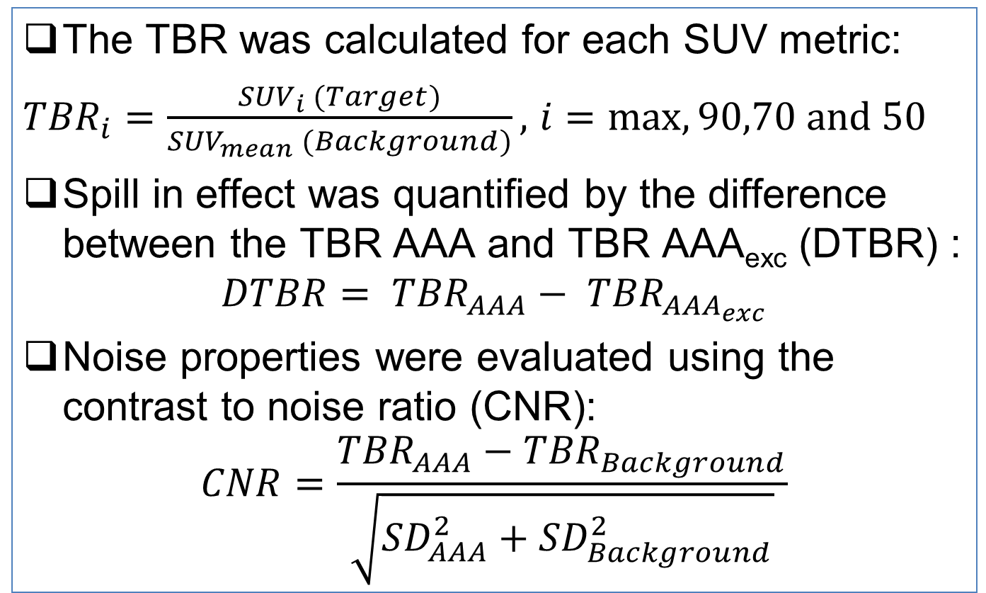
Quantification Metrics
Journal of Nuclear Cardiology | Official Journal of the American Society of Nuclear Cardiology
The TBR was calculated for each SUV metric:
${TBR}_{i}=\frac{{SUV}_{i} (Target)}{{SUV}_{mean} (Background)},$ $i=max, 90,70 and 50$
Spill in effect was quantified by the difference between the TBR AAA and TBR AAA_{exc} (DTBR) :
$$DTBR= {TBR}_{AAA}− {TBR}_{{AAA}_{exc}}$$
Noise properties were evaluated using the contrast to noise ratio (CNR):
$$CNR=\frac{{TBR}_{AAA}−{TBR}_{Background}}{\sqrt{{SD}_{AAA}^{2}+{SD}_{Background}^{2}}}$$
Copyright American Society of Nuclear Cardiology

Slide 5
RESULTS
Journal of Nuclear Cardiology | Official Journal of the American Society of Nuclear Cardiology
Comparison of the TBR metric for PSF and PSF+BC at (a) 10 iterations, and (b) 3 iterations. Spill in effect is more pronounced at 3 iterations than at 10 iterations (shown by variations above the black reference line). TBR₅₀ is closest to the reference line
Copyright American Society of Nuclear Cardiology

Slide 6
RESULTS
Journal of Nuclear Cardiology | Official Journal of the American Society of Nuclear Cardiology
This shows the difference in TBR values for AAA and AAA_{exc} (DTBR) against CNR for all the TBR metrics as iteration increases. A robust TBR metric will show low DTBR and high CNR. TBR₅₀ is the most robust metrics to reduce the spill in quantification error as it gave the best trade-off between DTBR and CNR.
Copyright American Society of Nuclear Cardiology

Slide 7
CONCLUSIONS
Journal of Nuclear Cardiology | Official Journal of the American Society of Nuclear Cardiology
1- The spill in quantification error as related to PET/CT imaging can be reduced by using the background correction method (PSF+BC), or by using the thresholding metrics in conventional method (PSF).
2- The spill in effect can also be reduced by increasing the number of iterations, but this comes at the expense of reduced CNR.
3- Using the thresholding metrics, TBR₅₀ is the most robust metrics as it gave the best trade-off between spill in effect and CNR.
Copyright American Society of Nuclear Cardiology

