Slide 1




Value of SiPM PET in myocardial perfusion imaging using Rubidium-82
Journal of Nuclear Cardiology | Official Journal of the American Society of Nuclear Cardiology
S.S. Koenders, MSc ^{1,4}, J.A. van Dalen, PhD², P.L. Jager, MD, PhD¹, S. Knollema, MD, MSc, PhD¹, JR Timmer, MD, PhD³, M. Mouden, MD, PhD³, C.H. Slump, PhD⁴, J.D. van Dijk, MSc, PhD¹
Isala Hospital, Department of ¹Nuclear Medicine, ²Medical Physics, ³Cardiology, Zwolle, the Netherlands and ⁴Technical Medicine Center, University of Twente, Enschede, the Netherlands
Copyright American Society of Nuclear Cardiology

Slide 2
BACKGROUND
Journal of Nuclear Cardiology | Official Journal of the American Society of Nuclear Cardiology
New PET systems using silicon photomultipliers with digital readout (SiPM PET) have an improved temporal and spatial resolution compared to PET scanners using conventional photomultiplier tubes (PMT PET).
The effect on image quality and visibility of perfusion defects in myocardial perfusion imaging (MPI) is unknown.
Our aim was to determine the added value in Rubidium-82 MPI of an SiPM PET scanner in comparison to a PMT PET scanner.
Copyright American Society of Nuclear Cardiology

Slide 3
METHODS
Journal of Nuclear Cardiology | Official Journal of the American Society of Nuclear Cardiology
Study type: prospective study.
Study subjects: 30 patients who underwent dynamic rest and regadenoson induced stress MPI using Rb-82 PET on the D690 PMT PET (GE Healthcare) and within three weeks on the Vereos SiPM PET (Philips Healthcare).
Primary end points:
  Effect of SiPM PET on image quality, defect interpretation, interpreter’s confidence, rest and stress MBF and MFR
  Test-retest precision
Copyright American Society of Nuclear Cardiology

Slide 4
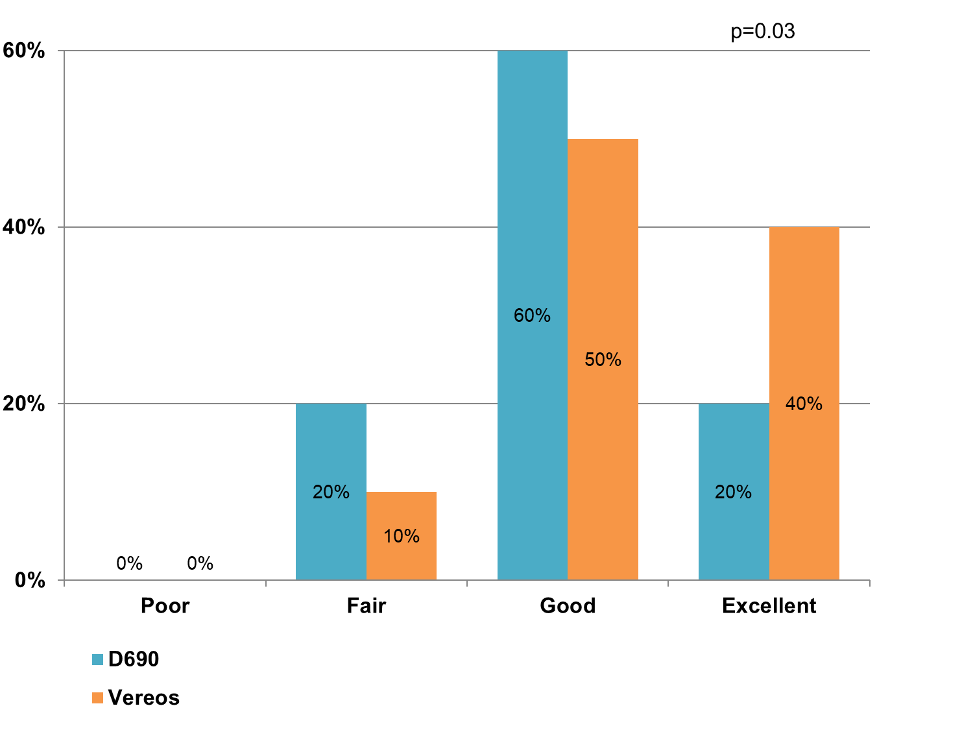
RESULTS
Journal of Nuclear Cardiology | Official Journal of the American Society of Nuclear Cardiology
Barplot showing the percentage of images scored as poor, fair, good and excellent for the D690 and Vereos PET system. Image quality improved for the Vereos (p=0.03)
Copyright American Society of Nuclear Cardiology

Slide 5
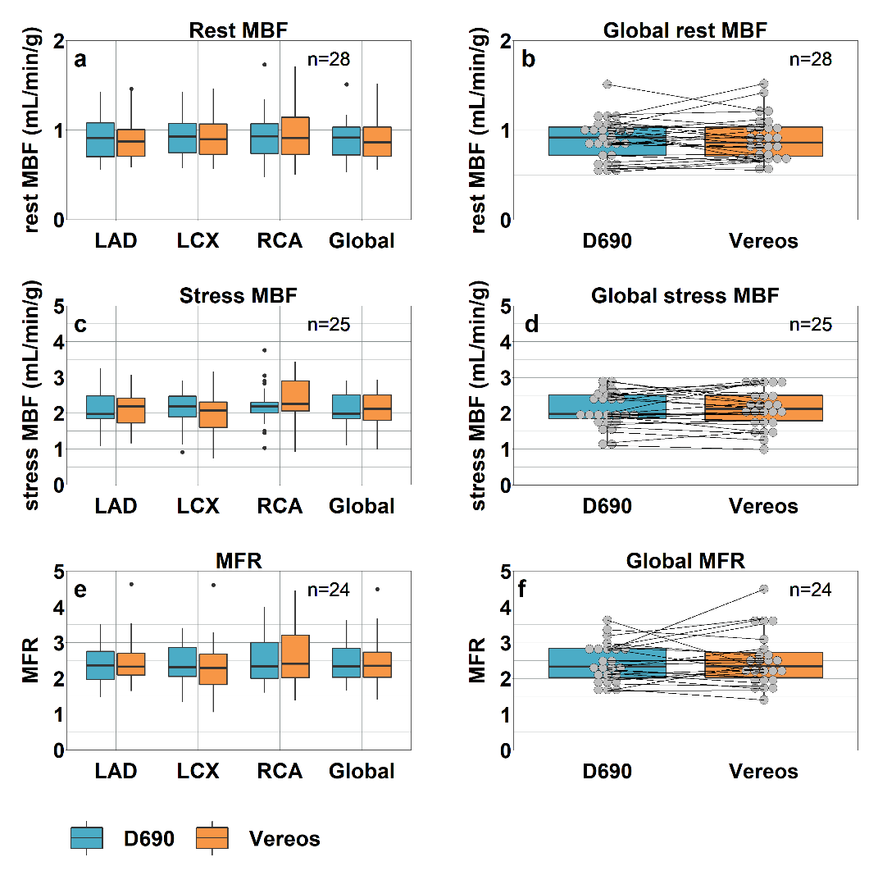
RESULTS
Journal of Nuclear Cardiology | Official Journal of the American Society of Nuclear Cardiology
Boxplots showing (a+b) comparable rest (n=28) and (c+d) stress (n=25) myocardial blood flows (MBFs) and (e+f) myocardial flow reserves (MFRs) (n=24) for the three vascular territories and for the whole myocardium (global) between the D690 and Vereos PET system. The individual global (b) rest MBF, (d) stress MBF and (f) MFR values are shown as well
Copyright American Society of Nuclear Cardiology

Slide 6
CONCLUSIONS
Journal of Nuclear Cardiology | Official Journal of the American Society of Nuclear Cardiology
PET using silicon photomultipliers with digital readout (SiPM) is a reliable technique for MPI using Rb-82.
SiPM PET provides an improved image quality.
SiPM results in similar interpreter’s confidence, defect interpretation and absolute blood flow measurements as compared to PET using conventional photomultiplier tubes.
Copyright American Society of Nuclear Cardiology

