Slide 1
Effusive–constrictive pericarditis after the second dose of BNT162b2 vaccine (Comirnaty): a case report
July 2021
EHJ-CR-D-21-00681

Slide 2
Introduction
Effusive-constrictive pericarditis (ECP) can rarely occur in COVID-19
We report a case of ECP after nucleoside modified RNA (nmRNA) BNT162b2 vaccine

Slide 3
Case Presentation
History and Examination Findings
59-year-old man with type 2 diabetes mellitus presents with chest pain and dyspnoea
Symptoms occurred 5 days after second dose of BNT162b2 vaccine
Pain was worsened by inbreathing and supine position
Heart sounds were muffled and pulsus paradoxus was detected

Slide 4
Case Presentation
Investigations
C reactive protein was elevated (120 mg/L; normal range between 0.3 to 10 mg/L); troponin T at 0h and 3h was within normal limits (< 15 ng/L)
Computed tomography pulmonary angiography was normal
Echocardiography and cardiac magnetic resonance (CMRI) showed ECP
Common acute viral infections, tuberculosis, asbestosis, autoimmune diseases were ruled out

Slide 5
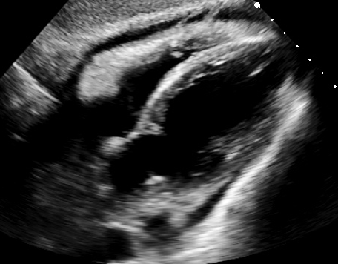
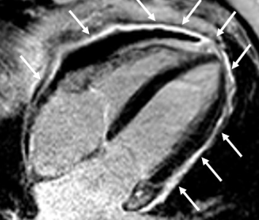
Case Presentation
Echocardiography: Subcostal view showing mild pericardial effusion with fibrinous stranding, suggestive for ECP
CMRI: Post-contrast image on four chamber view shows intense enhancement of the pericardium

Slide 6
Case Presentation
Management
Colchicine 0.5 mg BID and ibuprofen 600 mg TID were started
CRP was still mildly elevated at short term follow-up (18 mg/L)
Prednisone 25 mg OD was added on top of therapy
Symptoms improved, but close follow-up is warranted

Slide 7
Discussion
ECP is rare and potentially fatal (1)
COVID-19 can cause pericarditis (2)
Pericarditis is a rare adverse effect of nucleoside modified RNA COVID-19 vaccines (3)

Slide 8
Discussion
We report the first case of ECP after BNT162b2 vaccine
No other possible cause for ECP was identified
Pathophysiological mechanism of pericarditis after nmRNA COVID vaccines is still under research (4)
Correlation in this case is only presumptive

Slide 9
Learning Points
ECP in COVID-19 has been documented
Pericarditis is a possible adverse reaction to nmRNA vaccines
ECP might be induced by nmRNA vaccines as well

Slide 10
References
Miranda WR, Oh JK. Effusive-Constrictive Pericarditis. Cardiol Clin. 2017 Nov;35(4):551–8.
Su Y-B, Kuo M-J, Lin T-Y, Chien C-S, Yang Y-P, Chou S-J, et al. Cardiovascular manifestation and treatment in COVID-19. J Chin Med Assoc. 2020 Aug;83(8):704–9
Diaz GA, Parsons GT, Gering SK, Meier AR, Hutchinson IV, Robicsek A. Myocarditis and Pericarditis After Vaccination for COVID-19. JAMA. 2021 Sep 28;326(12):1210–2.
Hajjo R, Sabbah DA, Bardaweel SK, Tropsha A. Shedding the Light on Post-Vaccine Myocarditis and Pericarditis in COVID-19 and Non-COVID-19 Vaccine Recipients. Vaccines (Basel). 2021 Oct 15;9(10):1186.

