Slide 1
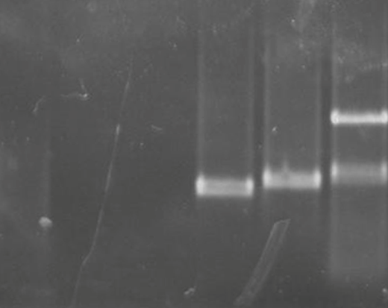


A
Chromosome
5’UTR
pbpp5
3’UTR
Plasmid
5’UTR
yfcu
hdhfr
3’UTR
GT
QCR2
GW1
QCR1
Recombined
5’UTR
yfcu
hdhfr
3’UTR
GW2
PbDHFR terminator
C
EF1alpha promotor
kDa
WT
Δpbpp5
3HA tag
180-
B
130-
100-
PbPP5
GW1+QCR1
GW1+QCR1
70-
GT+QCR2
GT+QCR2
bp
GT+GW2
GT+GW2
55-
5000
40-
3000
35-
2000
1500
1000
600
500
70-
HSP70
WT
△pbpp5

