Slide 1
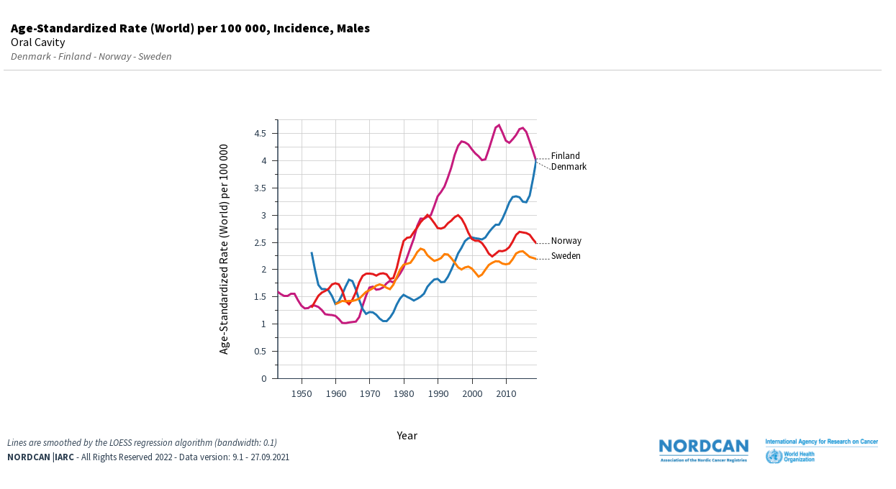
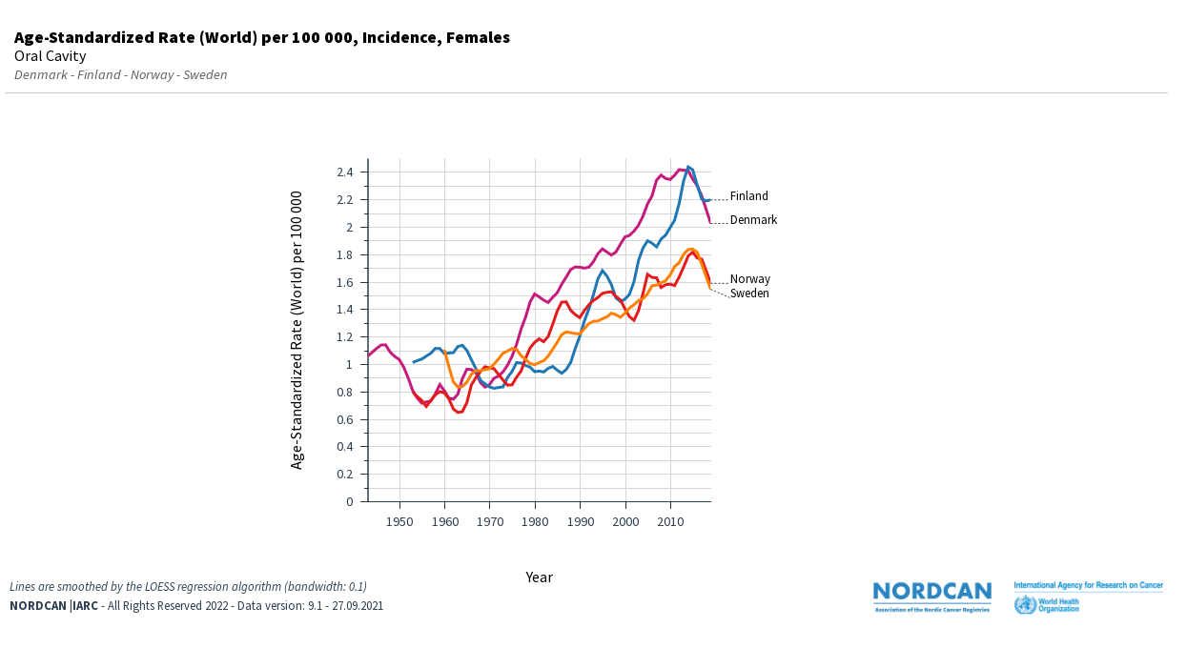
Supplementary Fig. 1. Incidence trends in cancer of the oral cavity in the Noridic countries, A males, B females.
A
B
Year

