Slide 1
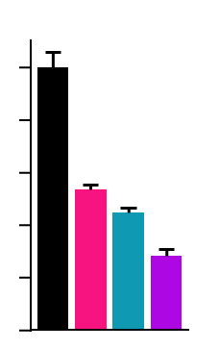

Supplementary Figure S4. MEKi/FAKi combination reduces B2905 syngeneic cells growth in allograft tumor models.
(A) B2905 cell viability after 72h treatment with the Gαq inhibitor FR900359 at the indicated dose. (B) B2905 cell viability after 72h treatment with vehicle,10nM trametinib, 1μM VS-4718 or combination of both. (C) Changes in B2905 xenograft tumor volume in C57BL/6 mice treated with vehicle (Control), 1 mg/kg trametinib, 50 mg/kg VS-4718 or trametinib+VS-4718. Data are mean±SEM (8 mice/group). ***p<0.001; **p< 0.01; *p<0.05
A
120
B
100
100
80
80
Cell viability
(% of vehicle)
Cell viability
(% of vehicle)
60
*
*
60
40
**
40
20
20
0
Vehicle
Trametinib
+ VS-4718
0
VS-4718
10⁻¹⁰
10⁻⁹
10⁻⁸
10⁻⁷
10⁻⁶
Trametinib
Vehicle
[FR900359], M
C
Control
VS-4718
1500
Trametinib
Trametinib
+ VS-4718
1000
1000
750
Tumor volume (mm³)
***
500
250
0
0
5
10
15
20
25
30
35
Days of treatment

