Slide 1
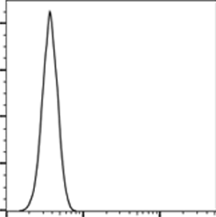
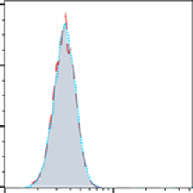
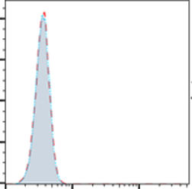
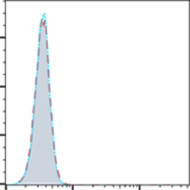
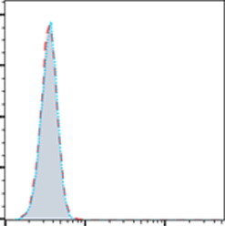
A
B
control
Gilteritinib
5.45
94.5
CD34+HSC count
67.5
32.5
CD34+HSC count
66.6
34.4
HSC count
10²
10³
10⁴
10²
10³
10⁴
10²
10³
10⁴
CD34 APC
FLT3 APC
FLT3 APC
C
CD34+HSC count
CD34+HSC count
CD34+HSC count
CD34+HSC count
CD34+HSC count
10²
10³
10⁴
10²
10³
10²
10³
10⁴
10²
10³
10⁴
10²
10³
10⁴
isotype
MICA/B FITC
ULBP1 FITC
ULBP2 FITC
ULBP3 FITC
isotype
control
Gilteritinib
D
ns
ns
ns
E
**
ns
100
*
****
****
UTD
25
ns
UTD
CAR-T
20
***
CAR-T
80
CAR-T+G
ns
live cells(%)
15
*
CAR-T+G
60
colonies
40
10
20
5
0
0
BFU-E
CFU-G/M
GEMM
1:1
10:1
20:1
E:T ratio
Supplementary Fig. 1. Cytotoxicity of FLT3scFv/NKG2D-CAR T cells to normal human hematopoietic stem cells (HSCs). (A) CD34+ HSCs accounted for 94.5±2.3% in HSCs derived from neonatal cord blood from 3 donors. (B) The expression of FLT3 in HSCs was not affected by gilteritinib treatment. (C) The expressions of NKG2DLs in HSCs were not affected by gilteritinib treatment. (D) Cytotoxicity of FLT3scFv/NKG2D-CAR T cells on HSCs detected by flow cytometry. (E) Colony formation assays showed a slight but significant reduction of GEMM, CFU-G/M and BFU-E colonies in HSCs cultured with CAR T cells with or without gilteritinib combination. Data shown are mean ± s.d. from n=3 independent experiments with T cells and HSCs obtained from different donors.* p<0.05; ** p<0.01; *** p<0.001；**** P<0.0001.（two-way ANOVA） G, gilteritinib; UTD: un-transduced CD3+T cells; ns, not statistically different.

