Slide 1
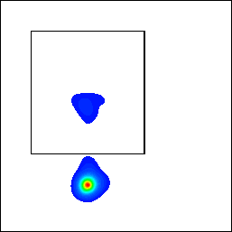
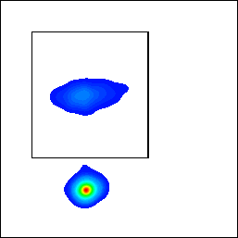
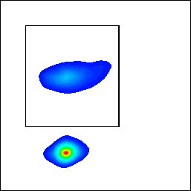
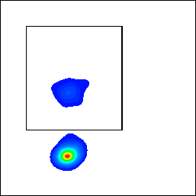
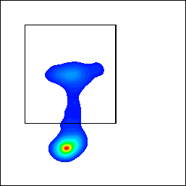
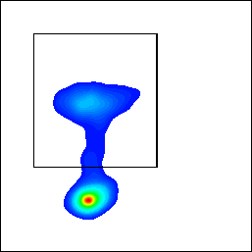
A-1
A-2
UTD+MOLM-13
CAR-T+MOLM-13
CAR-T+MOLM-13+G
**
Conjunction formation
15
UTD+MOLM-13
Conjunction formation
Conjunction formation
****
CFSE
CFSE
CFSE
10
CAR-T+MOLM-13
%Conjunction
CAR-T+MOLM-13+G
5
CD33 pcy5.5
CD33 pcy5.5
CD33 pcy5.5
0
B-1
B-2
UTD+MV4-11
CAR-T+MV4-11
CAR-T+MV4-11+G
15
***
UTD+MV4-11
Conjunction formation
Conjunction formation
Conjunction formation
****
CAR-T+MV4-11
CFSE
CFSE
CFSE
10
CAR-T+MV4-11+G
%Conjunction
5
0
CD33 pcy5.5
CD33 pcy5.5
CD33 pcy5.5
Supplementary Fig.7. Gilteritinib pretreatment promotes FLT3scFv/NKG2D CAR-T cell-target cell conjunction formation (A~B) MOLM-13 cells (A) and MV4-11 cells (B) pretreated with or without IC25 gilteritinib for 24h were co-cultured with CAR-T cells stained with CFSE for 1 h, and then immediately fixed and labelled target cells with pcy5.5 anti-human CD33 antibody. Conjunction formation between CAR-T cells and target cells were determined by CD33+CFSE+population among tumour cells using flow cytometry. Representative dot plots (A-1,B-1) and quantification (A-2,B-2) for conjunction are shown.Data represent at least three independent experiments. G,gilteritinib. UTD,untransfected T cells.* p<0.05, .* *p<0.01, .*** p<0.001, .**** p<0.0001

