Slide 1
Visual Abstract Submission Information
Paper # | 15
Presenter Name | Anuja L. Sarode, MPH
Presenter Twitter Handle | @
Additional Authors/Institutions to be tagged on the post | @uhrises @UHSurgery @metrohealthCLE @vanessapho
Title of Paper | TRAFFIC STOPS DO NOT PREVENT TRAFFIC DEATHS

Slide 2







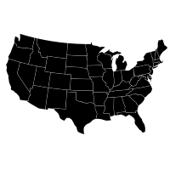

Traffic Stops Do Not Prevent Traffic Deaths
Study Population
State patrol police
traffic stops (PTS)
Deaths from motor
vehicle crash (MVC)
Data from 33 states,
2004-2016
Results
No association between PTS and
MVC deaths (p=0.4)
Level of Evidence
Retrospective Epidemiological,
level IV
Conclusion
Traffic stops do not prevent MVC deaths
Recommendations
  Motor vehicle modifications
  Community based safety
  initiatives
  Improved access to health
  care
Sarode A. et al.
EAST Annual Scientific Assembly
January 2021
@EAST_Trauma
@uhrises @UHSurgery @metrohealthCLE @vanessapho

