Slide 1
Supplementary Figure 1
100
Ceftriaxone / Internal Standard (log scale)
1
0.01
Supplementary Figure 1: Analysis of Ceftriaxone/IS analyzed at unit resolution. Boxplots of median ratios of Ceftriaxone/IS after incubation with: Control DFU –drug free urine (n=2), ESBL containing urine specimens (n=34), ESBL containing urine specimens from patients receiving beta-lactamase inhibitor treatment (n=6), and non-ESBL containing specimens (n=8).

Slide 2
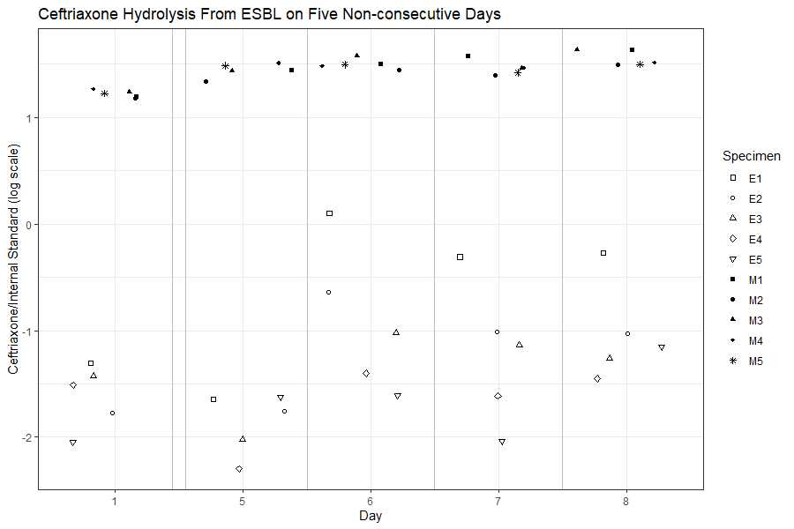
Supplementary Figure 2
10
1
Ceftriaxone / Internal Standard (log scale)
0.1
0.01
Supplementary Figure 2: Analysis of Ceftriaxone/IS after incubation with specimens on 5 non-consecutive days. Specimens E1 to E5 contain ESBL and are represented by open shapes. Specimens M1 to M5 do not contain ESBL and are represented by filled shapes or an asterisk.

Slide 3
Supplementary Figure 3
Ceftriaxone
Intensity
Time (min)
Supplementary Figure 3: Qualitative assesment of matrix effects observed in 10 unique patient specimens containing ESBL producing bacteria (n=5) or not containing ESBL producing bacteria (n=5). EICs of Ceftriaxone is shown for the 10 patient specimens with the observed Ceftriaxone peak overlaid for reference. Relative ion intensity of Ceftriaxone is indicated on the Y-axis with time (min) plotted on the X-axis.

Slide 4
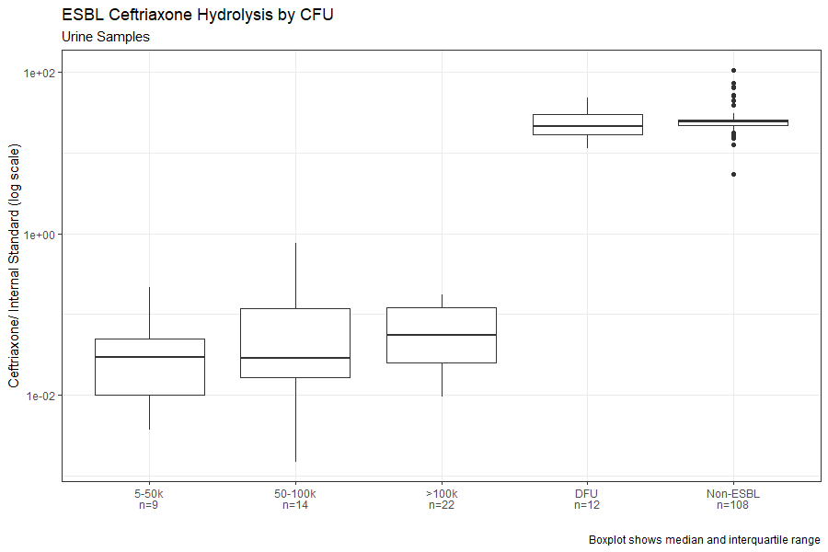
Supplementary Figure 4
100
1
Ceftriaxone / Internal Standard (log scale)
0.01
Supplementary Figure 4: Boxplots of median ratios of Ceftriaxone/IS after incubation with: 5-50 thousand CFU/mL (5-50k) ESBL containing specimens (n=9), 50-100 thousand CFU/mL (50-100k) ESBL containing specimens (n=14), greater than 100 thousand CFU/mL (>100k) ESBL containing specimens (n=22), Control DFU –drug free urine (n=12), and non-ESBL containing specimens (n=108).

Slide 5
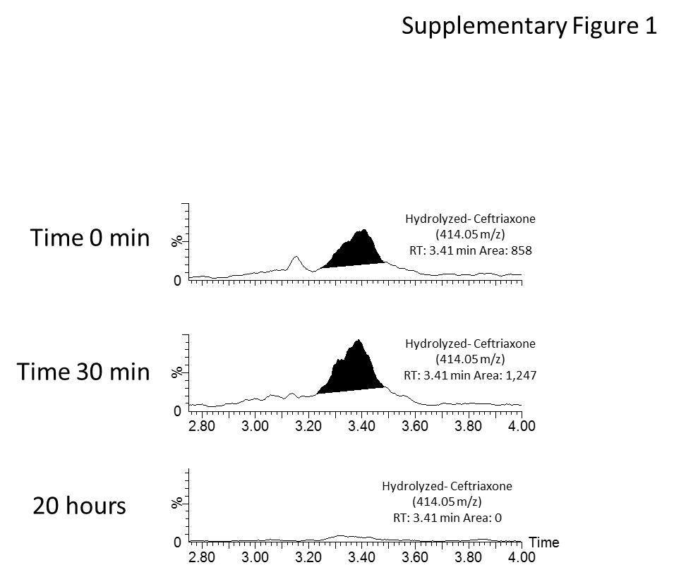
Supplementary Figure 5
Supplementary Figure 5: Stability of Ceftriaxone hydrolysis products during 37 °C incubation with an ESBL containing urine specimen. EICs of the hydrolysis product of Ceftriaxone (Observed m/z: 414.0543) after 5 min, 30 min, and 20 hours of incubation with an ESBL containing urine specimen. % ion intensity (indicated at top left of each EIC) is plotted on the Y-axis and Time (min) is plotted on the X-axis.

Slide 6
Supplementary Table 1
Liquid Chromatography Parameters
Ceftriaxone Analysis Chromatography
Time (minutes) | % Mobile Phase A | % Mobile Phase B | Flow State
0 | 95 | 5 | Waste
0.5 | 95 | 5 | Mass Spectrometer
4 | 35 | 65 | Mass Spectrometer
4.75 | 5 | 95 | Waste
6.25 | 5 | 95 | Waste
6.5 | 95 | 5 | Waste
8 | 95 | 5 | Waste
Multi-Drug Analysis Chromatography
Time (minutes) | % Mobile Phase A | % Mobile Phase B | Flow State
0 | 95 | 5 | Waste
0.5 | 95 | 5 | Mass Spectrometer
4 | 5 | 95 | Mass Spectrometer
4.1 | 5 | 95 | Waste
6.5 | 5 | 95 | Waste
6.51 | 95 | 5 | Waste
8 | 95 | 5 | Waste
Ceftriaxone Hydrolysis Product Analysis Chromatography
Time (minutes) | % Mobile Phase A | % Mobile Phase B | Flow State
0 | 95 | 5 | Waste
0.5 | 95 | 5 | Mass Spectrometer
10.5 | 75 | 25 | Mass Spectrometer
10.75 | 5 | 95 | Waste
12.25 | 5 | 95 | Waste
12.5 | 95 | 5 | Waste
15 | 95 | 5 | Waste

Slide 7
Supplementary Table 2
QTOF MS Data Processing
Analyte | Quantification Trace (m/z) | Retention Time Window (min.) | Mass Tolerance
Ceftriaxone
Ceftriaxone | 554.9926 | 2.50 ± 0.1 | 200 ppm
Amphetamine-d5 | 141.119 | 2.62 ± 0.1 | 200 ppm
Mixed Drug Analysis
Ceftriaxone | 554.9926 | 2.29 ± 0.1 | 200 ppm
Cefazolin | 455.0338 | 2.50 ± 0.1 | 200 ppm
Oxacillin | 402.1063 | 3.47 ± 0.1 | 200 ppm
Meropenem | 384.1118 | 2.14 ± 0.1 | 200 ppm
Amphetamine-d5 | 141.119 | 2.41 ± 0.1 | 200 ppm
Unit Resolution Ceftriaxone
Ceftriaxone | 554.9926 | 2.29 ± 0.1 | 1 Da
Amphetamine-d5 | 141.119 | 2.41 ± 0.1 | 1 Da

