Slide 1
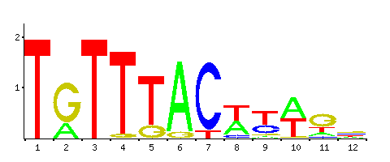






Supplementary Figure 4
a
P =0.0367
b
c
1.5
P =0.0107
1.0
kDa
Foxa2 levels
RIPK3
50
Bits
0.5
GAPDH
40
si-NC
Control
si-Foxa2
0.0
Foxa2 Binding Site
Control
si-NC
si-Foxa2
d
e
f
Foxa2 Binding Site
kDa
RIPK3
kDa
TGTTTACTT
Luc
RIPK3
50
50
GAPDH
40
GAPDH
40
WT promoter
NC
sh-NC
TGccccCTT
CNEACR
Control
Luc
Control
sh-CNEACR
Mut promoter

