Slide 1
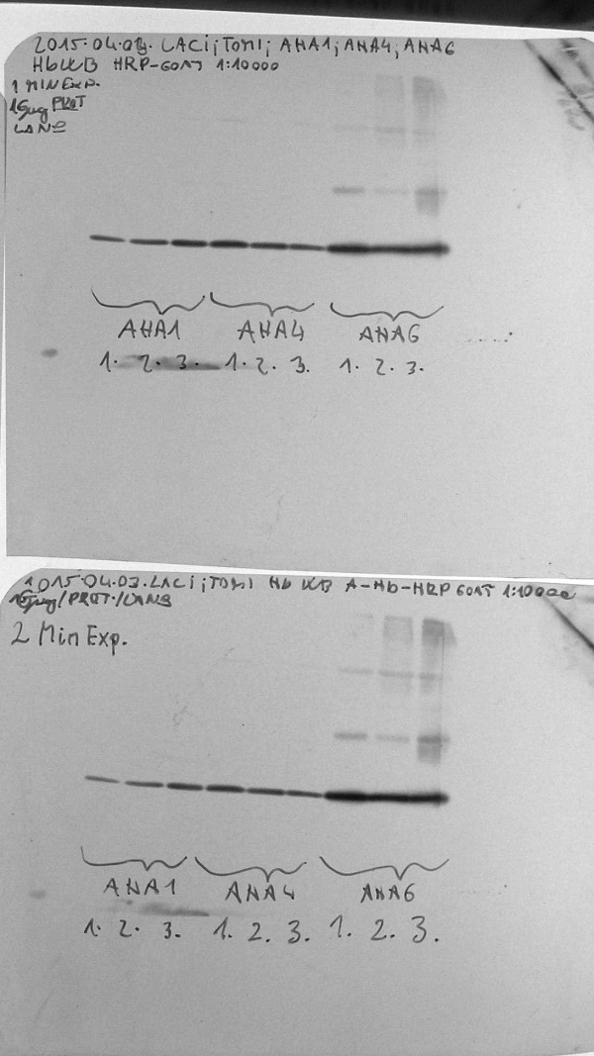
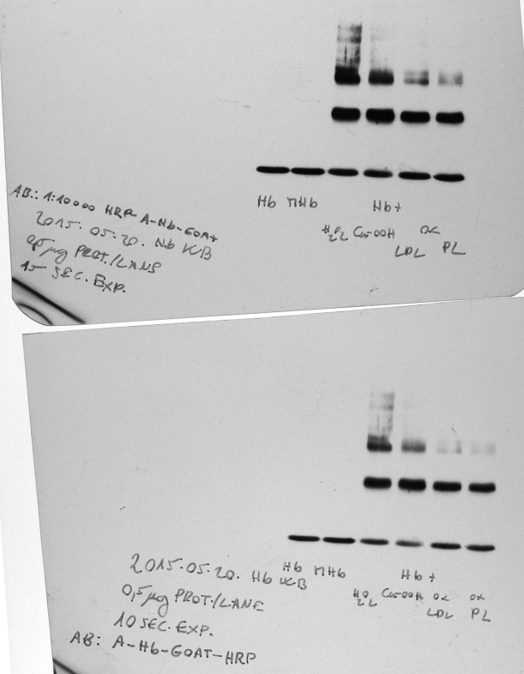
Full unedited gel for Supplementary Fig. S14.
A
B
Hb antibody
(Cat no. ab19362-1, Abcam Plc., Cambridge, UK)
Hb antibody
(Cat no. ab19362-1, Abcam Plc., Cambridge, UK)
C
FerrylHb antibody labeled with HRP (developed by our groups)

Slide 2
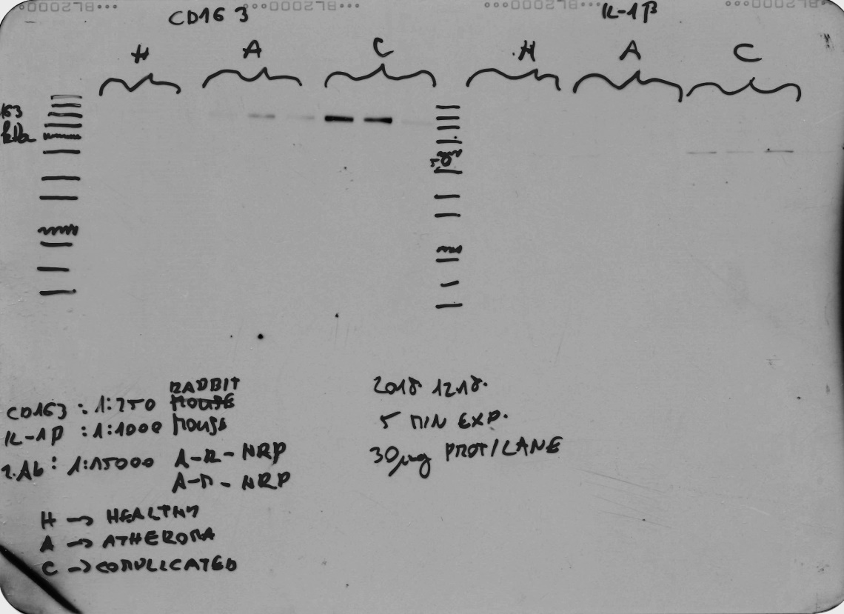
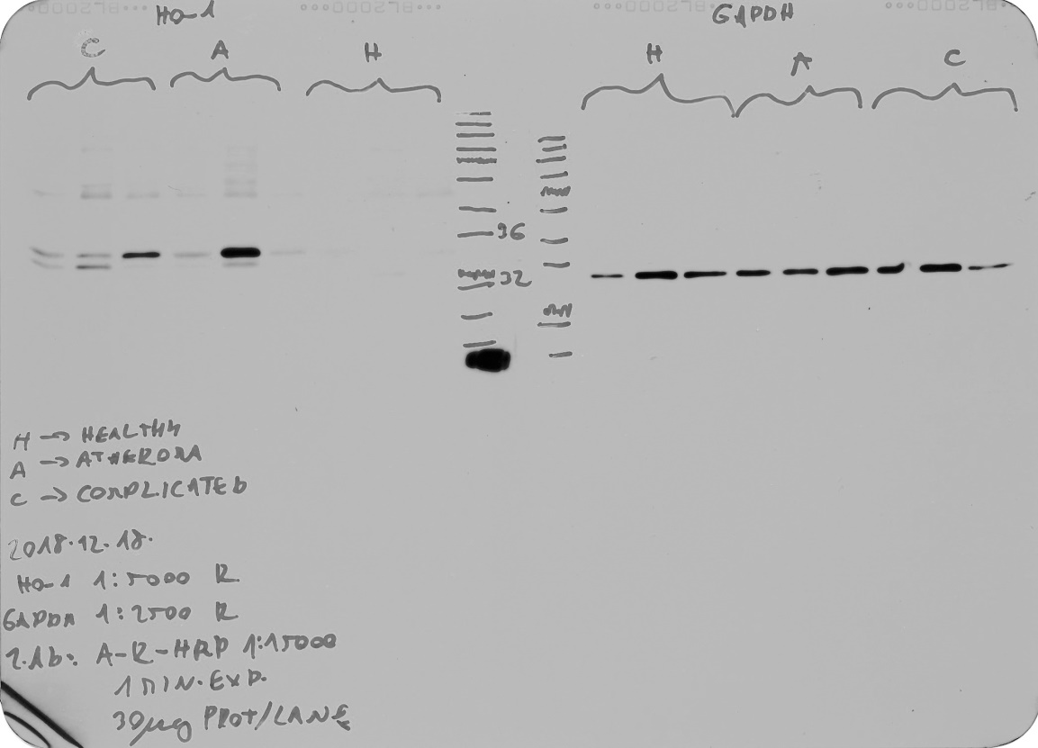
Full unedited gel for Supplementary Fig. S15.
B
CD163 antibody (Novusbio, NB110-40686)
GAPDH antibody (Proteintech, 60004-1)

Slide 3
Full unedited gel for Supplementary Fig. S16.
F
CD163 antibody (Novusbio, NB110-40686)
GAPDH antibody (Proteintech, 60004-1)

Slide 4
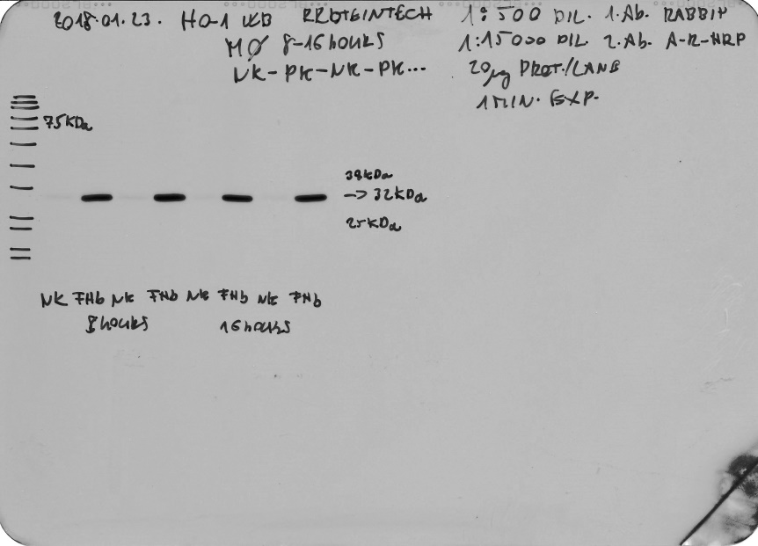
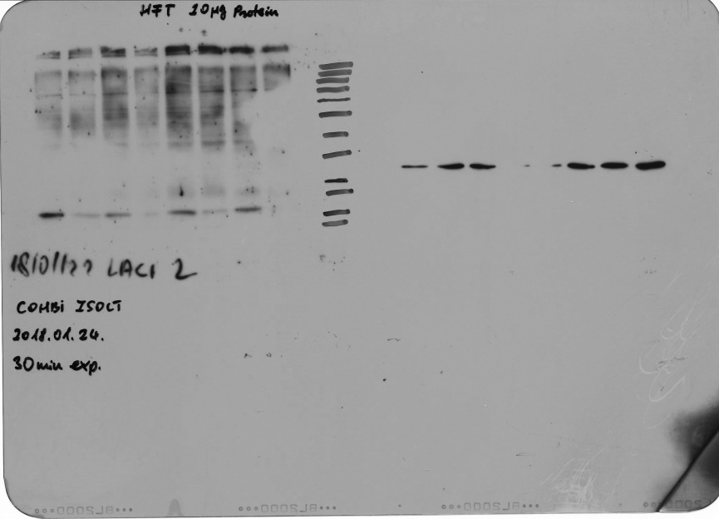
Full unedited gel for Supplementary Fig. S17.
E
HO-1 antibody (Proteintech,10701-1-AP)
H-FT antibody
(Santa Cruz, sc-25617
IL-1β antibody
(Thermofisher, P420B

Slide 5
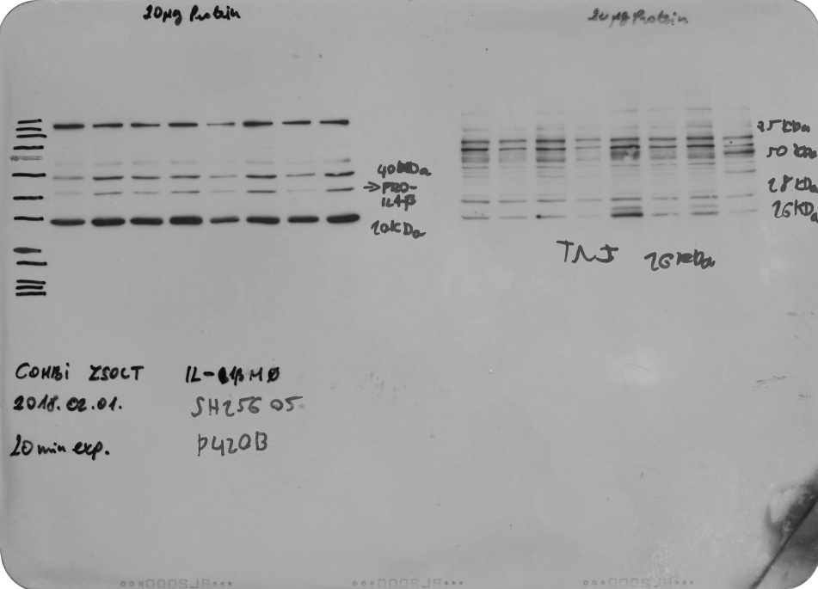
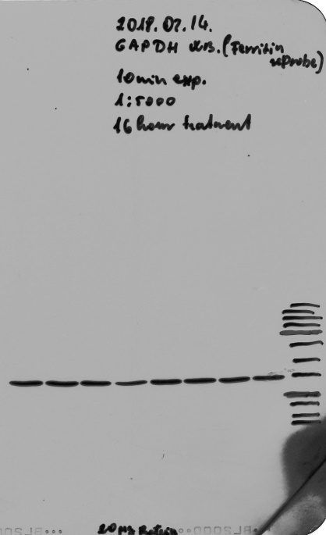
Full unedited gel for Supplementary Fig. S17.
E
TNF-α antibody
(Thermofisher, P300A
GAPDH antibody
(Proteintech, 60004-1)

Slide 6
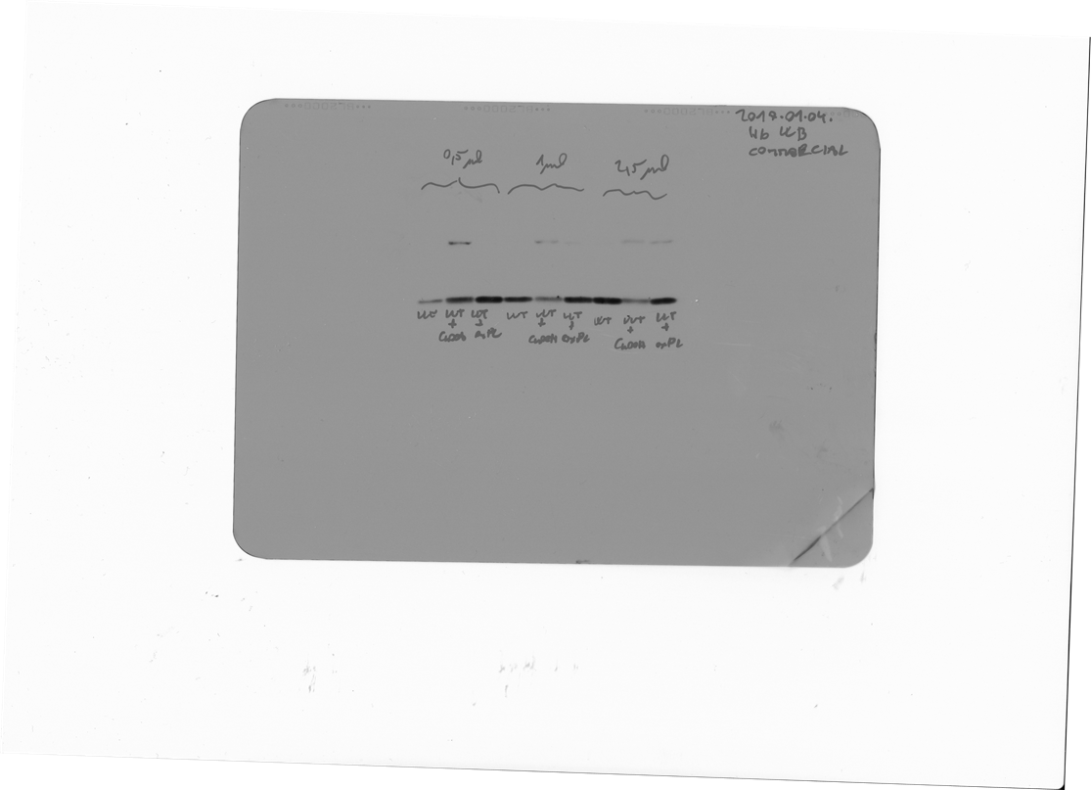
Full unedited gel for Supplementary Fig. S18.
FerrylHb antibody labeled with HRP (developed by our groups)
Hb antibody
(Cat no. ab19362-1, Abcam Plc., Cambridge, UK)

Slide 7
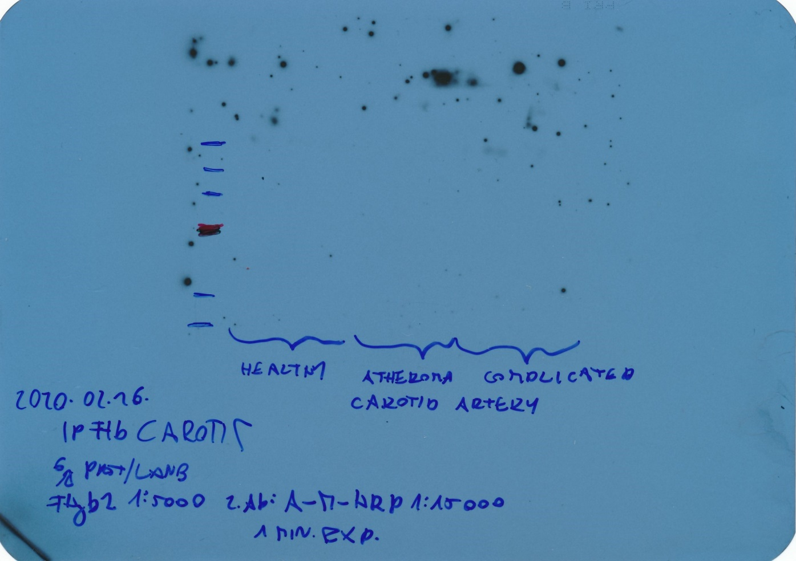
Full unedited gel for Supplementary Fig. S19.
Human Carotid arteries
Immunoprecipitation of FerrylHb (IP)
oxyHb
Hb antibody
(Cat no. ab19362-1, Abcam Plc., Cambridge, UK)

Slide 8
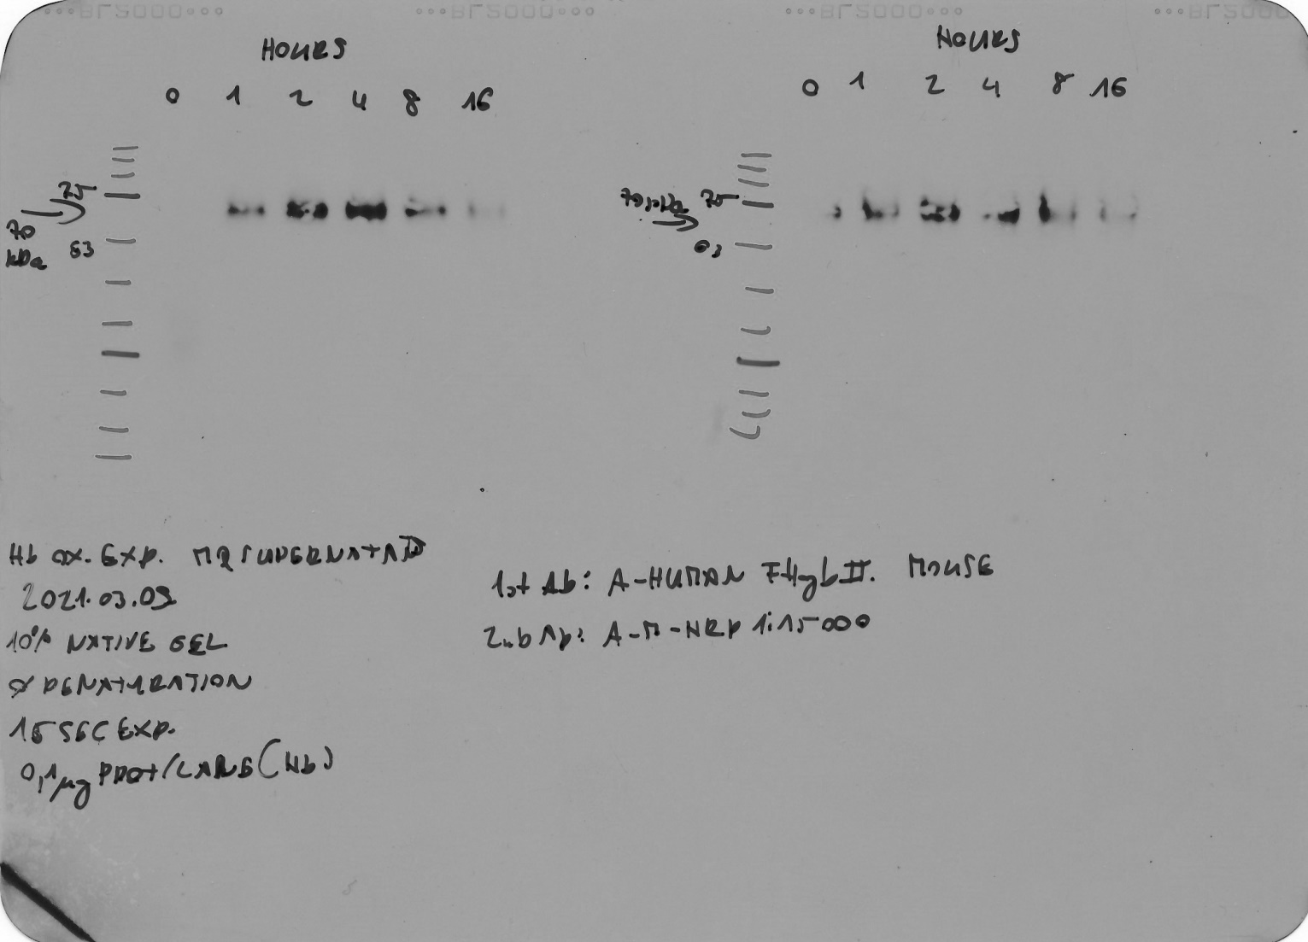
Full unedited gel for Supplementary Fig. S20.

Slide 9
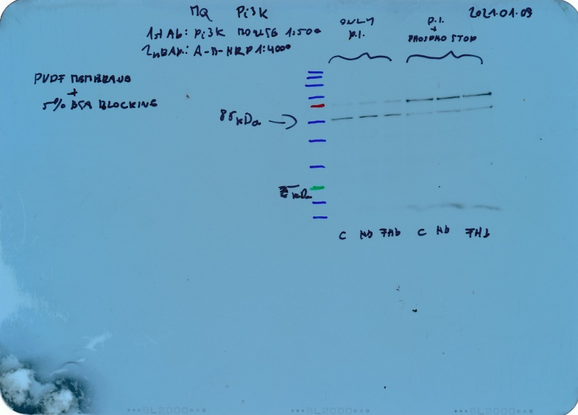
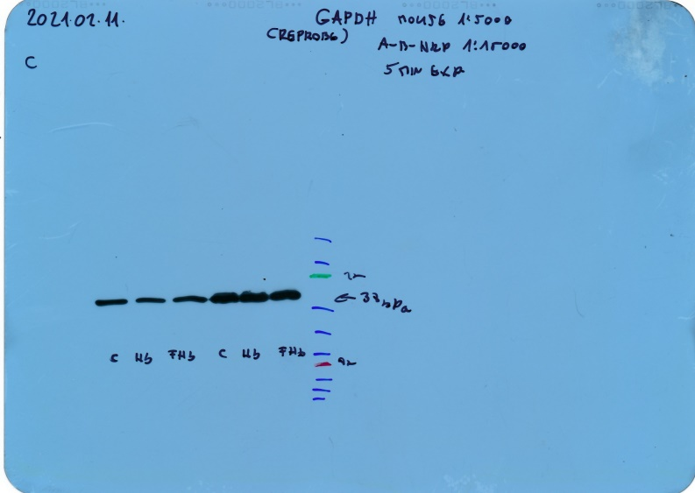
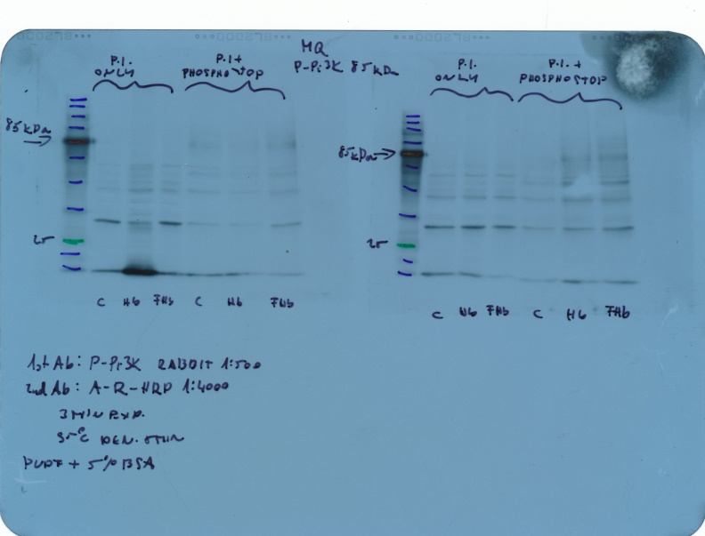
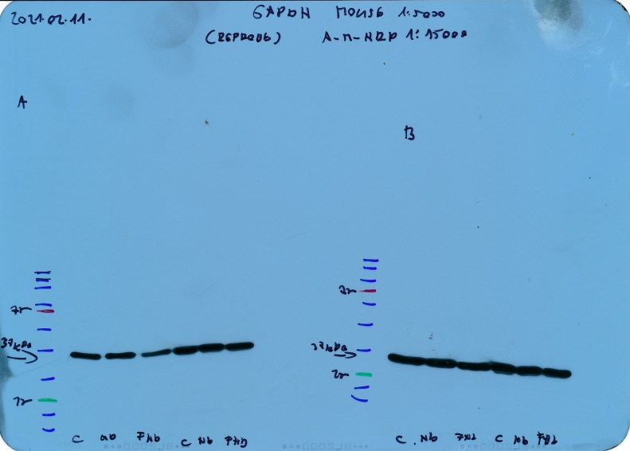
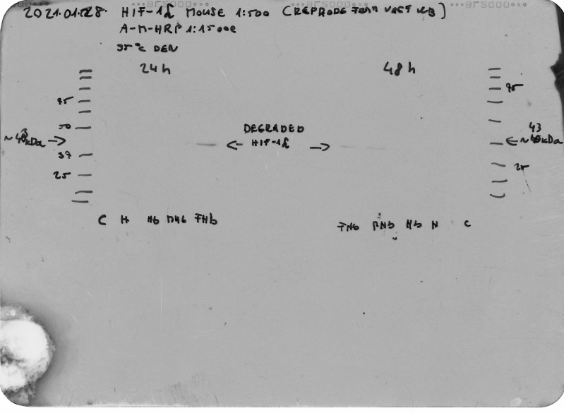
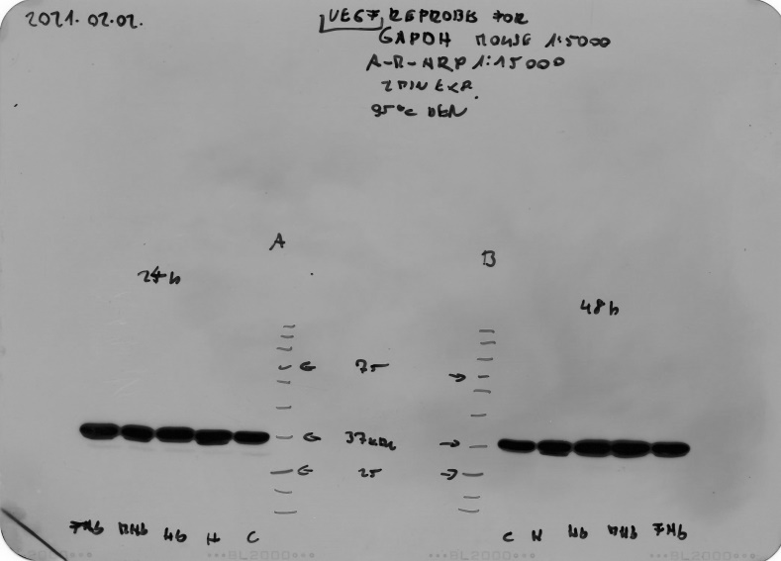
Full unedited gel for Supplementary Fig. S21.

Slide 10
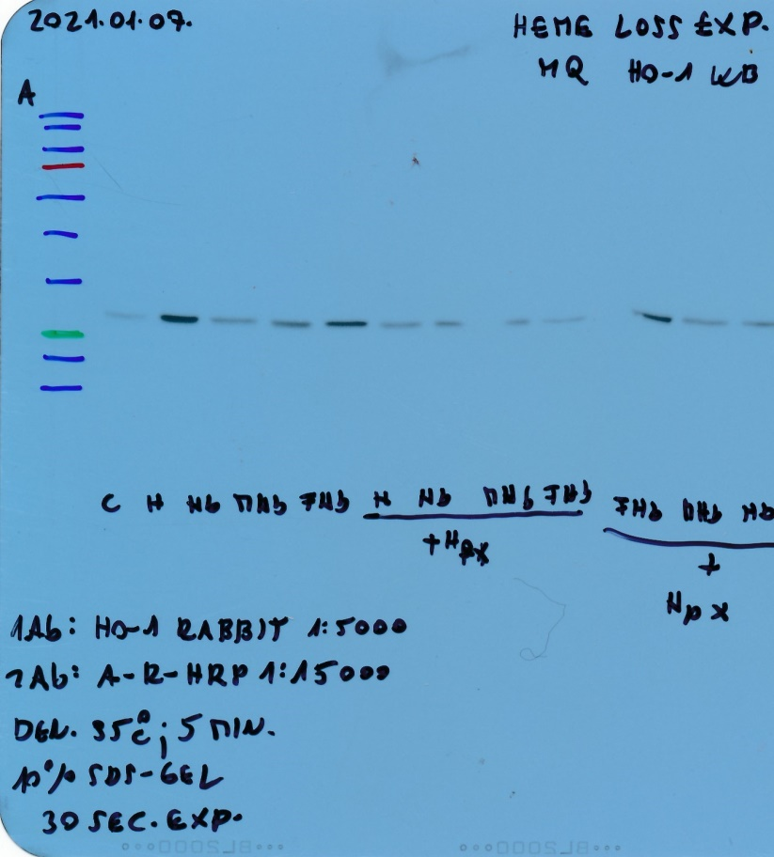
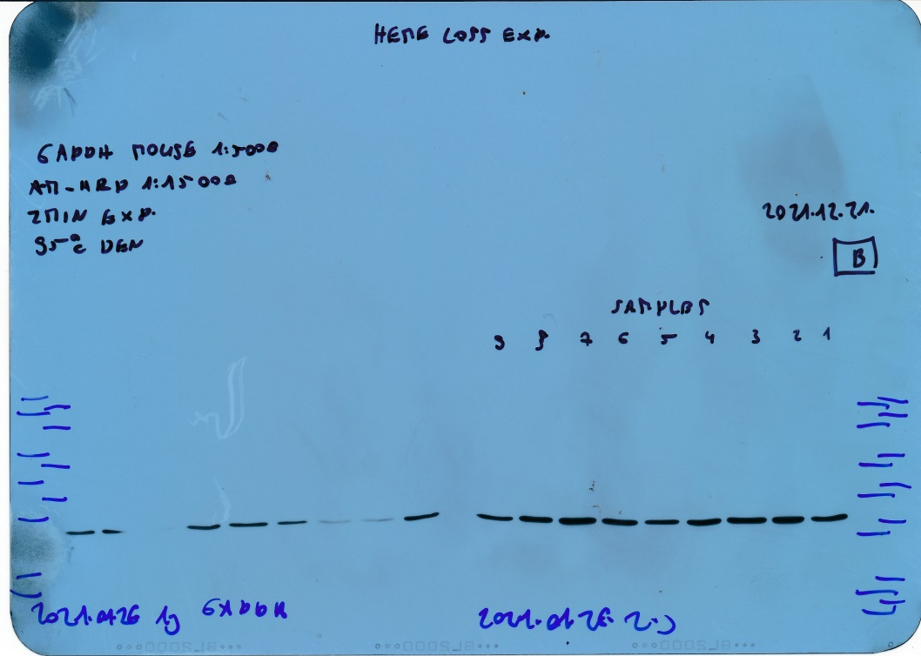
Full unedited gel for Supplementary Fig. S22.

Slide 11
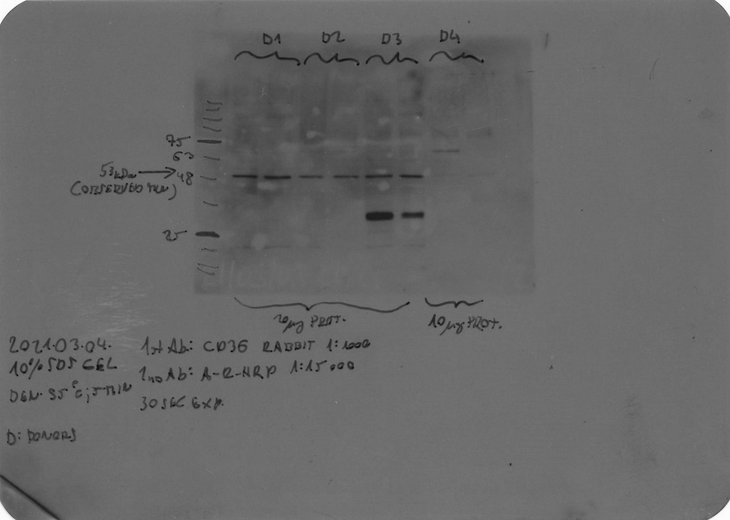
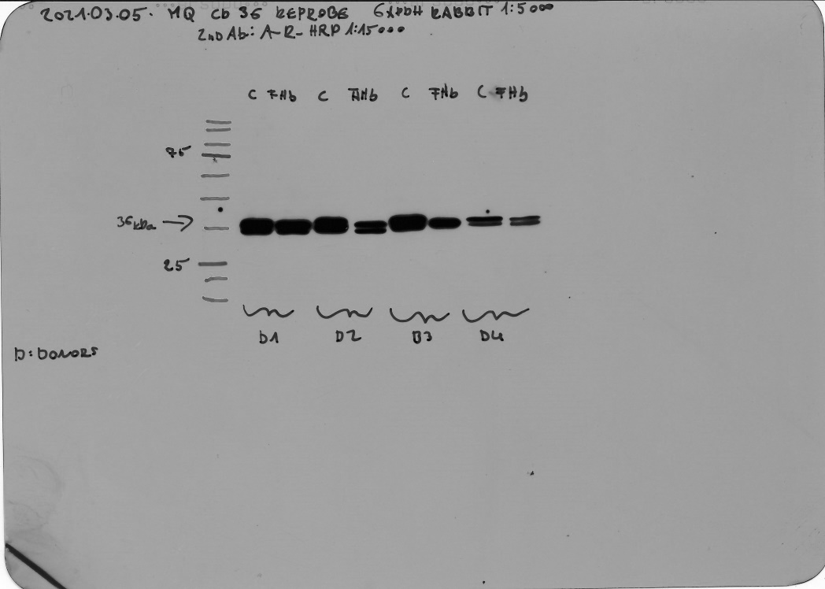
Full unedited gel for Supplementary Fig. S23.

