Slide 1
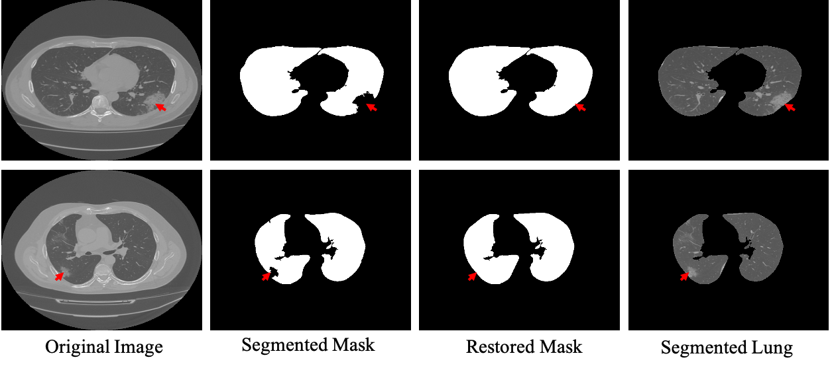
Figure. Lungs segmentation stepwise results. The red arrow shows the restoration steps of the infected region.

Slide 2
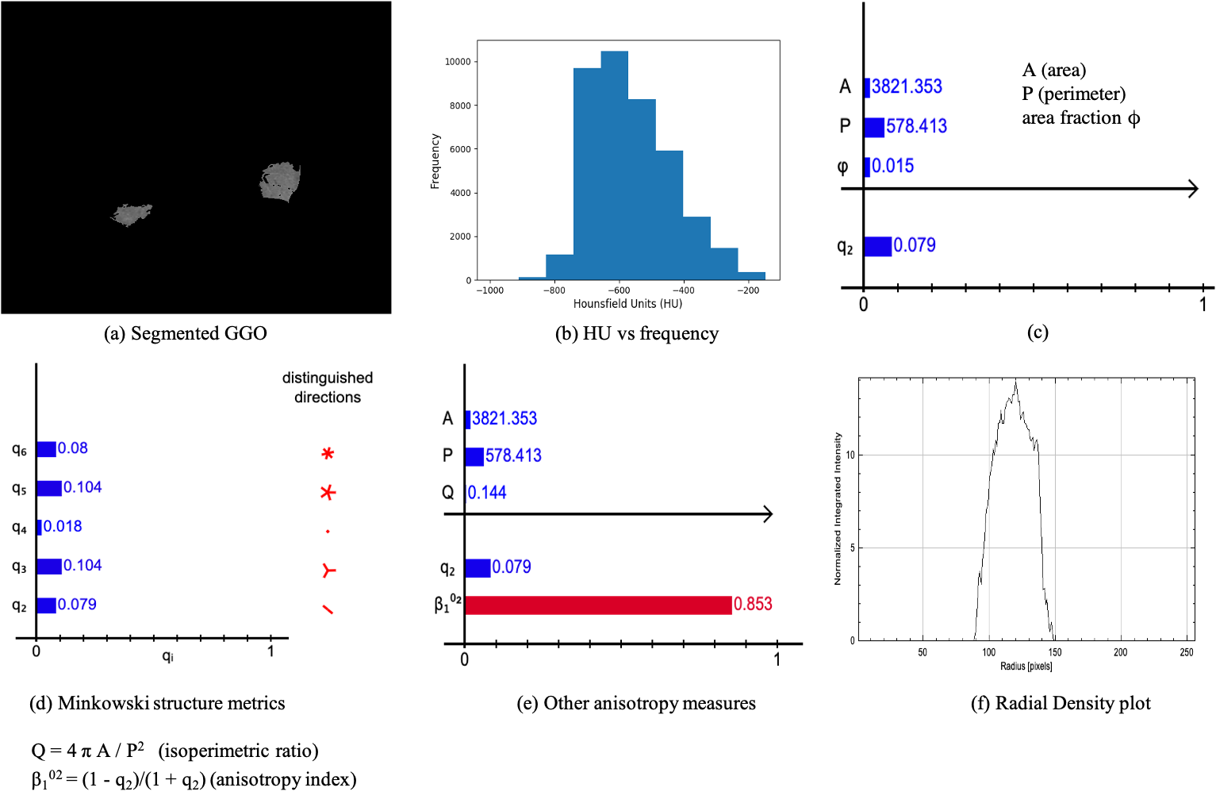
Figure: GGO shape analysis of COVID-19 data using Minkowski Tensors
Reference: Minkowski functionals: Robust and versatile shape descriptors, https://morphometry.org/morphometer/index.html?mode=EXPERT?type=IM?anaparam=other?anatype=grayscale, accessed: 2022-01-25.

Slide 3
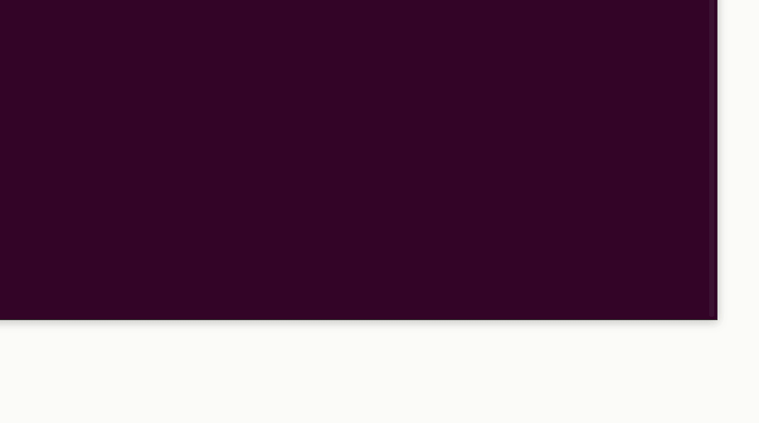
Number of points: 3,596
Figure: Representation of segmented lung using raw point cloud data

Slide 4
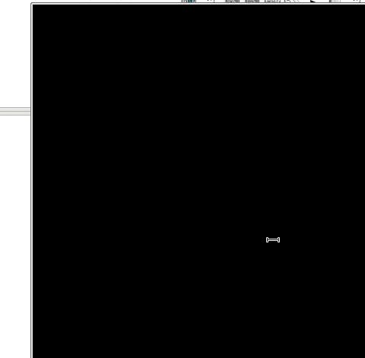
Figure: Final results after training the PointNet++ using point cloud data are shown here. The 3D images show different regions from different angles. Cyan color points/bubbles represent non-GGO regions and green color points/bubbles represent GGO regions.

