Slide 1
CD11c/CD163 gene expression ratio
Veh TU
NN
6 9
Veh TU
UN-RG
6 9
n
Supplemental Figure 1: Gene expression ratio of CD11c/
CD163 in epididymal adipose tissue at 16.5 wks
CD11c and CD163 gene expressions were measured by quantitative RT-PCR using primers of (5'-CTGGATAGCCTTTCTTCTGCTG-3’: 5'-GCACACTGTGTCCGAACTC-3’) and (5'-GGGTCATTCAGAGGCACACTG-3’: 5'-CTGGCTGTCCTGTCAAGGCT-3’), respectively. Squares and error bars indicate mean and standard deviation of CD11c/CD163 gene expression ratio. There was no statistically significant difference.

Slide 2
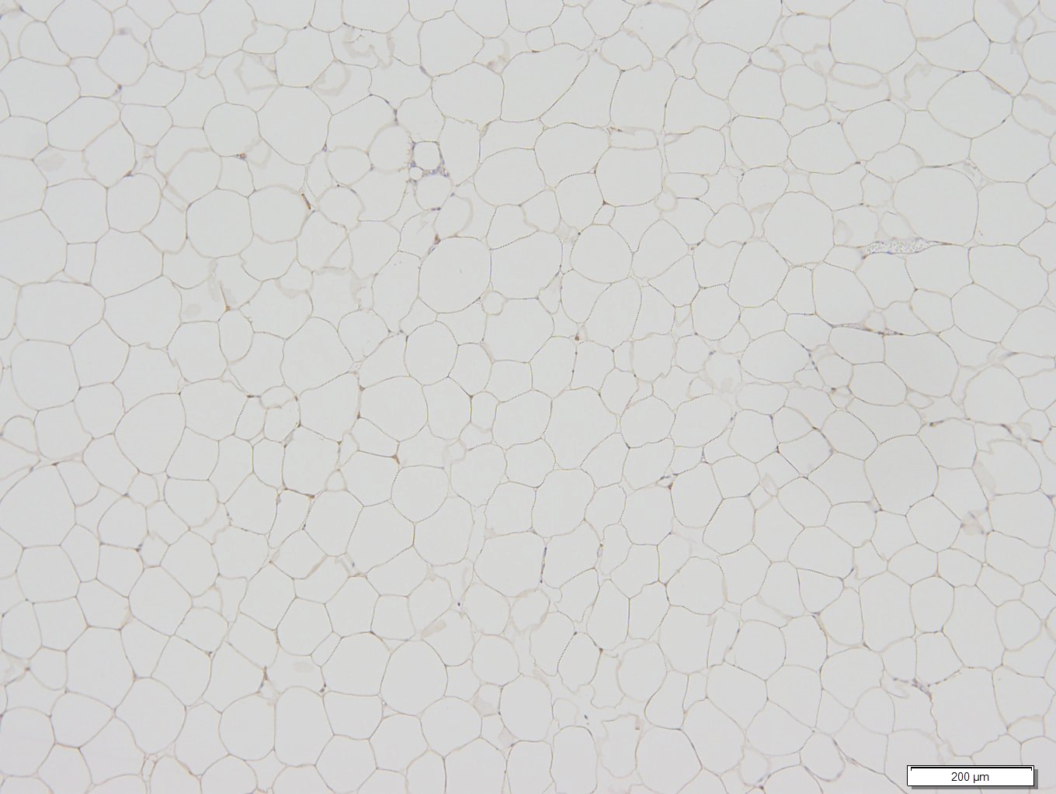
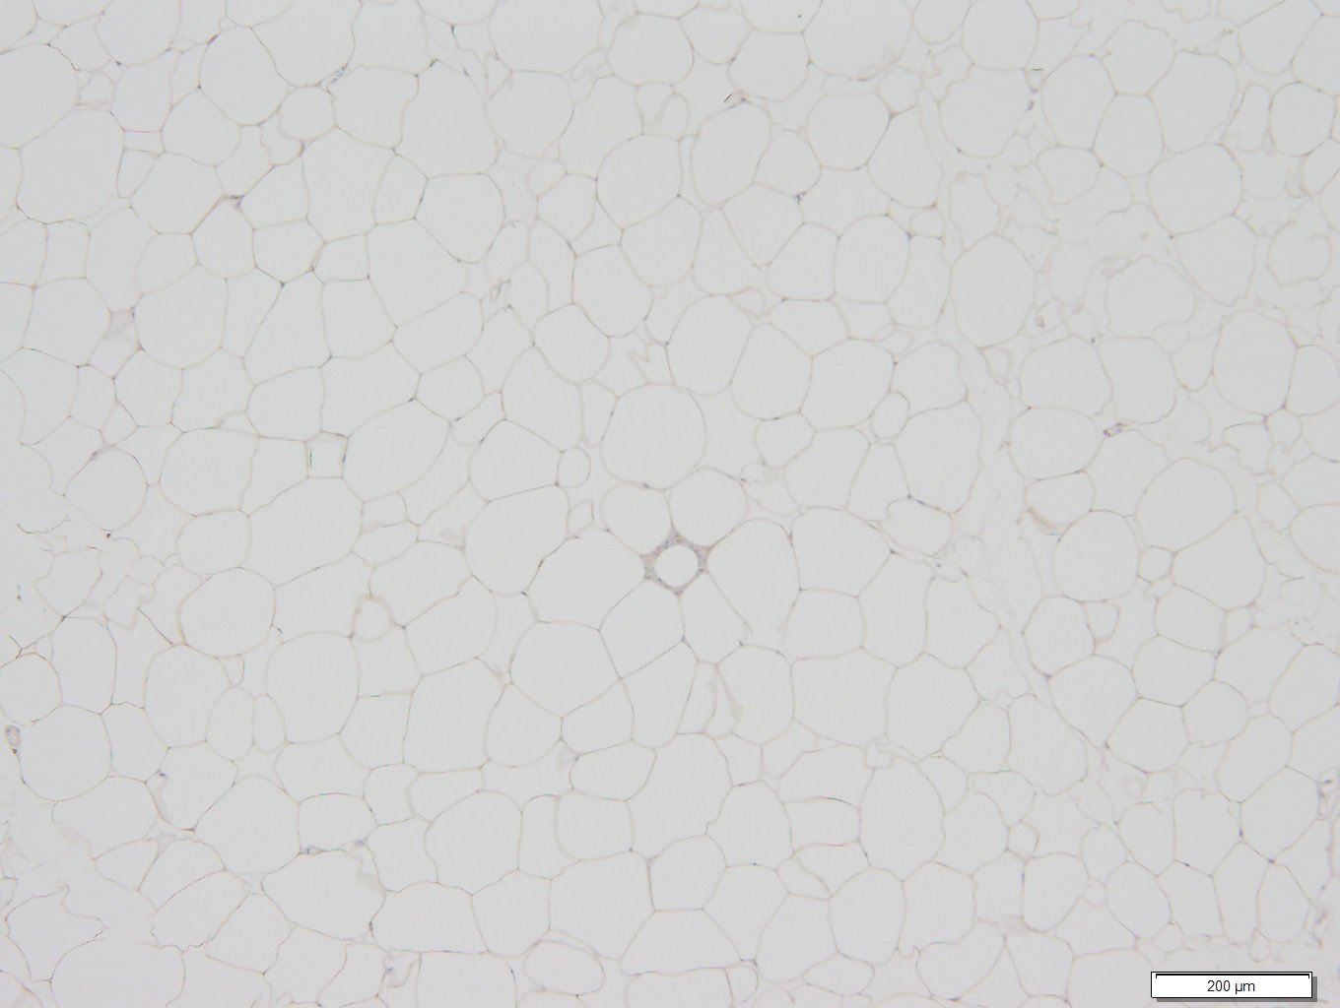
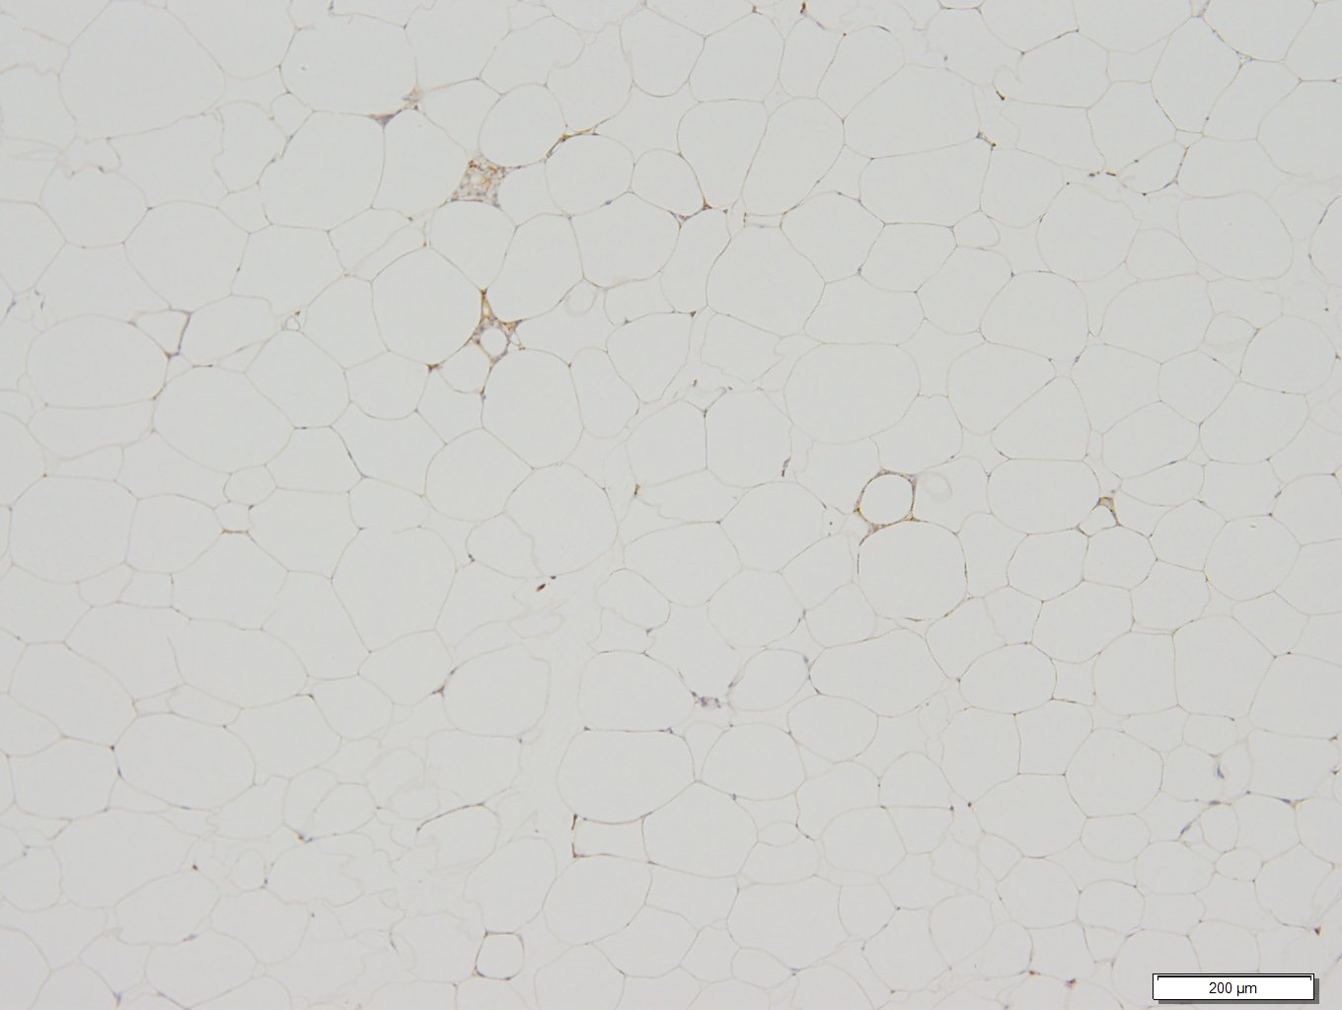
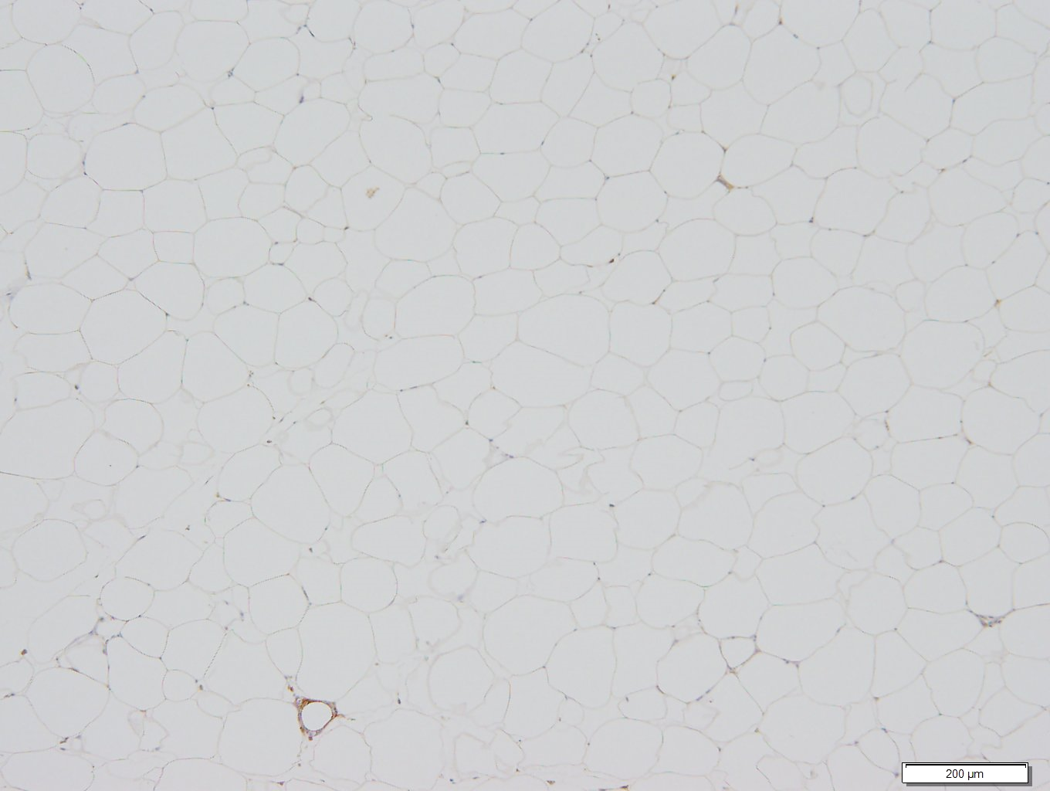
A
B
C
D
Supplemental Figure 2: Representative immunohistochemical detection of macrophages in epididymal adipose tissue.
Circles indicate immunostaining for F4/80 in crown-like structures of epididymal adipose tissue from NN-Veh (A), NN-TU (B), UN-RG-Veh (C), and UN-RG-TU (D) pups at 16.5 wks of age. The white bar indicates 200 μm.

