Slide 1
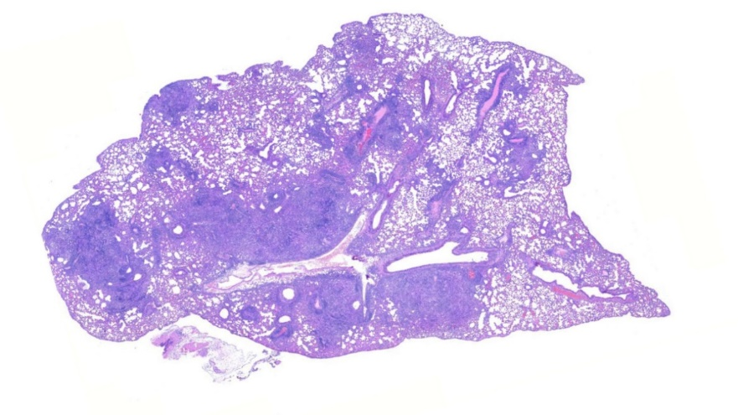
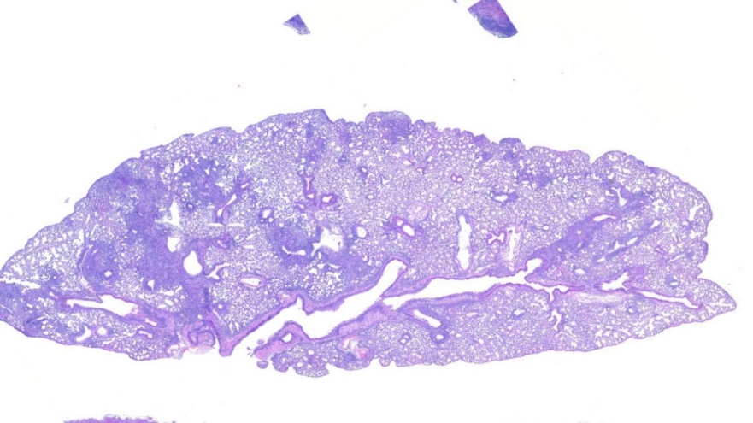
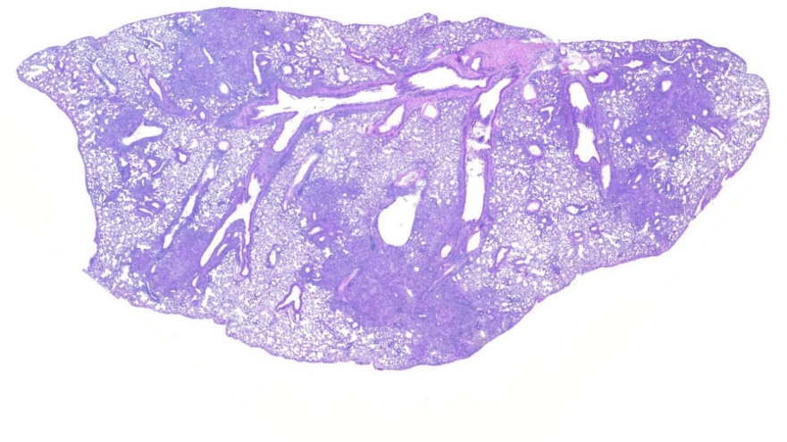
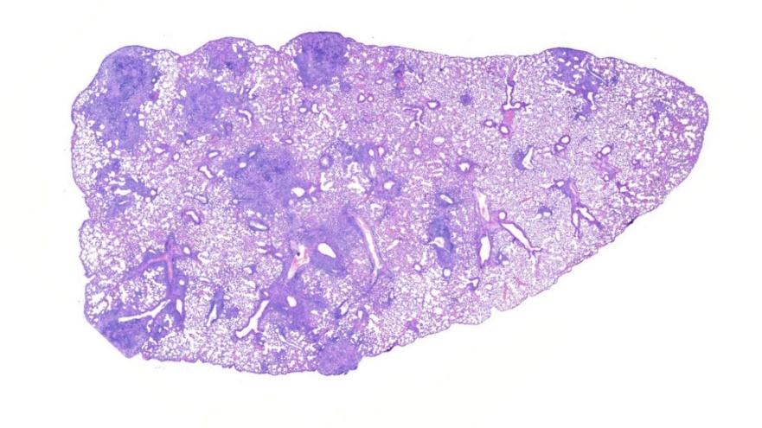
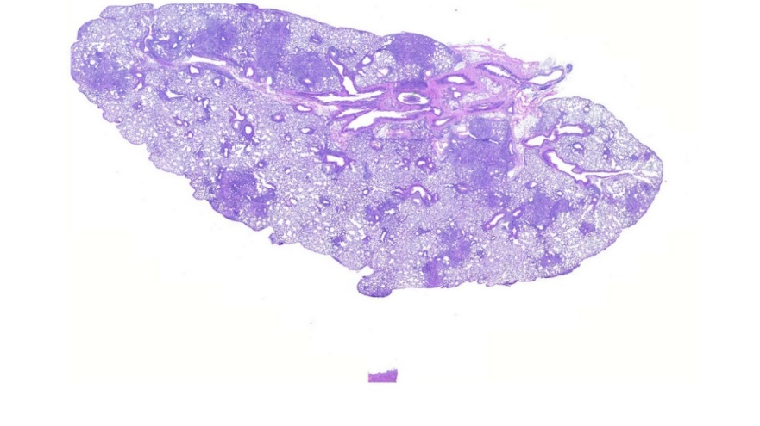
A. No Treatment
SUPPLEMENTAL FIGURE S.1
B. LF, 1mg/day, Prophylactic (D14)
C. LF, 100μg/day, Prophylactic (D14)
D. LF, 1mg/day, Therapeutic (D21)
E. LF, 100μg/day, Therapeutic (D21)

Slide 2
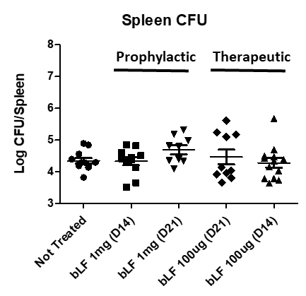
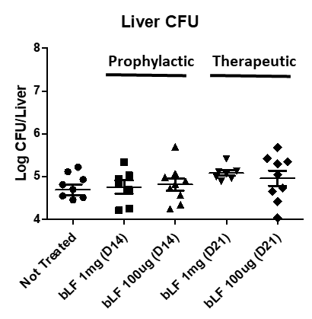
SUPPLEMENTAL FIGURE S.2
A
B
C
Prophylactic Therapeutic

Slide 3
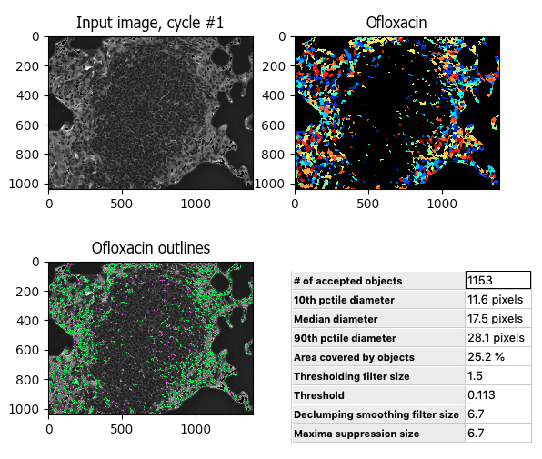
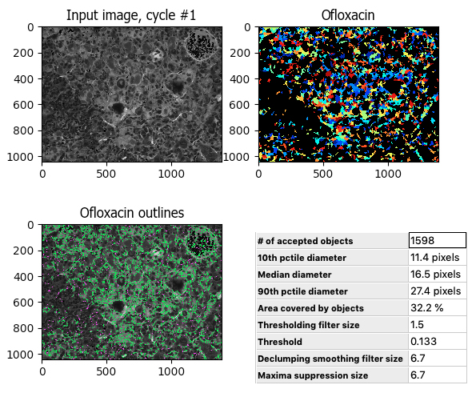
SUPPLEMENTAL FIGURE S.3
A. MTB alone, no treatment
B. MTB and LF treatment
1.
3.
1.
3.
2.
4.
2.
4.

