Slide 1
Trans-coronary Pacing via Rota Wire Prevents Bradycardia
During Rotational Atherectomy: A Case Report
October, 2021
EHJ-CR-D-21-00709

Slide 2
Introduction
Rotational atherectomy (RA) is used for plaque modification in patients
with heavily calcified coronary lesions.
RA can induce significant bradycardia or atrioventricular block requiring
for temporary pacemaker insertion. ¹
In this report, we present a case of trans-coronary pacing via a Rota wire to prevent bradycardia during RA in the proximal right coronary artery (RCA).

Slide 3
Case Presentation
History and Examination Findings
A 72-year-old woman was diagnosed with unstable angina.
Coronary angiography revealed significant coronary stenosis with severe calcification in the proximal right coronary artery.
Percutaneous coronary artery intervention was performed. RA induced significant bradycardia requiring temporary pacemaker insertion.
Trans-coronary pacing was provided via a Rota wire placed in the far distal RCA ; this was used for back-up pacing during RA.

Slide 4
Case Presentation
History and Examination Findings
RA was completed by safely modifying the calcified lesion.
After successful debulking of the calcified lesion, we dilated with a balloon, and a drug-eluting stent was implanted at the proximal RCA.
Final intravascular ultrasound (IVUS) and angiography showed good stent apposition and expansion.
We did not observe any serious intraprocedural complications.

Slide 5
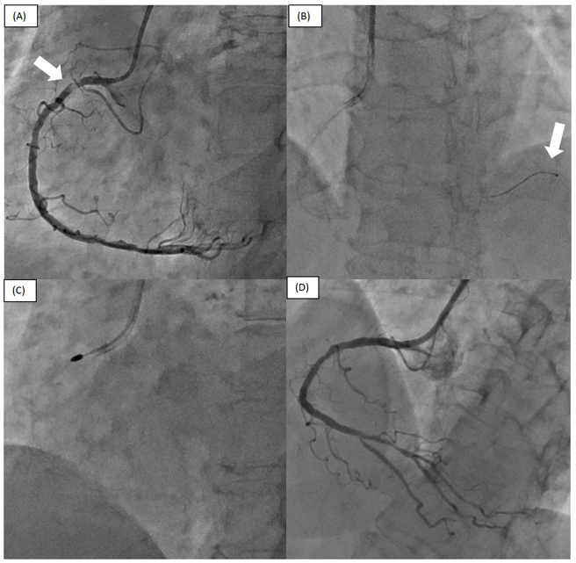
Case Presentation
Imaging
Figure 1. Result of coronary angiography
Initial angiography. Severely calcified
lesion of the proximal RCA(white arrow).
(B) The tip of the Rota wire is advanced to
the far distal end of the coronary artery
(white arrow).
(C) Rota burr was used in modifying heavily
calcified stenosis.
(D) Final PCI results.

Slide 6
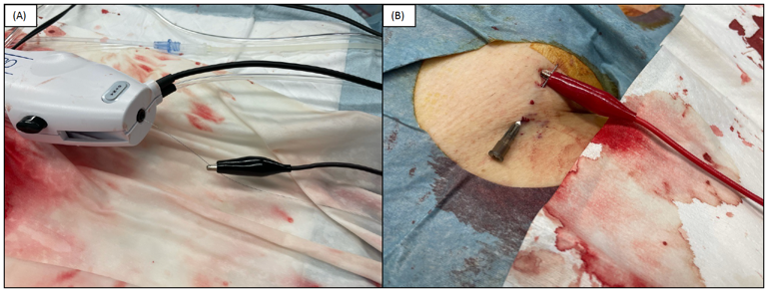
Case Presentation
Imaging
Figure 2. How to attach the electrodes.
The cathode is attached to the distal external end of the guide wire.
The anode is attached to the needle which is inserted under the skin.

Slide 7
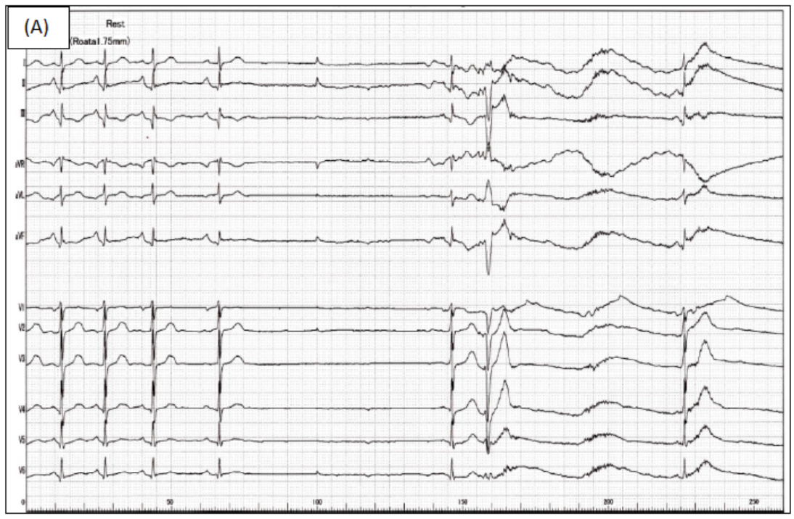
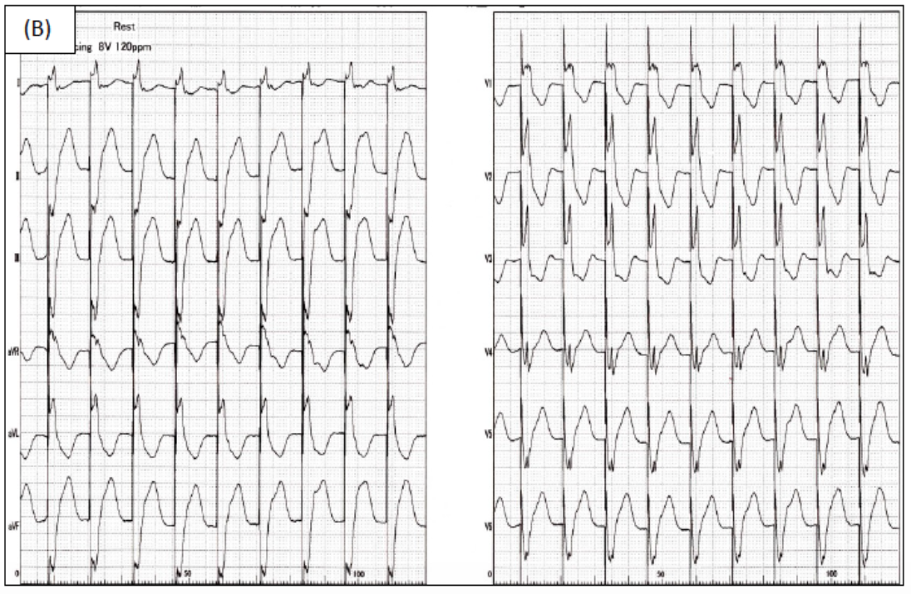
Case Presentation
Imaging
Figure 3 Results of Electrocardiogram(ECG)
First atherectomy induced significant bradycardias and heart block.
Back-up pacing at 120 beats per minute with an output set at 8 V during RA.

Slide 8
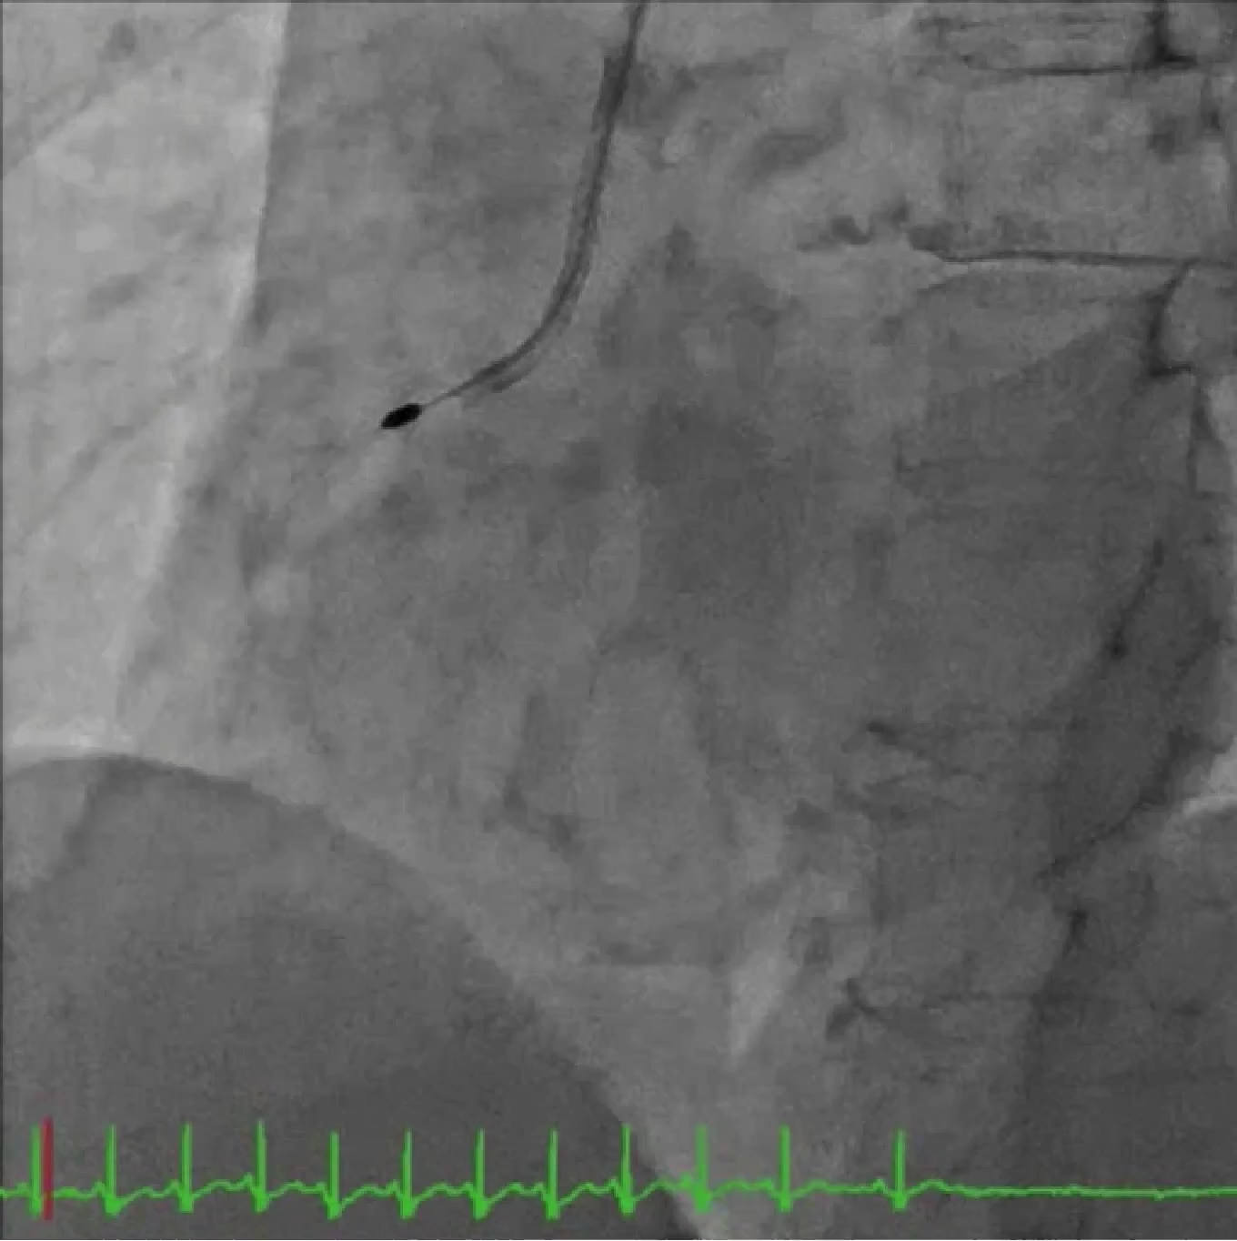
Case Presentation
Imaging
Figure 4.
This movie shows coronary pacing
during RA.

Slide 9
Discussion
RA is used for plaque modification in patients with heavily calcified coronary lesions.
RA can induce significant bradycardia or atrioventricular block requiring for temporary pacemaker insertion via the transvenous route. ¹
In this case, we performed trans-coronary pacing using a Rota wire.
Trans-coronary pacing requires no additional catheter and can be introduced easily and rapidly. ^{2,3}
This method could be an effective method to prevent bradycardia during RA.

Slide 10
Learning Points
Rotational atherectomy can induce significant bradycardia or
atrioventricular block requiring temporary pacemaker insertion.
Trans-coronary pacing via Rota wire can be useful for back up pacing
during Rotational atherectomy.

Slide 11
References
Mitar MD, Ratner S, Lavi S. Heart block and temporary pacing during rotational atherectomy. Can J Cardiol.2015; 31:335-40
Heinroth KM, Stabenow I, Moldenhauer I, Unverzagt S, Buerke M, Werdan K, et al. Temporary trans-coronary pacing by coated guidewires: a safe and reliable method during percutaneous coronary intervention. Clin Res Cardiol. 2006;95(4):206-11.
Heinroth KM, Unverzagt S, Mahnkopf D, Horenburg C, Melnyk H, Sedding D, et al. Transcoronary pacing in an animal model: Second coated guidewire versus cutaneous patch as indifferent electrodes. Med Klin Intensivmed Notfmed. 2021 Mar 31.

