Slide 1
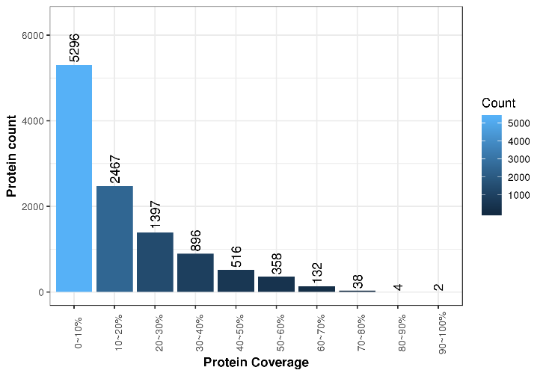
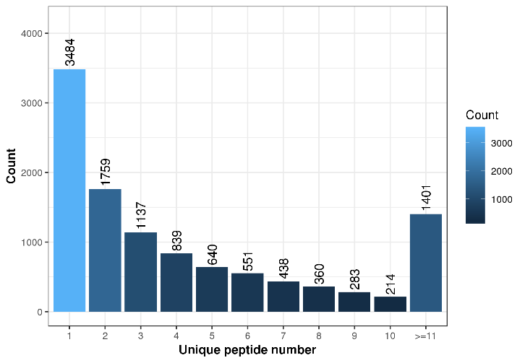
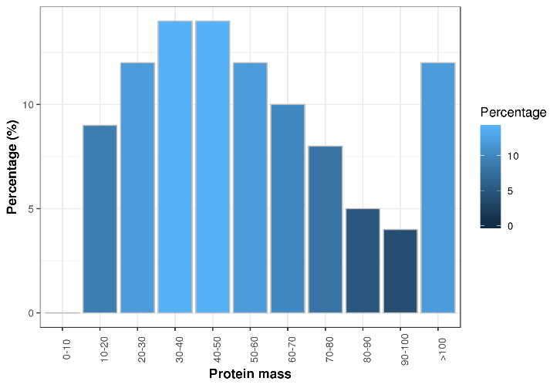
Fig. S1
(B)
(A)
Protein count
Count
6000
4000
Count
4000
5000
4000
3000
2000
1000
3000
Count
3000
2000
1000
2000
2000
1000
0
0~10
10~20
20~30
30~40
40~50
50~60
60~70
70~80
80~90
90~100
0
(C)
Protein coverage (%)
2 3 4 5 6 7 8 9 10 >=11
Unique peptide number
Percentage (%)
10
Percentage
10
5
5
0
0
0-10
10-20
20-30
30-40
40-50
50-60
60-70
70-80
80-90
90-100
>100
Protein mass (kDa)

Slide 2
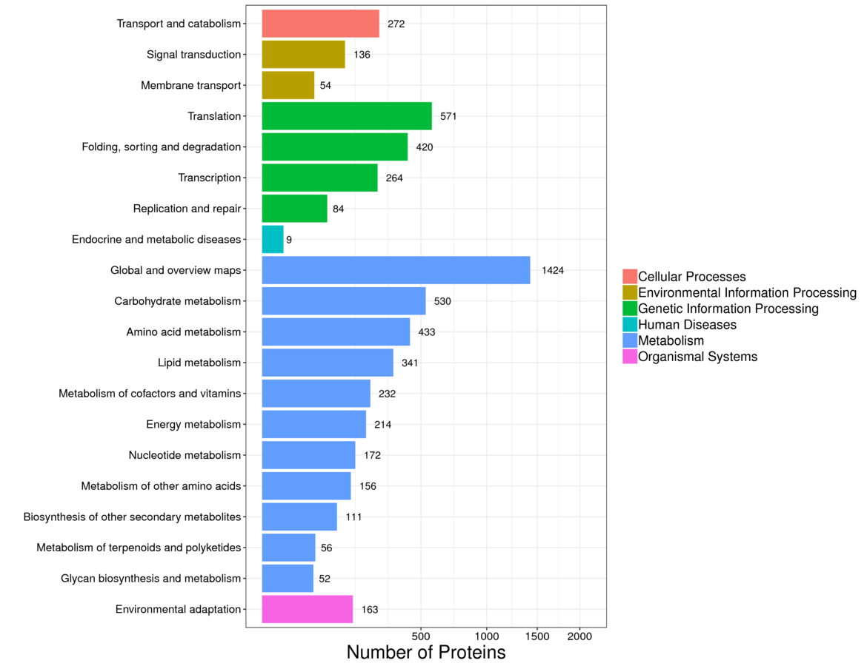
Fig. S2

Slide 3
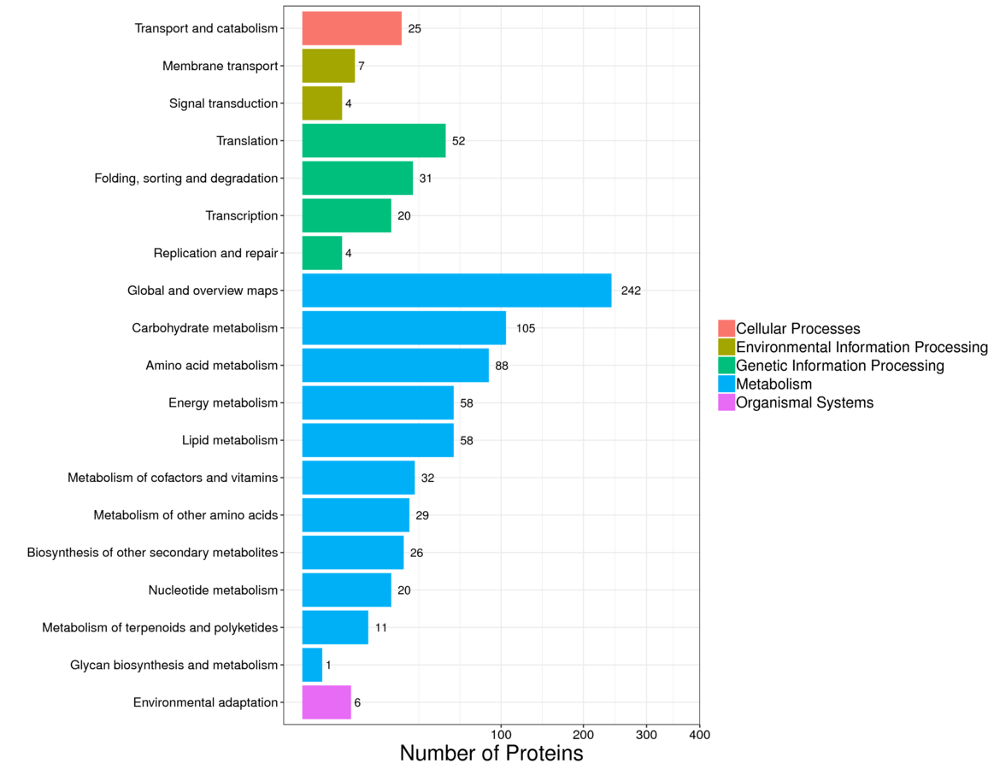
Fig. S3

