Slide 1
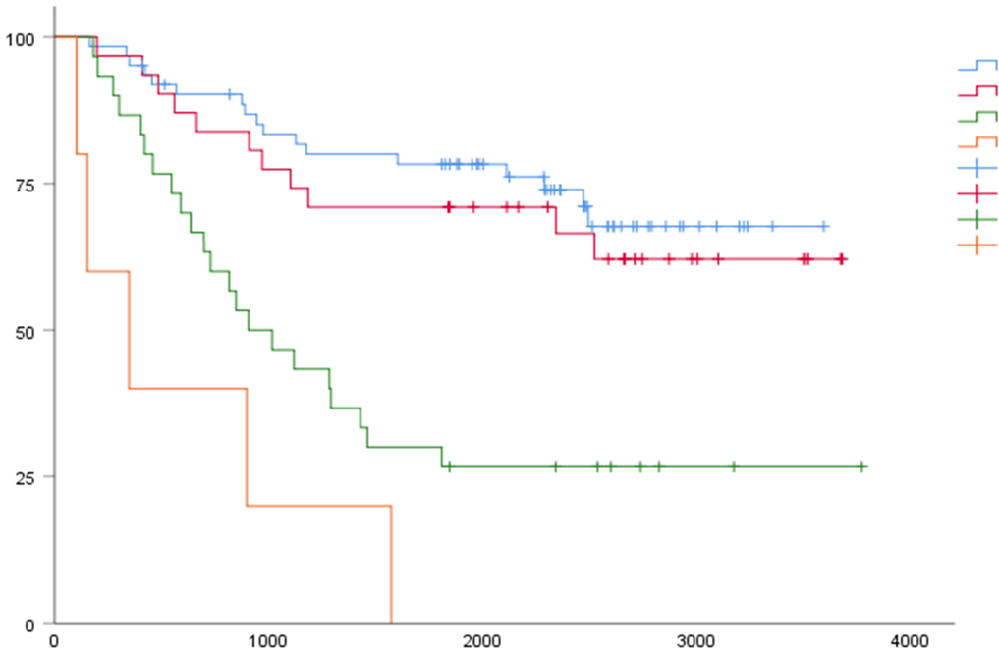
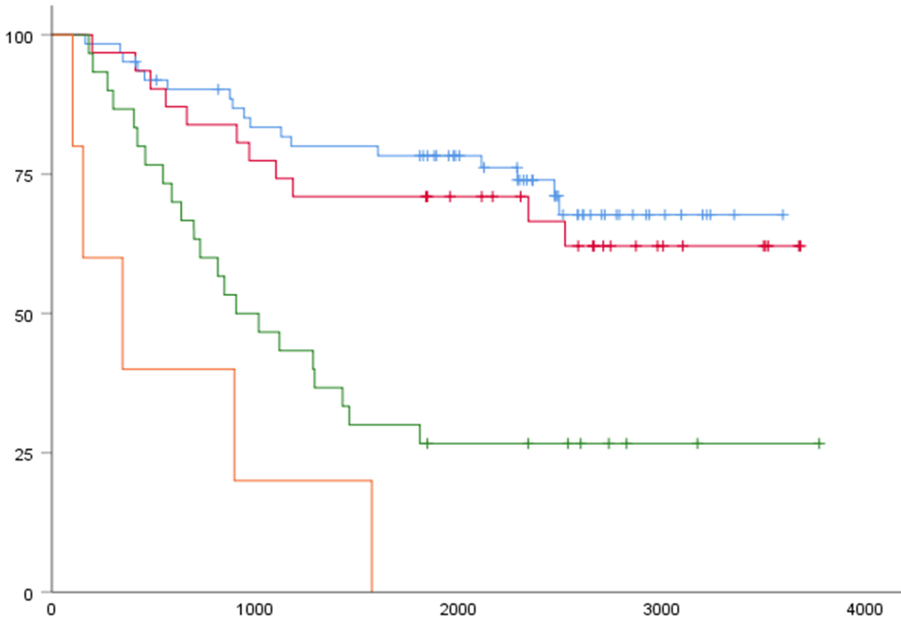
Supplementary Figure 1
Overall survival(OS)
StageⅠ
StageⅡ
StageⅢ
StageⅣ
Overall survival (%)
Log-Rank
p = 0.004
Days after operation

