Slide 1
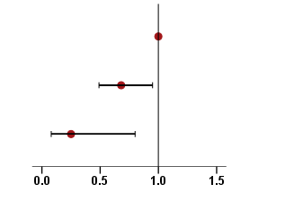
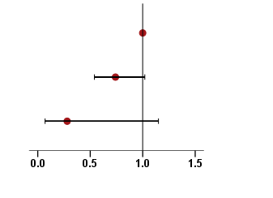
A
HER2 status
Hazard Ratio (95% CI)
P value
HER2 0 (Ref.)
1.00
HER2 1+
0.68 (0.49-0.95)
0.024
HER2 2+
Not Amplified
0.25 (0.08-0.80)
0.019
B
HER2 status
Hazard Ratio (95% CI)
P value
HER2 0 (Ref.)
1.00
HER2 1+
0.74 (0.54-1.02)
0.070
HER2 2+
Not Amplified
0.28 (0.07-1.15)
0.077

