Slide 1
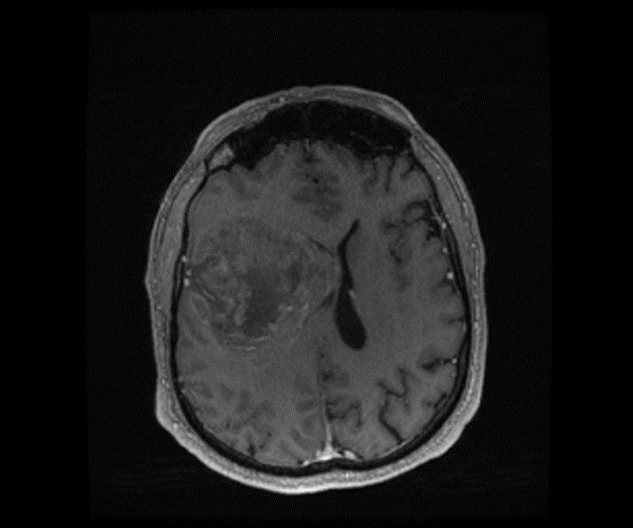
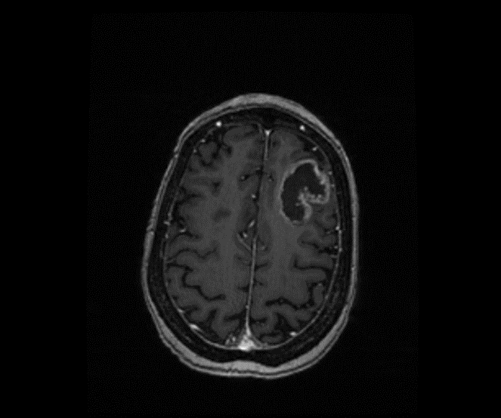
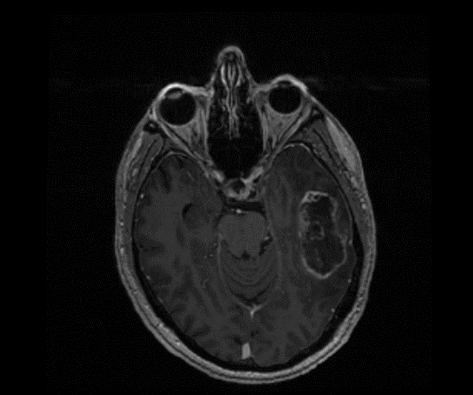
Supplementary Figure 1. Glioblastoma samples. Preoperative T1-weighted magnetic resonance images of A) J3, B) J7, and C) J14 glioblastomas. D) Molecular characteristics for each tumour.
A)
J3
B)
J7
C)
J14
 | IDH status | MGMT methylation | Mib-1 (%) | 1p/19q Codel
J3 | WT | Unmethylated | 40 | -
J7 | WT | Methylated (46%) | 15 | -
J14 | WT | Methylated (26%) | 15 | -
D)

