Slide 1
Supplemental Figure 1
Uric acid measurements for both patients demonstrated consistently elevated plasma uric acid subsequent to treatment with allopurinol. Normal range = 2.3-5.5 mg/dl. Allopurinol administered at time points indicated by arrows

Slide 2
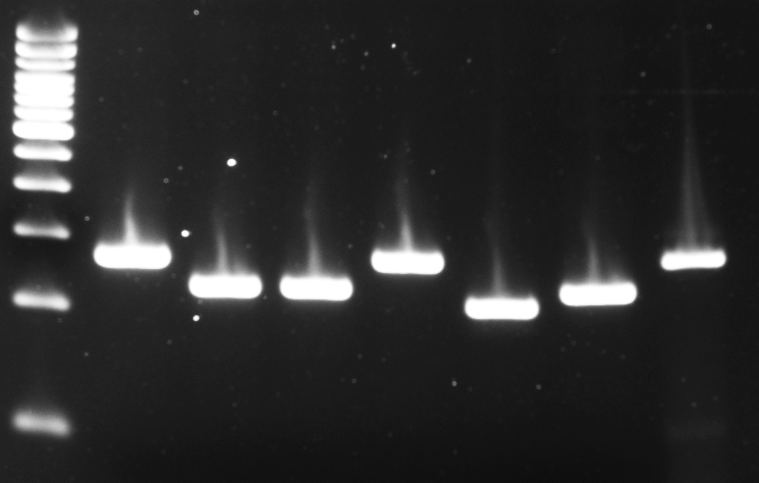
Supplemental Figure 2
TOPO cloned RT-PCR fragments from patient fibroblasts identify the presence of 3 distinct splice products

Slide 3
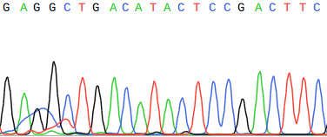
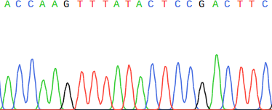
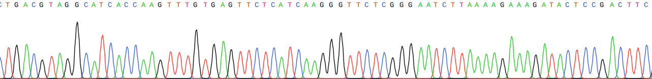
59bp del
41bp del
Normal
Splicing
Exon 2
Exon 3
Supplemental Figure 3
Sanger sequencing of TOPO cloned RT-PCR fragments demonstrates misspliced mRNA transcripts utilizing GT dinucleotides within exon 2 as alternative donor sites

Slide 4






CTRL_1
UDP_10287
Dapi
PUS7
Merge
Supplemental Figure 4
Localization of PUS7 protein to the nucleus in patient and control fibroblast cells demonstrated no difference in protein localization due to the patient missense variant.

Slide 5
Supplemental Figure 5
Quantification of western blots of 4EBP1 and phospho-4EBP1 relative to the average of two control cell lines, N = 3 for each sample. 4EBP1 and phospho-4EBP1 are not differentially expressed between patient and control fibroblasts.

Slide 6
PCR F
PCR R
Ex 1-9
10
11
12
Ex 13-16
PUS7; NM_019042
34bp deletion
Supplemental Figure 6
Schematic representation of CRISPR deletion location and primers used for RT-PCR amplification of PUS7 cDNA to confirm loss of stable PUS7 mRNA expression.

Slide 7
Supplemental Figure 7
Quantification of western blots of puromycin signal in PUS7 HeLa KO cells relative to the control HeLa cell line, N = 3. Loss of PUS7 expression in HeLa cells is sufficient to increase protein translation as measured by puromycin incorporation into peptide chains.

Slide 8
Supplemental Figure 8
Measurement of cellular proliferation of control HeLa cells and PUS7 KO cells demonstrate no increase in PUS7 KO cells.

Slide 9
Supplemental Figure 9
Quantification of western blots of puromycin signal relative to the control HeLa cells in control HeLa cells, PUS7 KO, cells, and PUS7 KO cells transfected with PUS7 cDNA, N = 3. Results demonstrate rescue of PUS7 expression in HeLa cells is capable of reversing the effect of PUS7 KO on protein translation.

