Slide 1
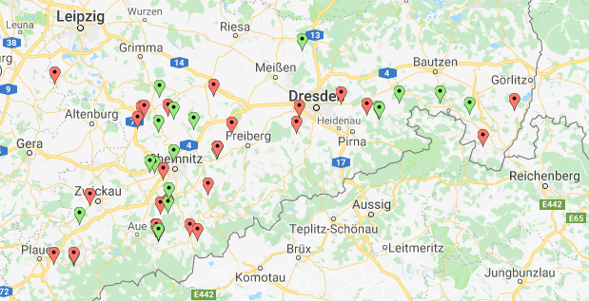
Supplemental Figure 1
https://de.batchgeo.com/map/4b7f5c0465f57d95cf6bd0e5accc2536

