Slide 1
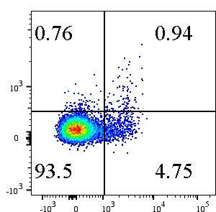
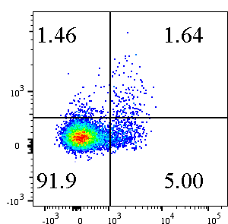
Mediastinal lymph node
Hilar lymph node
CCR8
FOXP3
Supplementary Figure S1. CCR8 expression in lymph nodes
Single cell suspensions isolated from lung tumor-adjacent mediastinal or hilar lymph nodes were analyzed by flow cytometry. Representative flow cytometric data of FOXP3 and CCR8 expression on CD4 T cells (gated on live CD45+CD3+CD4+ cells) are shown.
Notes:
As a reminder:
This journal prefers that supplementary information is provided in the following format: pdf, doc, docx, rtf, txt, csv, xls, xlsx, xlsb, xml, png, avi, mov, mp4, mp3 and zip.
Other file types may be acceptable but please contact the journal editorial office.
You may consider converting these to PDF or one of the file types listed above.
No further adjustments were suggested for the figure or the legend here.

Slide 2
**
***
***
***
MFI
***
***
N.S
**
MFI
Supplementary Figure S2. Treg-related molecule expression on lung tumor infiltrating CCR8+ and CCR8− Tregs. Protein expression levels of Treg-related molecules were analyzed by flow cytometry. MFI of each stained molecule on CCR8− and CCR8+ Tregs (gated on live CD45+CD3+CD4+FOXP3+ cells) are shown (n=11–13). Lines connect data from the same donor samples. Statistical analysis was performed using paired t-test (*, p≤0.05; **, p<0.01; ***, p<0.001).
Notes:
No further adjustments were suggested for the figure or the legend here.

Slide 3
Adenocarcinoma
Squamous cell carcinoma
CCR8 Expression
CCR8 Expression
PTPRC Expression
PTPRC Expression
Supplementary Figure S3. CCR8 and PTPRC mRNA expression
Whole tumor mRNA expression data of lung adenocarcinoma (n=510) and lung squamous carcinoma (n=484) were collected from TCGA cBioPortal database. CCR8 and PTPRC mRNA expression were plotted. Statistical analysis was performed using multiple regression analysis.
Notes:
No further adjustments were suggested for the figure or the legend here.

Slide 4
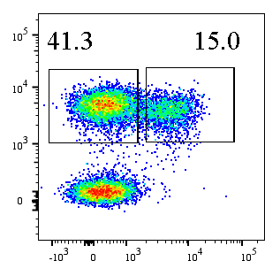
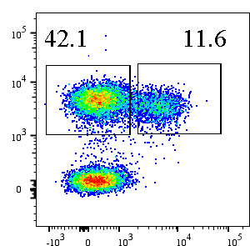
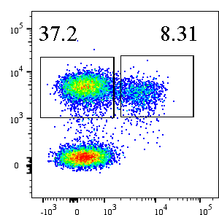
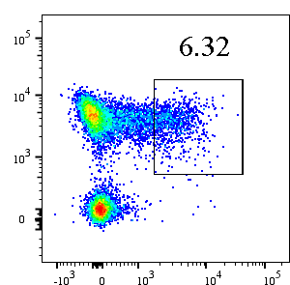
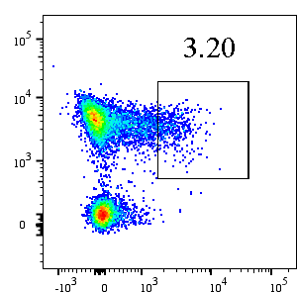
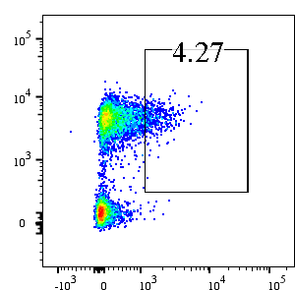
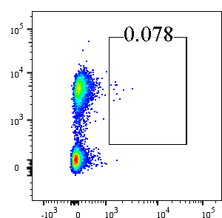
No depletion
CCR8 depletion
CCR4 depletion
CD4
Foxp3
CD4
No data
CCR8
CD4
No data
CCR4
Supplementary Figure S4. Treg reduction after CCR8+ cell or CCR4+ cell depletion
CD4+FOXP3+ Treg frequency was analyzed immediately after CCR8+ or CCR4+ cell depletion. Representative flow cytometric data gated on live CD45+CD3+ T cells are shown.
Notes:
No further adjustments were suggested for the figure or the legend here.

Slide 5
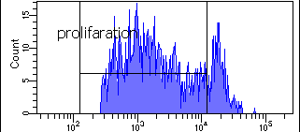
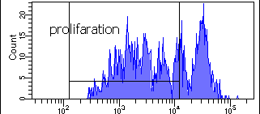
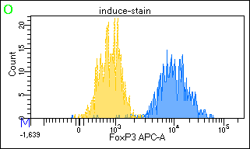
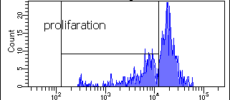
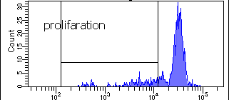
A
B
CD4
CD8
Without
Tregs
82.5%
65.9%
CD4
CD8
With
Tregs
40.3%
20%
FOXP3
Cell Trace Violet
Supplementary Figure S5. Proliferation assay of T cells co-cultured with expanded Tregs.
(A) FOXP3 expression on expanded Tregs (gated on live CD4+ cells). Dark gray, FOXP3 staining. Light gray, isotype control staining. (B) Naïve CD8 T or CD4 T cells from healthy doner PBMCs were labeled with Cell Trace Violet and co-cultured with expanded Tregs (E:T ratio=1:1) in the presence of anti-CD3 antibody and APCs for 5 days. Fluorescence of Cell Trace Violet in the CD4 T or CD8 T cells was measured by flow cytometry. Representative flow cytometric data are shown.
Notes:
No further adjustments were suggested for the figure or the legend here.

Slide 6
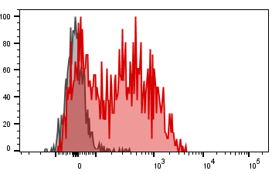
A
B
C
*
Treg gated
CCR8
Supplementary Figure S6. CCR8+ Treg infiltration in murine model of lung cancer
H-2Kb-LLC cells were intradermally inoculated into wild-type C57BL/6 mice. Thirteen days after tumor inoculation, the mice were received intravenous injection of anti-CCR8 antibody or isotype control (100μg per mouse) and 3days after, tumor-infiltrating cells were analyzed by flow cytometry. (A) Histogram of CCR8 expression in tumor-infiltrating Tregs (gated on live CD45+CD3+CD4+FOXP3+ cells) Red; CCR8 staining, Gray; isotype control staining. (B) Percentage of CCR8+ cells in tumor-infiltrating Tregs of isotype control mice are shown (n=6). (C) Percentage of Tregs in tumor-infiltrating CD45+ cells are shown (n=6 for each group). Statistical significance was determined by unpaired t-test with Welch’s correction (*, p≤0.05)

