Slide 1


Supplementary Figure 1. Time line of patient management
-Resected pancreas histology
-Islets isolated from a part of pancreas
-Islet functional studies
-10X single cell sequencing
l GPm
Initial GP referral
For evaluation of
hypoglycemia
spleen-preserving distal pancreatectomy
resection of the body and tail of pancreas
Initial GPm
Index case sister diagnosed to have GDM
Hypoglycemia noted during glucose monitoring
2018
2019
2020
2021
Initial GPm
-Neonatal hypoglycemia in index case’s nephew
-Genetic diagnosis of activating glucokinase
variant in sister and nephew
Initial GPm
-Evaluated in hospital- confirmed
hyperinsulinemia hypoglycemia
-Intraarterial calcium stimulation test localised
lesion to head of pancreas
-Imaging did not localise the lesion
Initial GPm
-Hypoglycemia persistent
-Minimal response to diazoxide,
verapamil Or octreotide
- Response to pasireotide
Initial GPm
-genetic diagnosis of
activating heterozygous glucokinase
variant in index case and his mother
Treatment. Diazoxide verapamil Sx. Octeotide pasireotide
Patient 141 155 150 130 132 125 123
Wt (Kg).

Slide 2
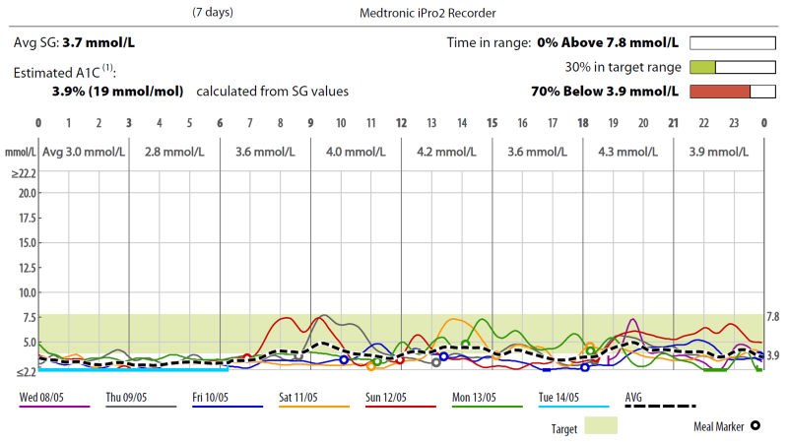
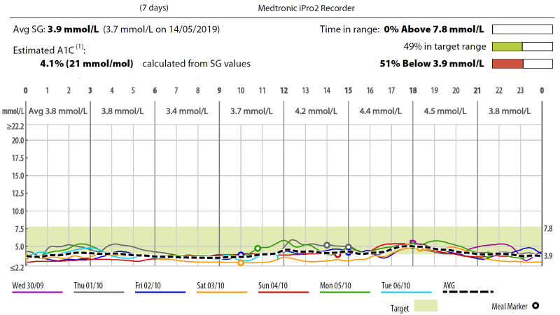
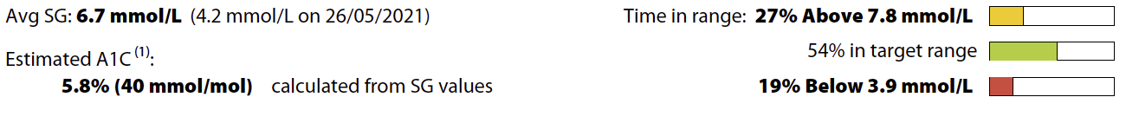
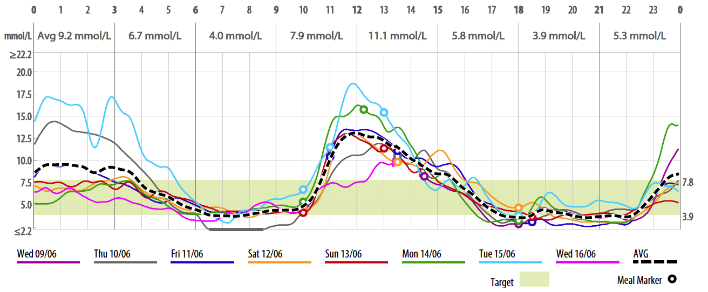
Supplementary Figure 2. Continuous glucose monitoring profile while on treatment
A
B
C
Percentage of time in hypoglycemia in patient after various interventions. Continuous glucose monitoring via Medtronic iPro2 Recorder after surgery (A) and while in treatment with Octreotide (B) and Pasireotide (C).

