Slide 1
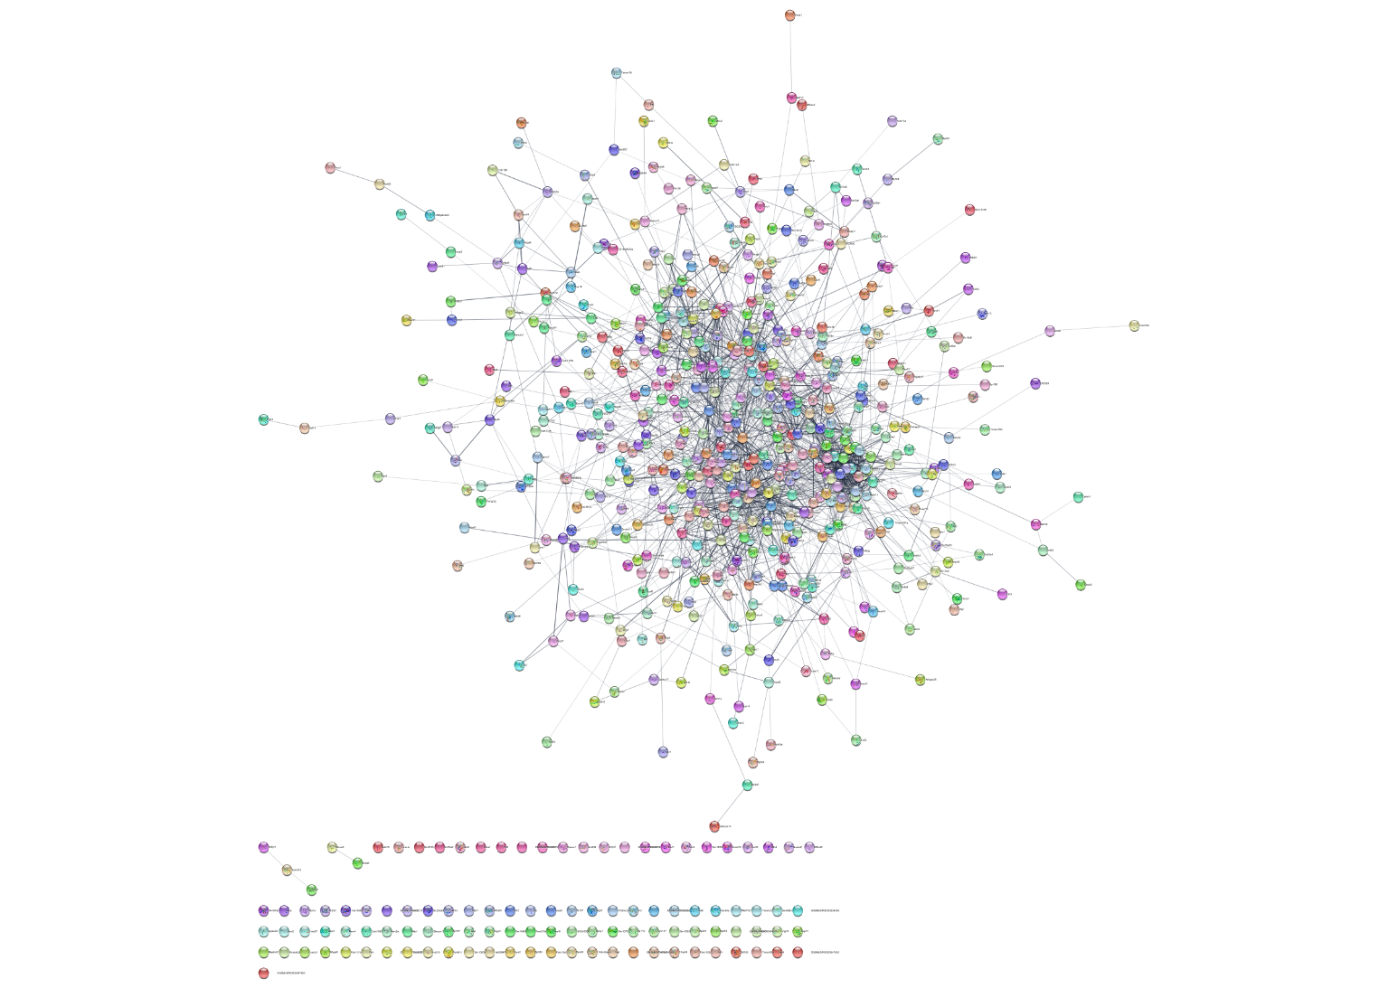
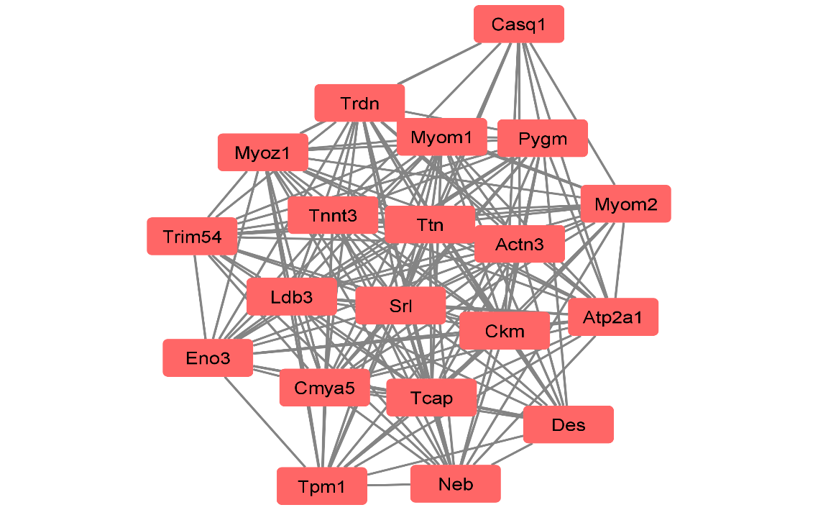
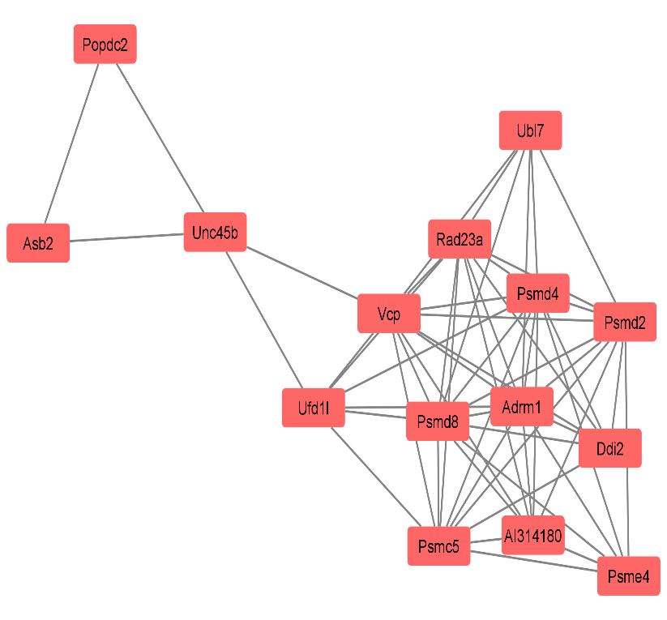
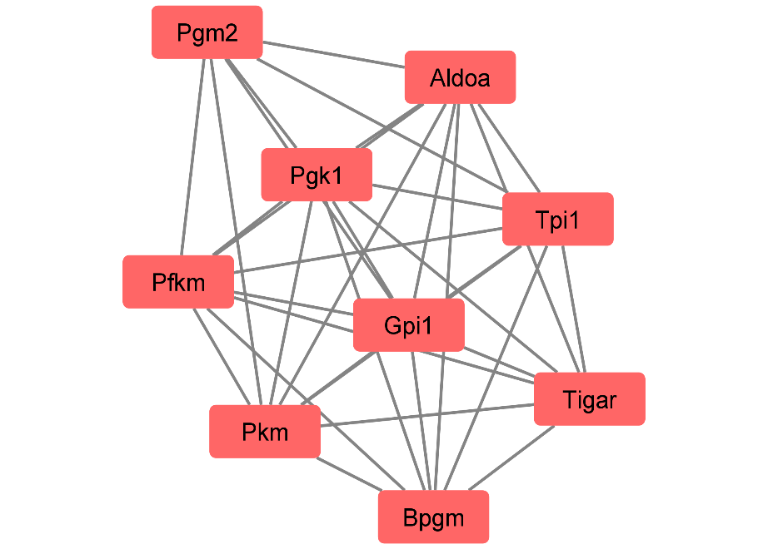
Supplemental Figure 1
Upregulated genes
A
B
Cluster1 - muscle function
D
Cluster3 – protein modification,
muscle structure
C
Cluster2 – metabolic process
Notes:
S. Fig. 4: Protein-protein network interaction using cytoscape v3.8.2 for the up-regulated genes as a STRING network in (A) while MCODE (molecular complex detection) was used to identify dense clusters with enrichment scores in panel (B) for the top three clusters. Cluster 1 has enrichment score = 17.579, cluster 2 has enrichment score = 8.500 and cluster 3 has enrichment score = 8.286.

Slide 2
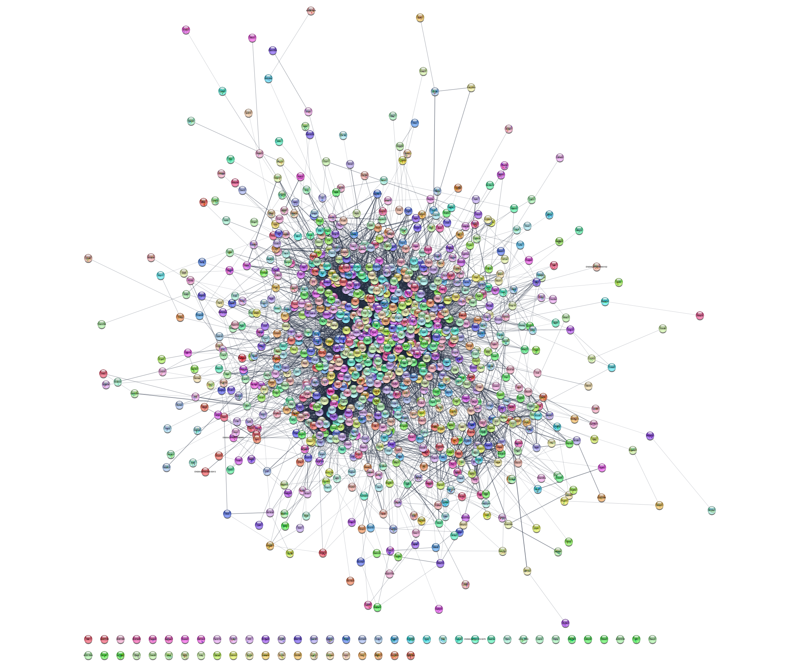
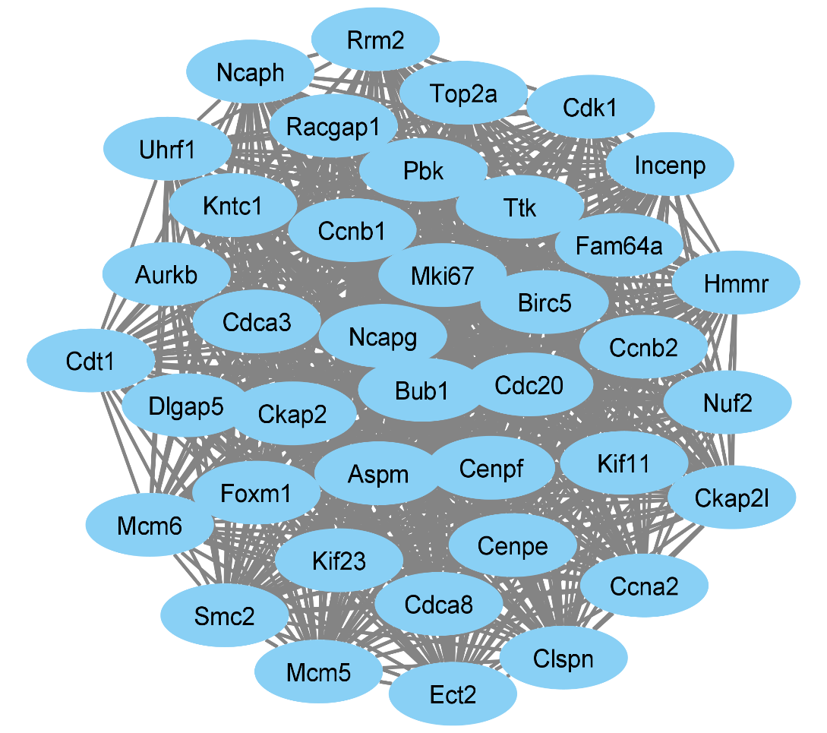
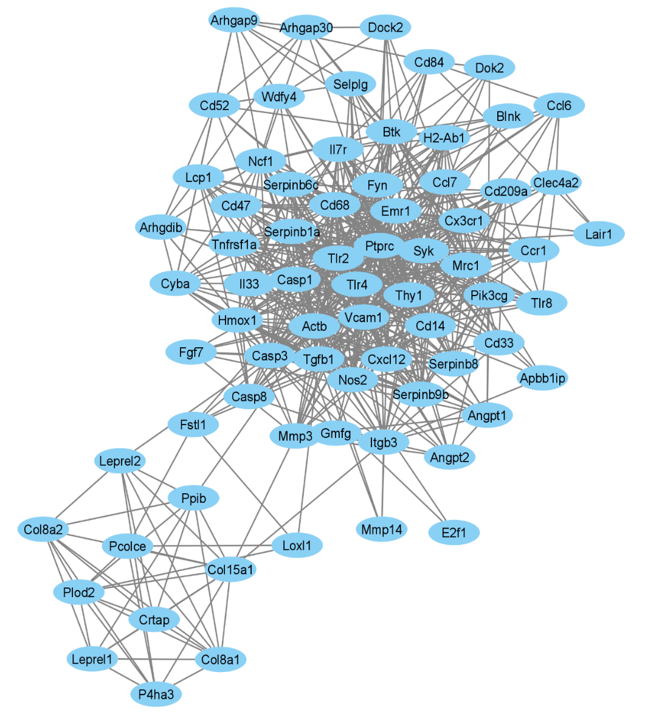
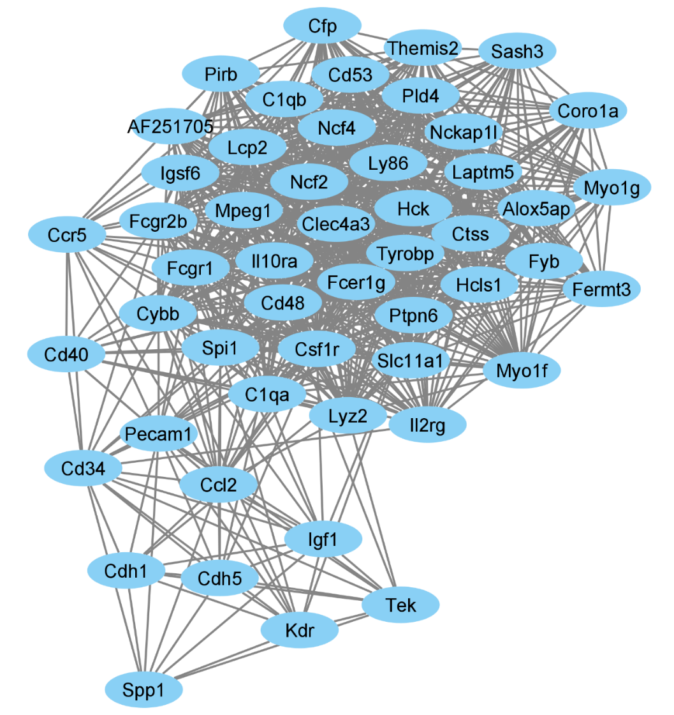
A
Supplemental Figure 2
Down regulated genes
B
Cluster1 – Cell cycle
D
Cluster3 – cytokine/chemokine
C
Cluster2 – inflammation,
apoptosis
Notes:
S Fig.5: Protein-protein network interaction using cytoscape v3.8.2 for the down-regulated genes as a STRING network in (A) while MCODE (molecular complex detection) was used to identify dense clusters with enrichment scores in panel (B) for the top three clusters. Cluster 1 has enrichment score = 38.789, cluster 2 has enrichment score = 29.760 and cluster 3 has enrichment score = 16.833.

Slide 3
A
B
Supplemental Figure 3
C
D
E

Slide 4
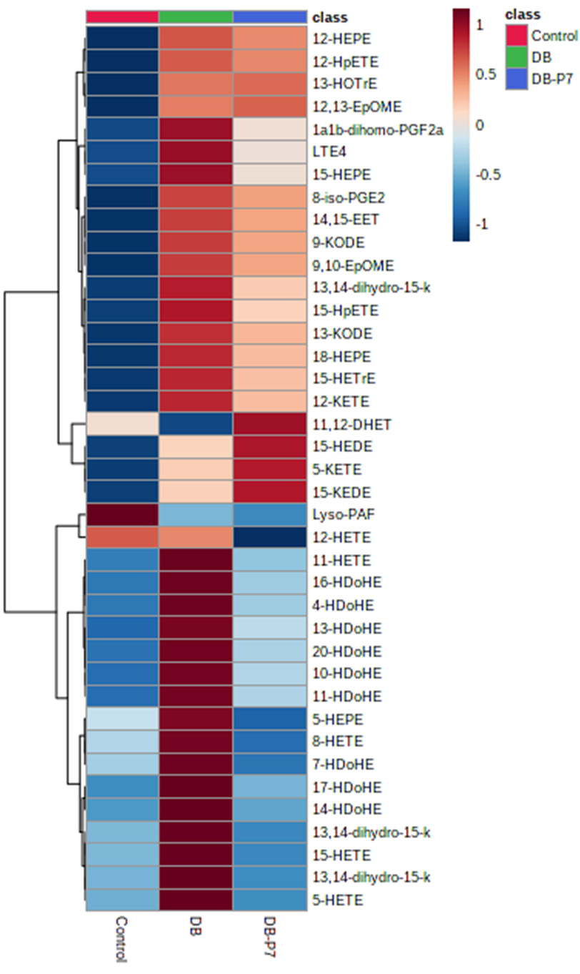
Supplemental Figure 4
A
B

Slide 5
Supplemental Figure 5
A
B
C
D
E
F
G
H

Slide 6
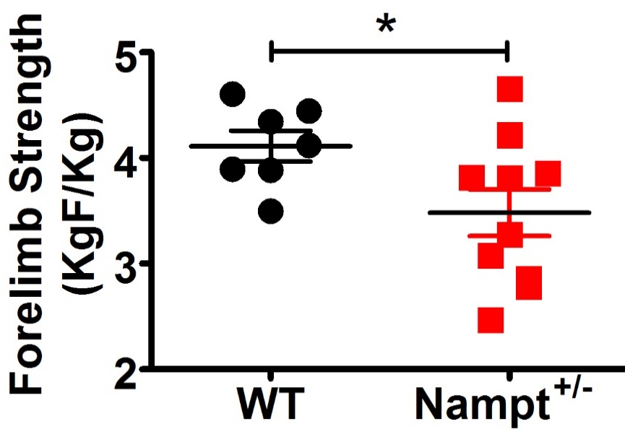
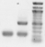
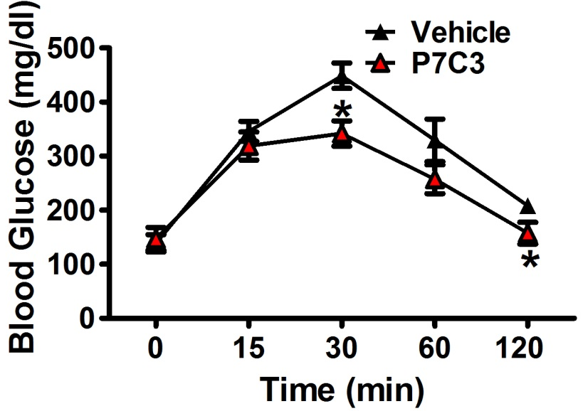
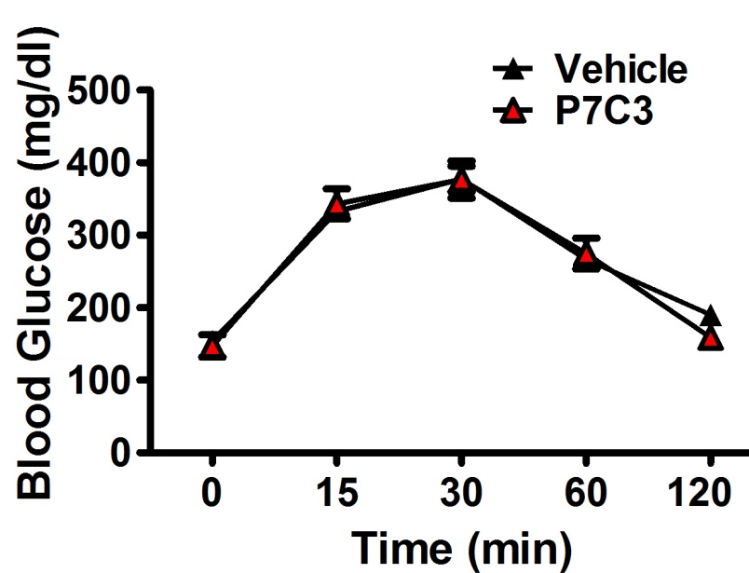
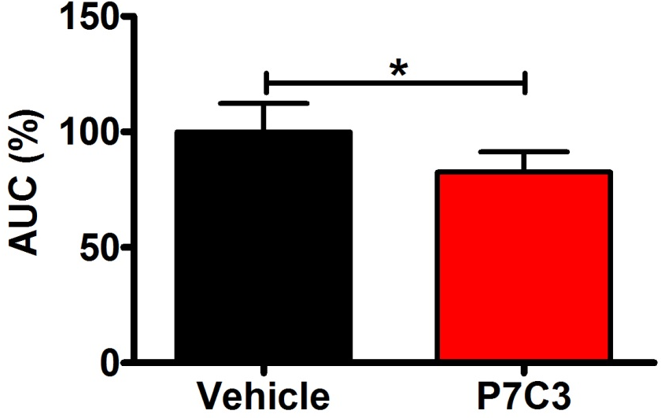
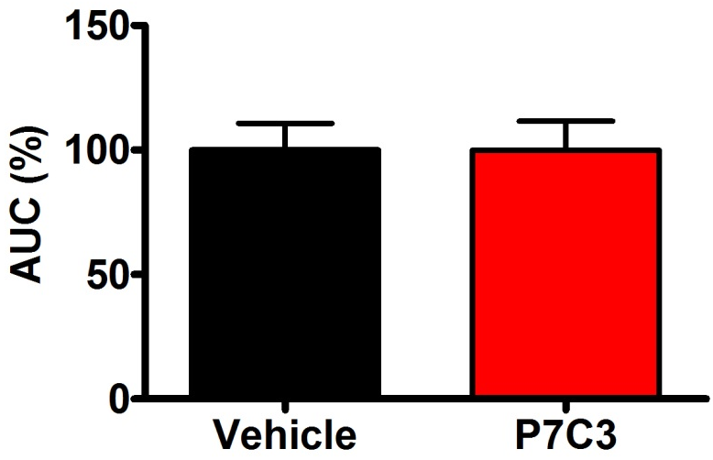
Supplemental Figure 6
A
Nampt ^{+/-}
B
WT
1kb
500 bp
300 bp
C
Wildtype
D
Nampt^{+/-}
E
F
Notes:
P7C3 reverses hyperglycemia in a Nampt dependent manner. (A) Genotype of Nampt wildtype (Nampt WT) and Nampt^{+/-} heterozygous mice. (B) Forelimb grip strength recorded from Nampt WT and Nampt^{+/-}. Glucose tolerance test was conducted as previously described in Nampt^{+/-} and wildtype mice aged 20-24 weeks of age after overnight fasting treated with a single bolus injection (i.p.) of P7C3 (10 mg/kg) or vehicle (10 ml/kg/day). Blood samples were collected at 0, 15, 30, 60 and 120 min after glucose challenge and serum glucose levels were measured (C) Wild type mice and (D) Nampt^{+/-} mice. (E and F) Percentage of area under curve (AUC) for IPGTT obtained by using Trapezoidal rule and variation in % glucose concentration from baseline over the test duration for both wild type and Nampt^{+/-} mice. Data are expressed as means±SEM; *P<0.05 P7C3 vs. vehicle treated in wild type and Nampt^{+/-} mice.

